Slide 1
CASE STUDY 1
Energy sustainability and municipal roadmaps

Slide 2
MOOC 1 - CASE STUDY 1
Case study aimed at selecting local strategies to improve the energy transition in municipalities.
STEPS
Study of available resources in the region/municipality
Analysis of transport used in the region
Selection of appropriate measures at the municipal level according to the results obtained
MOOC 1: Energy sustainability and municipal roadmaps

Slide 3
MOOC 1 - CASE STUDY 1
STEPS
Study of available resources in the region/municipality
There is a possibility that the resources in the area are already known.
In the event that this is not the case, this case study provides tools available to assess the potential and resources of different European regions. The resources to be studied will be:
POWER GENERATION: solar and wind energy potential
COOLING/HEATING PRODUCTION: biomass and geothermal potential
MOOC 1: Energy sustainability and municipal roadmaps

Slide 4
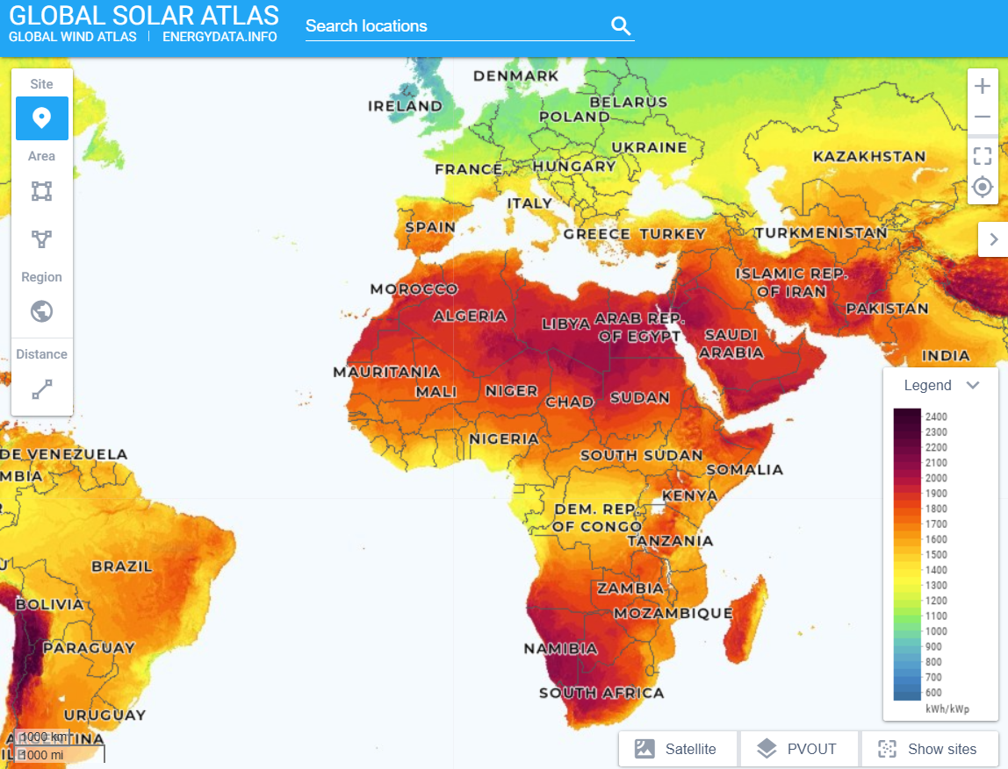
MOOC 1 - CASE STUDY 1
POWER GENERATION: CALCULATION OF SOLAR POTENTIAL
Generically, it can be observed whether the study region has a high or lower solar energy potential.
To do so, it is proposed to use the Solar Atlas and locate the region on the map. The colors of the legend give an idea of the potential of the region. This is the amount of energy generated per unit of long-term installed PV capacity, and is measured in kilowatt-hours per installed kilowatt-peak of system capacity (kWh/kWp). The following tool is used for this purpose “Global Solar Atlas” https://globalsolaratlas.info/map
MOOC 1: Energy sustainability and municipal roadmaps

Slide 5
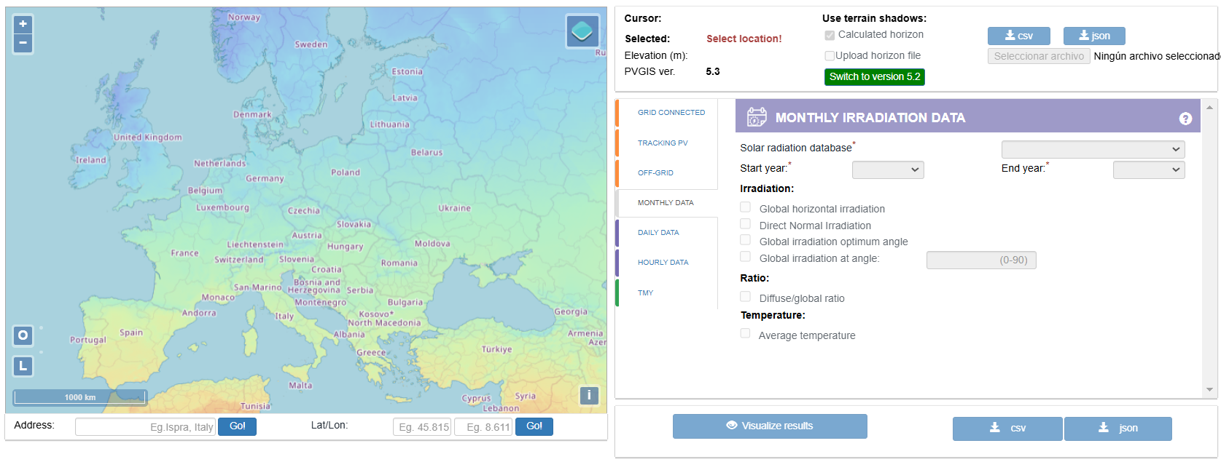
MOOC 1 - CASE STUDY 1
POWER GENERATION: CALCULATION OF SOLAR POTENTIAL
To calculate the solar potential of a region, the Peak Solar Time (PSH), which is often used for photovoltaic calculations, can be used.
In simple terms, the Peak Solar Hour (PSA) is the amount of solar energy received by one square meter of surface area.
The following tool is used for this purpose “Photovoltaic geographical information system” https://re.jrc.ec.europa.eu/pvg_tools/en/
MOOC 1: Energy sustainability and municipal roadmaps

Slide 6
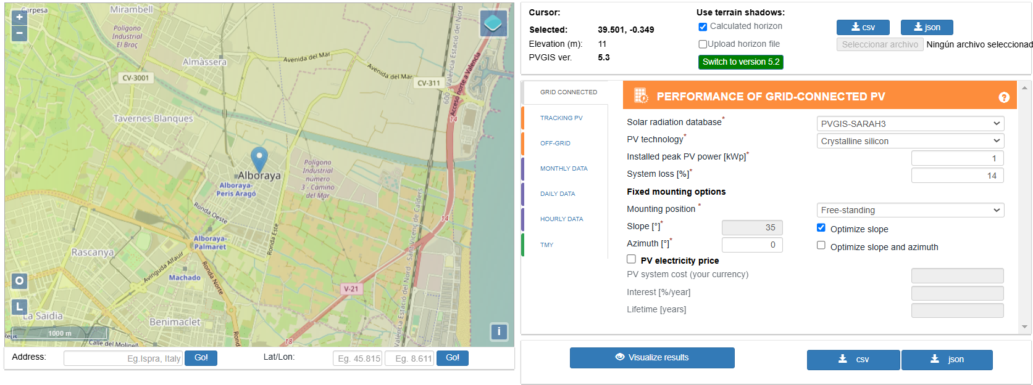
MOOC 1 - CASE STUDY 1
POWER GENERATION: CALCULATION OF SOLAR POTENTIAL
1- Locate the region or locality of study on the map.
2- Select the monthly radiation, type of panel technology and the optimal angle of the structure.
1
2
MOOC 1: Energy sustainability and municipal roadmaps

Slide 7
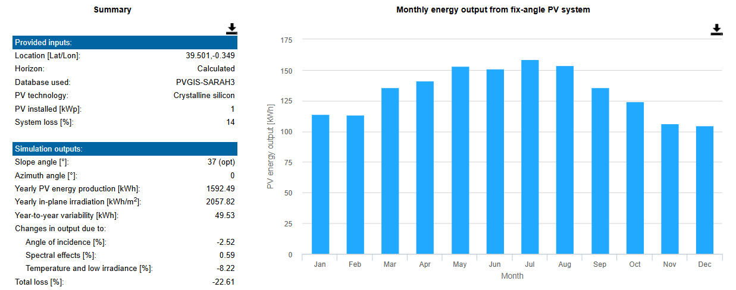
MOOC 1 - CASE STUDY 1
POWER GENERATION: CALCULATION OF SOLAR POTENTIAL
3- Results obtained:
Optimal tilt angle (º)
Photovoltaic (PV)
Production Annual (kWh)
Monthly PV Production (kWh)
Fixed PV System Monthly Energy Production (kWh)
MOOC 1: Energy sustainability and municipal roadmaps

Slide 8
MOOC 1 - CASE STUDY 1
POWER GENERATION: CALCULATION OF SOLAR POTENTIAL
In order to know the wind potential, it is proposed to use the World Wind Atlas: https://globalwindatlas.info/es/
This is a free web-based application developed to help policy makers, planners and investors identify high wind areas for wind power generation virtually anywhere in the world, and then perform preliminary calculations.
It is proposed to locate the study region/municipality and calculate the energy yield and annual energy production, to know the potential of the study area, as shown in the slide below.
MOOC 1: Energy sustainability and municipal roadmaps

Slide 9
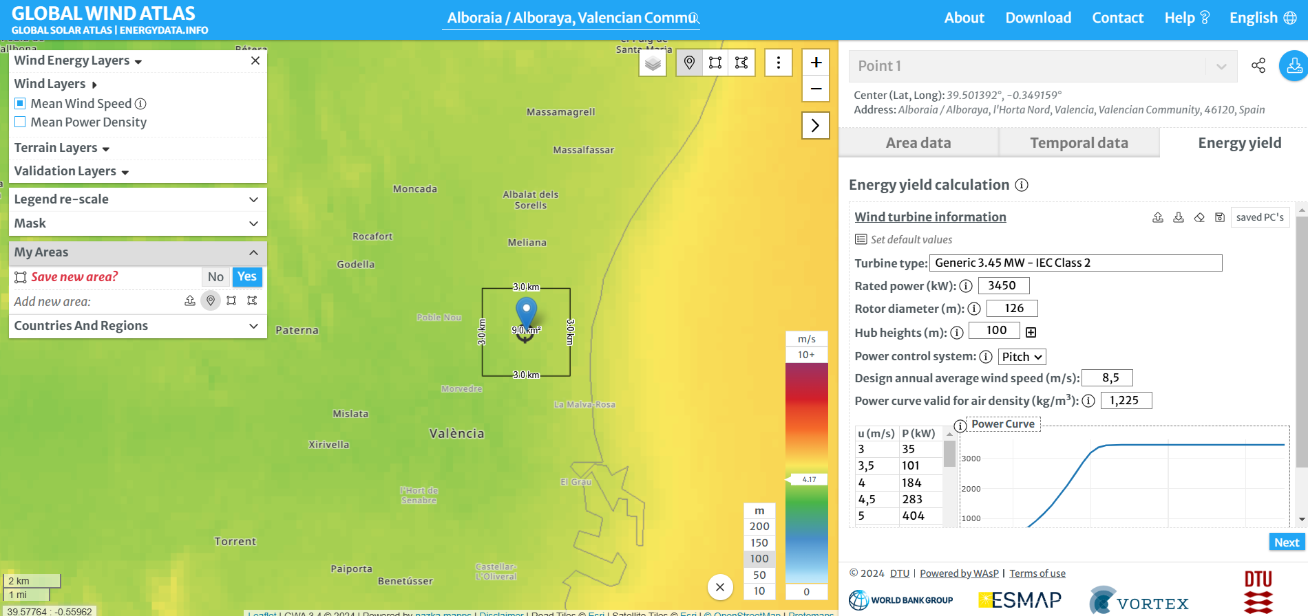
MOOC 1 - CASE STUDY 1
POWER GENERATION: CALCULATING WIND POWER POTENTIAL
In this case, the legend above the map can be observed.
When selecting the study region, the value of the annual energy production is 4,17GWh, being a rather small value as can be seen in the color legend. It corresponds to the blue colored area.
MOOC 1: Energy sustainability and municipal roadmaps

Slide 10
MOOC 1 - CASE STUDY 1
COOLING/HEATING PRODUCTION
Concerning the resources for heating and cooling, it is mainly proposed to study the availability of biomass and geothermal energy for the region/municipality. For this purpose, the European Heat Roadmap methodology allows to know the available resources in different areas. This tool is very useful to know the heat/cooling demand densities by regions, district heating in zones, biomass resources as well as geothermal resources at different depths.
The methodology has been continuously evolving, allowing both a better understanding and a more accurate quantification of the European heating and cooling sector. The key to the project is the combination of mapping and modeling, in order to understand not only the systemic effects of energy efficiency, but also the spatial dimension..
The map can be accessed through this link : https://heatroadmap.eu/peta4/
MOOC 1: Energy sustainability and municipal roadmaps

Slide 11
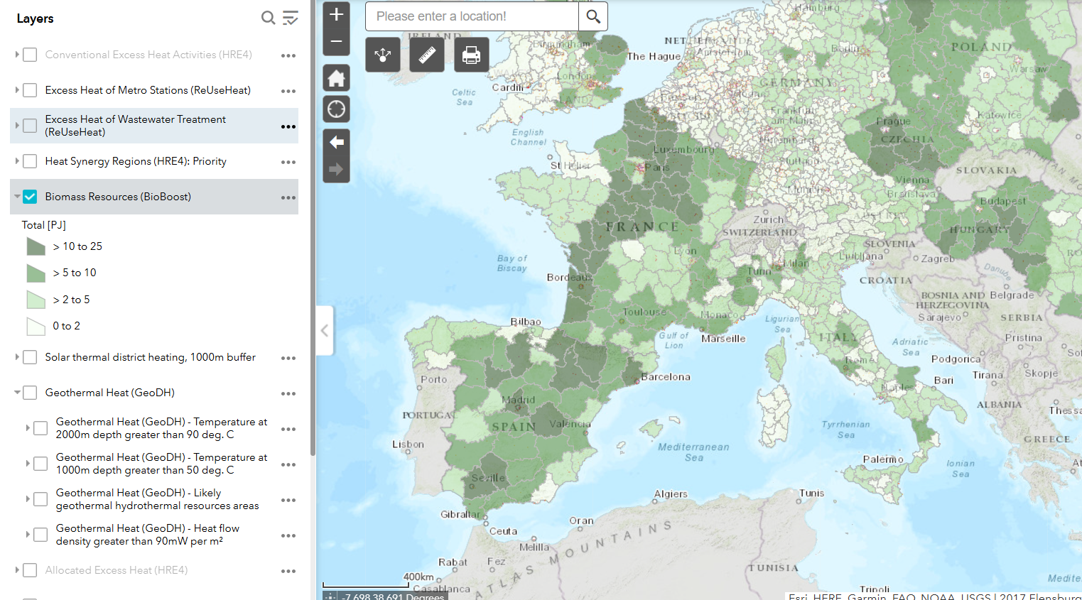
MOOC 1 - CASE STUDY 1
Enter the location of the region/municipality
COOLING/HEATING PRODUCTION
BIOMASS
Selecting the “Biomass Resources” layer from all the layers, the map is colored according to the biomass availability in terms of energy (PJ).
Therefore, it is sufficient to locate the study region/municipality and know the biomass potential according to the legend data.
MOOC 1: Energy sustainability and municipal roadmaps

Slide 12
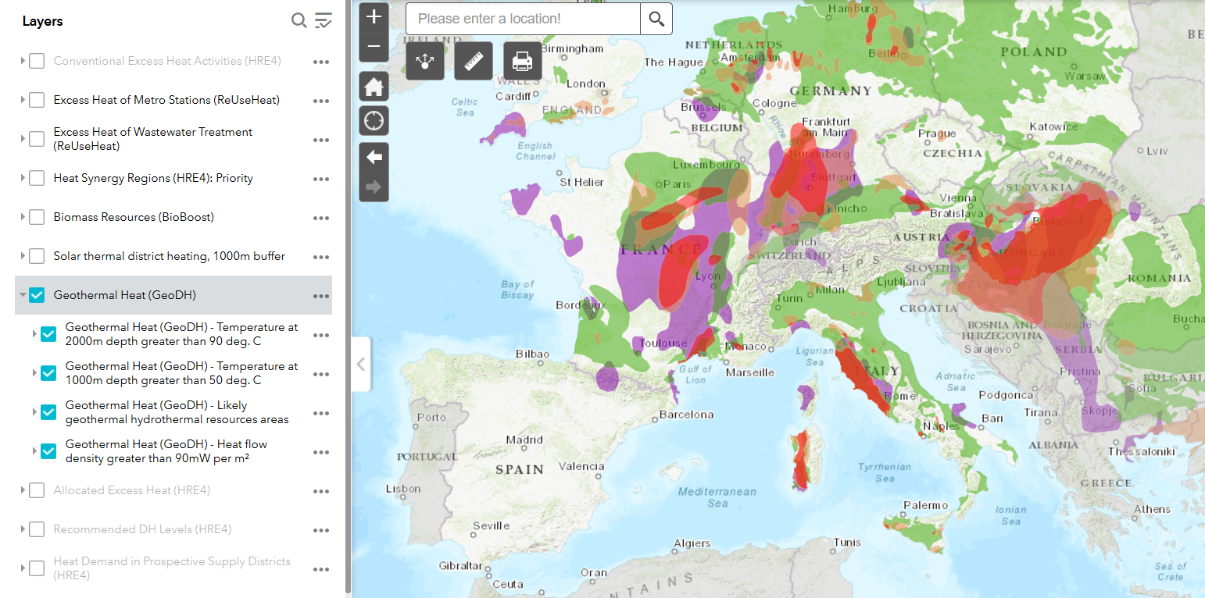
MOOC 1 - CASE STUDY 1
COOLING/HEATING PRODUCTION
GEOTHERMIA
After selecting the “Geothermal Heat” layer from all the layers, the map is colored according to the availability of geothermal heat at different depths (2000 and 1000 meters), areas of hydrothermal geothermal and heat flux greater than 90 (mW/m2).
MOOC 1: Energy sustainability and municipal roadmaps

Slide 13
MOOC 1 - CASE STUDY 1
STEPS
Analysis of transport used in the region
In order to evaluate regional or municipal transport, a series of mobility indicators are proposed that will have to be evaluated from the municipal point of view.
The objective is to conduct an analysis of the current situation and identify points for improvement in order to implement a series of measures to facilitate more sustainable mobility. The indicators will be evaluated in each of the following aspects:
Type of transport required: air, sea and land transport
Urban Public Transport
Multimodal nodes
Personal transport
MOOC 1: Energy sustainability and municipal roadmaps

Slide 14
MOOC 1 - CASE STUDY 1
PROPOSED INDICATORS
First, the main means of transport available to reach the municipality should be identified: sea (boat, ferry, etc.), air (plane) and land (car, cab, bus, train, subway, etc.).
TYPE OF TRANSPORT
Availability of means of transport suitable for the region: sea, air and land.
Is there a possibility of using electric means such as boats, ferries, buses or streetcars?
Timeliness, regularity and reliability of transport to reach the right region
Accessibility to transport
Access to schedules and planning through web pages
MOOC 1: Energy sustainability and municipal roadmaps

Slide 15
MOOC 1 - CASE STUDY 1
URBAN PUBLIC TRANSPORT
Timeliness, regularity and reliability of public transport frequency
Accessibility to public transport
User satisfaction
Are there public participation processes for station/stop co-design?
Air quality in public transport
Night service
Sustainable transportation (use of renewable energies, route optimization, etc.)
On-demand transportation zones
MOOC 1: Energy sustainability and municipal roadmaps

Slide 16
MOOC 1 - CASE STUDY 1
MULTIMODAL NODES
Multimodal public transport service platforms available to allow route planning and payments through a single channel
User-accessible intermodal points
Low Emission Zones (LEZ) with availability of multimodal nodes.
Electric vehicle recharging points near multimodal zones
Availability of park-and-ride parking lots with adequate connection to the center.
Bicycle parking and/or rental of bicycles/scooters near the nodes
MOOC 1: Energy sustainability and municipal roadmaps

Slide 17
MOOC 1 - CASE STUDY 1
PERSONAL TRANSPORT
There are bicycle lanes for municipal access and circulation
Electric vehicle recharging points
Bicycle and scooter parking available
Restricted speed zones in the center
Priority for users to use personal transport rather than public transport for convenience.
Paid parking zones (blue zone etc.)
There are car-sharing options available
MOOC 1: Energy sustainability and municipal roadmaps

Slide 18
MOOC 1 - CASE STUDY 1
STEPS
Selection of appropriate measures at the municipal level according to the results obtained
A series of measures included in different action plans are proposed, so that they can be linked to the previous analysis carried out in points 1 and 2 of this case study.
There is also the possibility of including new actions if considered.
The following slide shows the proposed actions.
MOOC 1: Energy sustainability and municipal roadmaps

Slide 19
MOOC 1 - CASE STUDY 1
PROPOSED LOCAL STRATEGIES
Renewal of the municipal fleet with electric or plug-in hybrid vehicles.
Public procurement of green electricity (100% renewable).
Installation of renewable energies (photovoltaic and thermal) for electricity and DHW generation.
Regulatory and technical development of energy saving and efficiency criteria and bioclimatic construction.
Improvement of insulation and air conditioning systems
Energy audits in municipal facilities and public lighting.
Improvement of lighting systems in municipal facilities.
MOOC 1: Energy sustainability and municipal roadmaps

Slide 20
MOOC 1 - CASE STUDY 1
PROPOSED LOCAL STRATEGIES
Installation of renewable self-consumption in municipal buildings.
Replacement of existing luminaires with new ones equipped with LED lamps and remote management.
Communication, training and awareness-raising plan
Energy saving information program for schools
Campaign to promote sustainable mobility
Promotion of walking and electric personal mobility vehicles.
MOOC 1: Energy sustainability and municipal roadmaps

Slide 21
MOOC 1 - CASE STUDY 1
CREATE YOUR CASE STUDY
1- Region or municipality of study
Municipality/Region
2- Energy production
Solar potential:
2.1 Photovoltaic energy production (PVOUT) (kWh/kWp)
2.2 Photovoltaic (PV) production Annual (kWh)
2.3 Monthly PV Production (kWh)
Wind potential:
2.4 Annual energy production (GWh)
MOOC 1: Energy sustainability and municipal roadmaps

Slide 22
MOOC 1 - CASE STUDY 1
CREATE YOUR CASE STUDY
3- Cooling/heating production:
Biomass potential:
3.1 Biomass Resources (PJ)
Geothermal potential :
3.2 Geothermal heat
4- Energy summary :
ENERGY PRODUCTION |  | COOLING/HEATING PRODUCTION
Solar Energy |  | Biomass
Wind Energy |  | Geothermal
MOOC 1: Energy sustainability and municipal roadmaps

Slide 23
MOOC 1 - CASE STUDY 1
CREATE YOUR CASE STUDY
5- Points to improve in relation to transportation (missing indicators). Classify indicators according to: reached, in process o necessary but absent.
REACHED
MOOC 1: Energy sustainability and municipal roadmaps

Slide 24
MOOC 1 - CASE STUDY 1
CREATE YOUR CASE STUDY
IN PROCESS
NECESSARY BUT ABSENT
MOOC 1: Energy sustainability and municipal roadmaps

Slide 25
MOOC 1 - CASE STUDY 1
CREATE YOUR CASE STUDY
6- Propose measures considering the availability of resources for power generation and cooling/heating production, as well as the results of the indicator ranking. To facilitate the process, the following information is provided to consider in order to assess each of the proposed measures.
MEASURES | CONSIDERATIONS
Renewal of the municipal fleet with electric or plug-in hybrid vehicles | - Medium or high solar and/or wind potential Electric vehicle charging points Electric vehicle recharging points near multimodal zones
Replacement of existing luminaires with new ones equipped with LED lamps and remote management. | - Medium or high solar and/or wind potential
Installation of renewable energies (photovoltaic and thermal) for electricity generation and DHW. | Medium or high solar and/or wind potential Medium or high geothermal and/or biomass potential
Regulatory and technical development of energy saving and efficiency criteria and bioclimatic construction | Medium or high solar and/or wind potential Medium or high geothermal and/or biomass potential
MOOC 1: Energy sustainability and municipal roadmaps

Slide 26
MOOC 1 - CASE STUDY 1
CREATE YOUR CASE STUDY
MEASURES | CONSIDERATIONS
Improvement of insulation and air conditioning systems | - Medium or high solar and/or wind potential
Energy audits in municipal facilities and street lighting | - Medium or high solar and/or wind potential - Electric vehicle charging points - Medium or high geothermal and/or biomass potential
Installation of renewable self-consumption in municipal buildings | - Medium or high solar and/or wind potential
Procurement of green electricity (100% renewable) | - Medium or high solar and/or wind potential - Medium or high geothermal and/or biomass potential
MOOC 1: Energy sustainability and municipal roadmaps

Slide 27
MOOC 1 - CASE STUDY 1
CREATE YOUR CASE STUDY
MEASURES | CONSIDERATIONS
Plan Communication, training and awareness plan | - There are bicycle lanes for municipal access and circulation - Public participation processes are in place for station/stop co-design
Campaign to promote sustainable mobility | - There are bicycle lanes for municipal access and circulation - Bicycle and scooter parking available - Multimodal public transport service platforms available to allow route planning and payments through a single channel
Promotion of walking and electric vehicles for personal mobility | - There are bicycle lanes for municipal access and circulation - Bicycle and scooter parking available
MOOC 1: Energy sustainability and municipal roadmaps

Slide 28
MOOC 1 - CASE STUDY 1
CREATE YOUR CASE STUDY
MEASURES | CONSIDERATIONS
ADD YOUR OWN MEASUREMENTS | ACCORDING TO THE MUNICIPAL CASUISTRY
ADD YOUR OWN MEASUREMENTS | ACCORDING TO THE MUNICIPAL CASUISTRY
ADD YOUR OWN MEASUREMENTS | ACCORDING TO THE MUNICIPAL CASUISTRY
MOOC 1: Energy sustainability and municipal roadmaps

Slide 29
MOOC 1 Energy sustainability and municipal roadmaps

