Slide 1
MOOC 2
Energy transition measurement and monitoring tools

Slide 2
Course Index
UNIT 1: INTRODUCTION
UNIT 2: PARTICULARITIES OF TOURIST ISLANDS
UNIT 3: AVAILABLE TYPES OF ENERGY PLANNING AND MONITORING TOOLS
UNIT 4: GENERA TOOLS: ENERGY PLANNING
UNIT 5: GENERA TOOLS:
STRATEGY EVALUATION
UNIT 6: CASES STUDY USING THE GENERA MONITORING TOOL

Slide 3
UNIT 1
INTRODUCTION
MOOC 2: Energy transition measurement and monitoring tools
3

Slide 4
UNIT 1. INTRODUCTION
INDEX
Evolution of the energy transition
1
2
Regional overview
Decision support models
3
4

Slide 5
1.1 Evolution of the energy transition
Policymakers face two challenges inherent in the energy transition: what is needed to accelerate the improvement of energy systems, and what should be the conditions necessary to take advantage of the transition's emerging opportunities? The evaluation of a country's energy system performance revolves around these three key premises. Balancing these aspects is crucial for a successful energy transition.
Equity
Ensure fair distribution, accessibility and affordability of energy for everyone.
Security
Ensure security of supply through the energy mix, trading partners and electricity generation.
Sustainability
Incorporate metrics to reduce carbon intensity, improve efficiency, and promote renewable energy sources.
5

Slide 6
1.2 Regional overview
Reduce Regulatory Disparity
Balance Equity and Sustainability
Prioritize Equity
Address disparities in equity, which represent the most significant divergence in system performance between advanced economies and emerging nations.
Work towards reducing the regulatory gap between regions with advanced economies and those that are developing.
Address the global imperative to balance equitable transition with decarbonization efforts.
6

Slide 7
1.3 Decision Support Models
Nowadays, decision making mainly in the environmental field requires information from different scientific disciplines and this gives rise to integrated assessment models.
The main objective of integrated assessment models is to provide a political view of global environmental change and sustainable development through a quantitative description of processes and interactions.
Analytical Role
Integrated Assessment
Quantitative Description
Analyze the feasibility, costs, and impacts of different energy transition routes. Provide information on technology deployment, policy implications, and socio-economic factors.
Combine information from different scientific disciplines to provide a comprehensive view of global environmental change and sustainable development.
Offer a quantitative description of processes and interactions in the energy system, enabling policymakers to make informed decisions.
7

Slide 8
1.3 Decision Support Models
Modeling Approach for Integrated Assessment Systems
Define Scope
Determine the sectors of the economy and focal points to be included in the model.
Select Methodology
Choose between general equilibrium and partial equilibrium models based on the complexity required.
Gather Data
Collect relevant data on energy production, consumption, and environmental impacts.
Develop Scenarios
Create various scenarios to explore different policy options and their potential outcomes.
8

Slide 9
1.3 Decision Support Models
Challenges in Modeling Integrated Assessment Systems
Data and Uncertainty
High levels of uncertainty due to hard-to-access data and assumptions about future technological advances, political decisions, and social behavior.
Intermittency and Storage
Modeling the intermittency of renewable sources and advances in energy storage technologies requires sophisticated algorithms.
Regional Differences
Systems must consider regional variations in renewable resource availability, energy demand, and infrastructure.
Socioeconomic Factors
Incorporating social, political, and behavioral factors that are difficult to quantify but crucial for a comprehensive analysis.
9

Slide 10
UNIT 2
PARTICULARITIES OF TOURIST ISLANDS
MOOC 2: Energy transition measurement and monitoring tools
10

Slide 11
UNIT 2. PARTICULARITIES OF TOURIST ISLANDS
INDEX
Importance of island regions
1
2
Challenges specific to tourist islands
Use of energy in isolated microgrids
3
4
Renewable islands
11

Slide 12
2.1 Importance of island regions
Importance of Island Regions
Specific Challenges
Energy in Isolated Microgrids
EU islands offer unique opportunities for modern energy planning, with potential for energy efficiency, renewable energy, and innovative solutions. Their small size and remoteness make them ideal testbeds for energy autonomy.
Islands face challenges such as land scarcity, climate risks, high seasonality of demand, isolation, and data scarcity. These factors complicate energy planning and require tailored solutions.
Microgrids offer potential solutions for electrifying remote areas, supporting isolated regions energetically, and facilitating the integration of renewable energy sources.
12

Slide 13
2.2 Challenges specific to tourist islands
Land Scarcity
Climate Risks
Limited space for renewable energy deployment. Solutions include offshore floating photovoltaics, rooftop solar, offshore wind, and innovative technologies like vertical photovoltaics and agrivoltaics.
Islands are particularly vulnerable to climate change impacts. Incorporating distributed energy systems and storm-resistant technologies can enhance system resilience.
High Seasonality
Isolation and Data Scarcity
Tourism-driven demand fluctuations require comprehensive seasonal storage solutions and explicit demand modeling beyond typical continental load curves.
System stability issues and lack of data affect demand forecasting. Solutions include physical connections to neighboring systems and use of global demand databases.
13

Slide 14
2.3 Use of energy in isolated microgrids
Definition
Objectives
Challenges
Interconnected energy system operating as a controllable entity within defined electrical boundaries
Support isolated areas, integrate renewable sources, reduce emissions
Complex optimization needed to manage renewable uncertainty and maintain service quality
The adoption of isolated microgrids remains limited due to the uncertainty produced by renewables and intrinsic load demand. Therefore, the use of intermittent energy resources along with conventional ones could resolve the uncertainty.
It is of utmost importance to incorporate efficient optimization strategies that reduce energy costs, pollution, fuel consumption, etc. and ensure the highest quality of service.
Optimization strategies are a complex process involving different variables such as the time frame, the existing constraints, the objective function, the optimization framework, the treatment of uncertainty or the optimization algorithm.
14

Slide 15
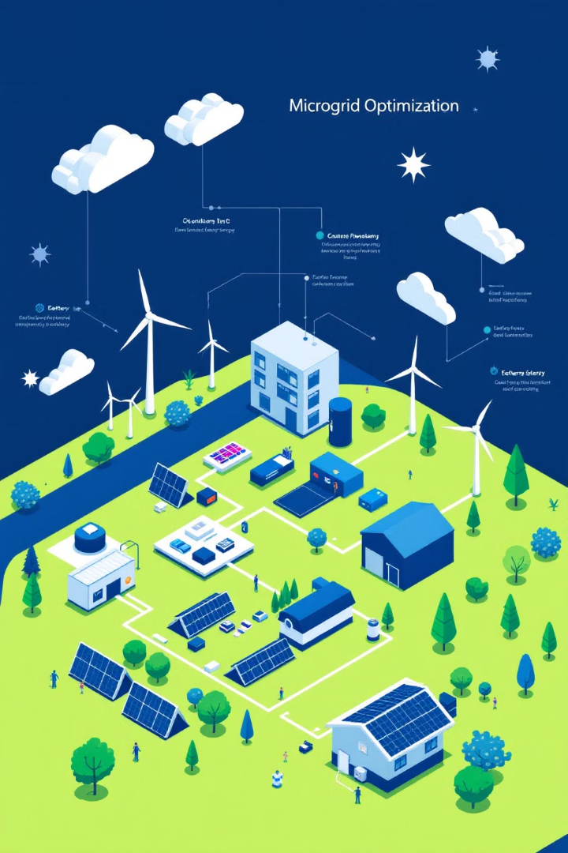
2.3 Use of energy in isolated microgrids
Time Frame
Consider the time horizon and resolution time of the optimization algorithm.
Constraints
Address technical, environmental, and logical constraints specific to isolated microgrids.
Objective Function
Define the function to be optimized, typically involving minimization of network costs and pollutant emissions.
Optimization Framework
Choose between centralized, decentralized, or distributed architectures for information processing.
15

Slide 16
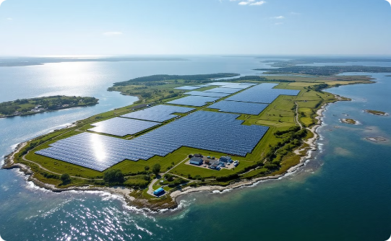
2.4 Renewable islands
Ameland, Netherlands
Menorca, Spain
Installed a 23,000-panel solar park in 2015, producing enough electricity for 1,500 households annually. The community plays a key role in developing a holistic and sustainable energy vision.
Plans to increase renewable generation to 85% of electricity consumption by 2030, reduce fossil fuel use by 50% for transportation and 30% for buildings. High environmental awareness drives the transition.
16

Slide 17
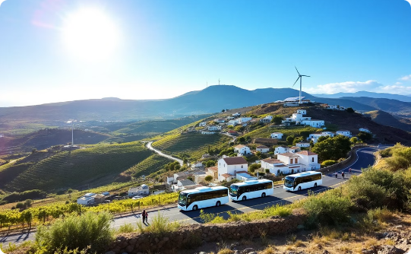
2.4 Renewable islands
Tilos, Greece
The local community and City Council are motivated to undertake a deeper energy transition, including clean electromobility and the development of a prosumer cluster on the island. Plans include increased automation and flexibility of the local electricity distribution network, showcasing the potential for small islands to lead in renewable energy adoption.
Pantelleria, Italy
As it is not connected to the national grid, the island's electricity is produced locally in a 22 MW diesel power plant.
Focusing on electrifying local public transportation, including a large photovoltaic system to cover 100% of electric bus consumption annually.

Slide 18
UNIT 3
AVAILABLE TYPES OF ENERGY PLANNING AND MONITORING TOOLS
MOOC 2: Energy transition measurement and monitoring tools
18

Slide 19
UNIT 3. AVAILABLE TYPES OF ENERGY
PLANNING AND MONITORING TOOLS
INDEX
Integrated Assessment Models (IAMs)
1
2
Available Tools
Challenges for Tool Improvement
3
19

Slide 20
3.1 Integrated Assessment Models (IAMs)
As discussed in Unit 1, Integrated Assessment Models are very useful for addressing societal challenges, specifically those related to environmental policy and the path towards decarbonization.
Scope
Program
Cover multiple sectors of the economy and focal points, addressing the multidisciplinary nature of energy transition challenges.
Consider programming and software requirements for implementing and running the models.
Economic Complexity
Choose between general equilibrium and partial equilibrium models based on the level of detail and interactions required.
20

Slide 21
3.1 Integrated Assessment Models (IAMs)
Understanding these synergies is crucial for developing holistic approaches to decarbonization pathways and associated socioeconomic narratives.
There are three main types of synergies:
Complementary
Two or more models work together to achieve a result, with each model being essential to the overall analysis.
Cooperative
The output of one model is used as input to another model, creating a chain of analysis.
Independent
Models create their own results independently, but can be merged to provide a more comprehensive analysis.
21

Slide 22
3.1 Integrated Assessment Models (IAMs)
Significant IAMs for Energy Transition
G4M (Global Forest Model)
IBC (Integrated Benefits Calculator)
PRIMES
Compares income from forests with potential income from alternative land uses, such as growing food grains or biofuels.
Simulates energy consumption and supply in the European Union, modeling energy market equilibrium for each member state.
Converts LEAP emissions scenarios into estimates of health problems, ecosystem impacts, and climate impacts.
22

Slide 23
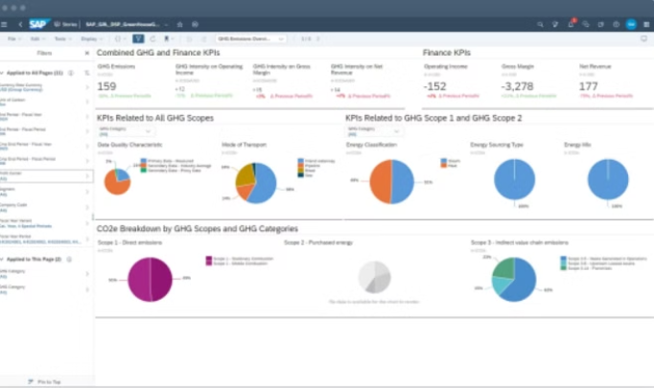
3.2 Available Tools
SAP Temperature Calculator
Purpose
Calculates annual temperature changes based on input of all relevant emissions affecting temperature.
Features
Application
Shows the degree of influence of different warming and cooling substances over time. Uses globally averaged coefficients for temperature change calculations.
Useful for quick assessments of emission scenarios and their potential temperature impacts.
23

Slide 24
3.2 Available Tools
LEAP-IBC
Description
Limitations
LEAP-IBC (Long-range Energy Alternatives Planning system - Integrated Benefits Calculator) is an integrated modeling and scenario planning tool for energy and greenhouse gas planning.
Requires an elaborate database on the study site and a medium level of knowledge from users.
Key Features
Considers the location of emissions, which significantly affects the temperature impact at different points on the globe. Useful for quantifying the impact of various existing plans.
24

Slide 25
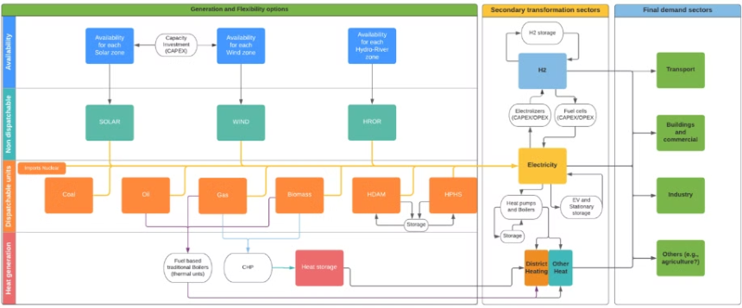
3.2 Available Tools
H2RES
Purpose
Limitations
Specifically designed to increase the integration of Renewable Energy Sources (RES) in stand-alone systems. Used as a planning tool for individual energy systems.
Not sold to external users, requires up to two months of training, and has limited accessibility due to its complexity.
Advantages
Tailored for island systems, offering detailed analysis of renewable integration in isolated grids.
25

Slide 26
3.2 Available Tools
GAINS
SWEET
Roadmap Model
EnergyPlan
Greenhouse Gas – Air Pollution Interactions And Synergies assesses GHG and air pollutant emissions from main emitting sectors. It evaluates the effect of different emission control strategies.
Solid Waste Estimation Tool quantifies GHG emissions and other air pollutants from the municipal solid waste sector. It can estimate historical emissions and assess impacts of waste sector policies.
Developed by ICCT, it estimates GHG emissions and pollutants from road transport. Useful for developing historical inventories and projecting future emissions under different policy scenarios.
A simulation model for evaluating different energy system alternatives. Free to download but requires expert knowledge. Assists in designing national or regional energy planning strategies.
26

Slide 27
3.3 Challenges for Tool Improvement
In short, the creation of a CETA or SECAP is necessary to achieve the objectives set by the EU, for this the use of some tools acquires a fundamental role. In this unit we have reviewed some of them, and we have also identified some of the challenges that need to be addressed so that the energy transition can be tackled from the municipal level:
Generic Guidelines
Lack of Regional Specificity
Existing tools offer guidance to policymakers, but provide very generic guidelines that may not offer concrete solutions.
Many tools do not integrate data specific to certain regions, such as islands, limiting their applicability in these contexts.
Technical Complexity
Monitoring Limitations
Use is often limited to personnel with technical knowledge, making them less accessible to policymakers.
Difficulty in easily monitoring progress towards energy transition goals, as tools often only provide quantifiable scenarios or results for different strategies.
27

Slide 28
3.3 Challenges for Tool Improvement
GENERA PROJECT
Objective
Focus Areas
Approach
GENERA aims to help public authorities transform the energy context of European regions to facilitate a rapid transition to a decarbonized and sustainable economy.
EU and island energy context, identification of existing monitoring tools, key players and stakeholders, financial mechanisms, and best practices at the municipal level.
Provide municipalities with simple and accessible Energy Transition monitoring tools for all interested parties, addressing the limitations of existing tools.
EU and island energy context: Canary, Balearic, Greek and Italian islands
Identification of key players and stakeholders
Identification of existing monitoring tools
Financial mechanisms
Raising awareness of the energy transition
Best practices applied at the municipal level
28

Slide 29
3.3 Challenges for Tool Improvement
GENERA PROJECT
The GENERA project proposes to provide municipalities with simple and accessible ET monitoring tools for all interested parties:
Monitor their progress towards established commitments (such as the Covenant of Mayors).
Create a knowledge database integrating holistic information related to ET (specifically in Mediterranean islands).
Provide a package of specific energy solutions for tourist islands, transforming information into added value for policy and decision makers.
Introduce a co-creation approach to the decision making process by using a multi-criteria methodology for identifying the most promising solution.

Slide 30
UNIT 4
GENERA TOOLS:
ENERGY PLANNING
MOOC 2: Energy transition measurement and monitoring tools
30

Slide 31
UNIT 4. GENERA TOOLS:
ENERGY PLANNING
INDEX
Objectives of the energy planning module
1
2
Features
Indicators
3
4
Tool sections
Application example
5
31

Slide 32
4.1 Objectives of the Energy Planning Module
Objectives of the GENERA Project
Business As Usual (BAU) Scenario
Alternative Scenarios
Comparative Analysis
Compare alternative energy scenarios with the same time horizon and demand constraints to explore different transition pathways.
Provide insights into the potential outcomes of different energy strategies and policy decisions.
Analyze the current scenario and its evolution over the considered time interval as a reference point.
32

Slide 33
4.2 Features
Scenario Evaluation
Annual Rate Projections
Comparative Analysis
Macro-level Insights
Assess and optimally match energy sources and their conversion to the energy needs of different demand sectors (commercial, industrial, residential, etc.).
Use annual rates of change to define the energy demand of each sector over time.
Compare the BAU scenario with an Energy Transition (ET) scenario based on renewable energy and policy-driven sustainability goals.
Provide a macro-level comparison between scenarios to inform high-level decision-making.
33

Slide 34
4.3 Key Indicators
Primary Indicators
Secondary Indicators
Primary energy demand by energy source
Percentage of foreign dependence on primary energy supply
Electricity generation by each energy source
Total CO2 emissions from each energy sector
Percentage of renewable energies in total energy consumption
Energy intensity (ratio of energy consumption to GDP)
34

Slide 35
4.4 Tool sections
Introduction
Brief explanation of the tool's contents and purpose
Growth Rates
Calculation of growth ratios used for estimations
Auxiliar
Data entry from external sources (e.g., IEA database)
ESC-BAU
Calculation of Business-As-Usual scenario and future trends
ESC-ET
Calculation of Energy Transition scenario with new projections
35

Slide 36
4.4 Tool sections
Recommended Database
Data Selection
Importance
The tool is adapted to use information from the IEA's "World Energy Balances Highlights" database.
Use the latest year containing the most complete information possible for accurate analysis.
Reliable and standardized data ensures consistency and comparability in energy planning across different regions.

Slide 37
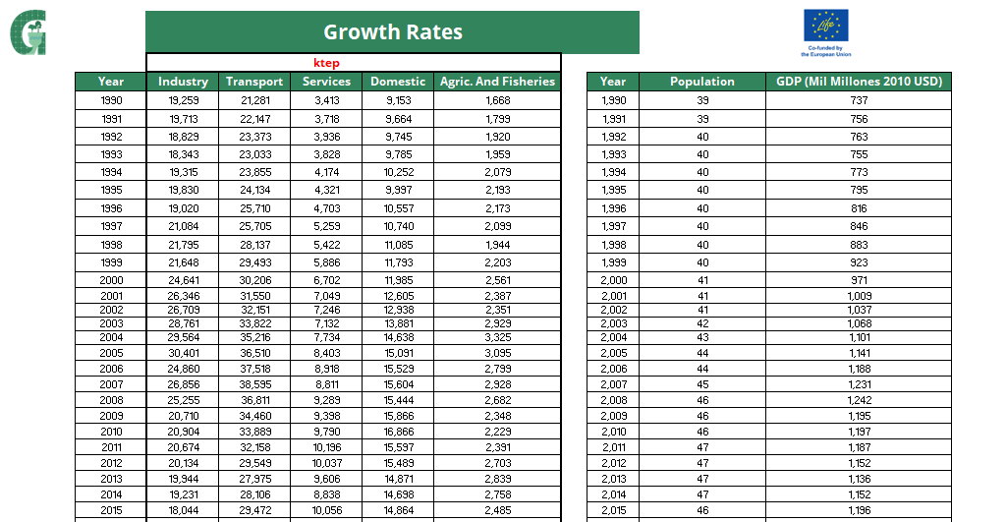
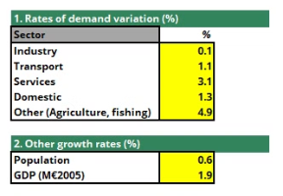
4.4 Tool sections
Growth Rates
Data Input
Enter total energy consumed by each sector for the last reference year from the IEA database. Include recent population and Gross Domestic Product data for the country under study.
Calculation
Importance
Growth rates are calculated based on the last year entered in the tool, providing a basis for future projections.
Accurate growth rates are crucial for realistic scenario modeling and energy demand forecasting.
37

Slide 38
4.4 Tool sections
Auxiliary Section: Data Entry
Energy Sources
Sector Contribution
Unit Conversion
Enter information for each energy source: coal, crude oil, oil products, natural gas, nuclear, renewables, biofuels, electricity, and heat energy vectors.
Input each source's contribution to different sectors: industry, transportation, residential, commercial, and others.
Data is provided in PJ but must be converted to kteps. The tool includes auxiliary sheets for automatic conversion.
38

Slide 39
4.4 Tool sections
Auxiliary Section: Data Entry
39

Slide 40
4.4 Tool sections
Auxiliary Section: Data Entry
40

Slide 41
4.4 Tool sections
ESC-BAU
Inputs Section
Outputs Section
Time Frame
Assumptions are made and input data is automatically entered from pre-filled sheets (growth rates and auxiliary).
Automatically calculates estimates for future years. Provides evolution of growth rates, energy source contributions to each sector, and emissions produced.
Years can be entered manually or automatically, allowing for flexible scenario planning.
41

Slide 42
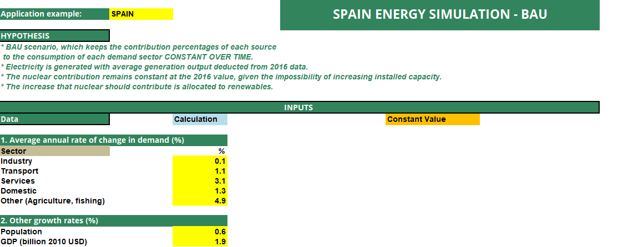
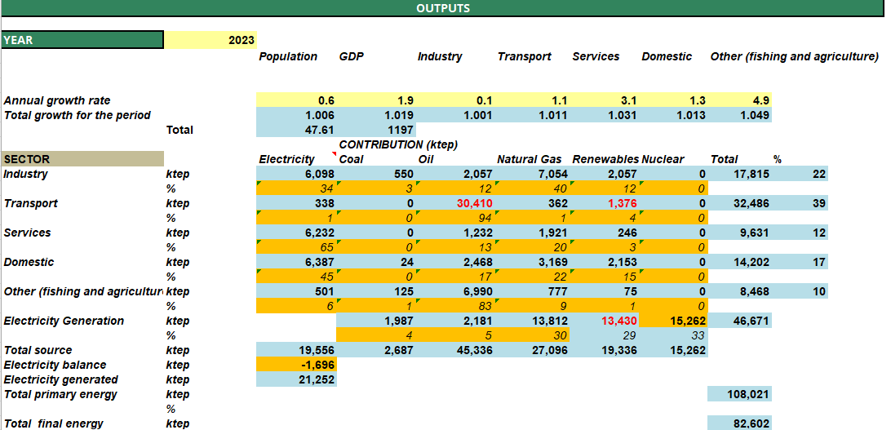
4.4 Tool sections
ESC-BAU
INPUTS
OUTPUTS
42

Slide 43
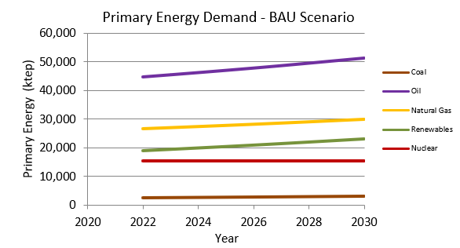
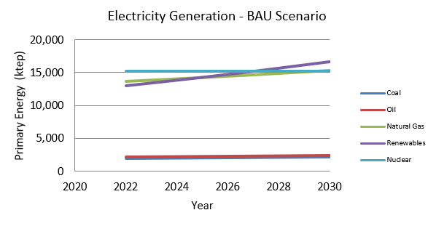
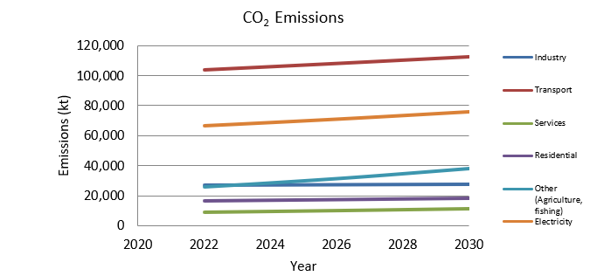
4.4 Tool sections
ESC-BAU: Results Visualization
Energy Demand Projection
Electricity Generation Mix
CO2 Emissions Trend
Visualizes the projected energy demand over time for different sectors.
Illustrates the projected electricity generation by source over the years.
Shows the projected CO2 emissions from different energy sectors over time.
43

Slide 44
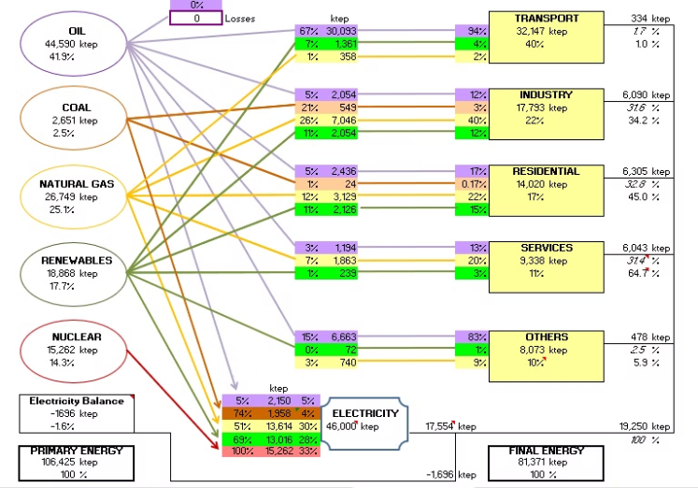
4.4 Tool sections
ESC-BAU: BAU Diagram
Purpose
Provides a comprehensive overview of the country's energy context in the Business-As-Usual scenario.
Content
Illustrates the contribution of each energy source to each sector, showing the conversion of primary energy to final energy.
Utility
Helps visualize the current energy flow and identify areas for potential improvement in the energy transition process.
44

Slide 45
4.4 Tool sections
ESC-ET
Purpose
Inputs Section
Outputs Section
Models an energy transition scenario proposing sustainable improvements for the country.
Allows modification of previously established assumptions to create different transition scenarios.
Can be modified according to the criteria deemed necessary for the specific ET scenario being evaluated.
45

Slide 46
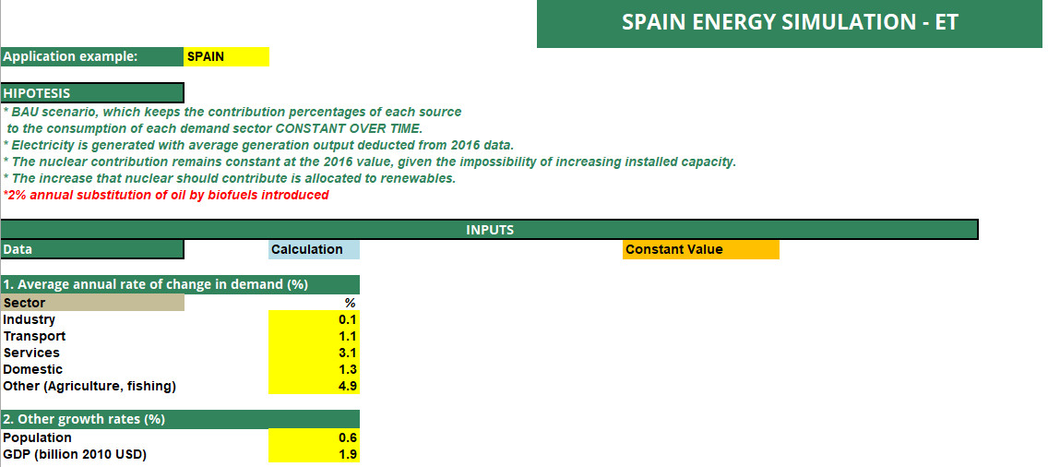
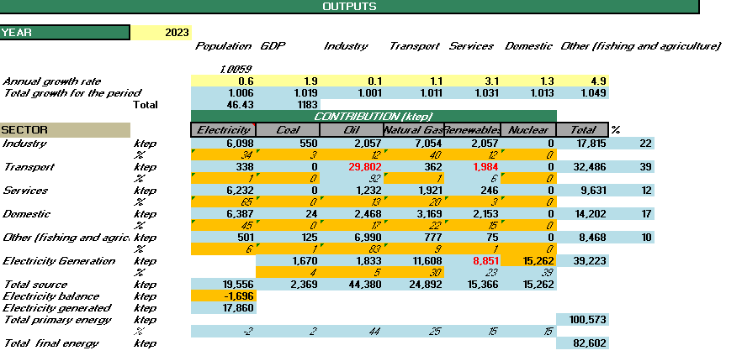
4.4 Tool sections
ESC-ET
INPUTS
OUTPUTS
Shows the input fields for modifying assumptions in the Energy Transition scenario.
Displays the calculated results based on the modified assumptions for the ET scenario.
46

Slide 47
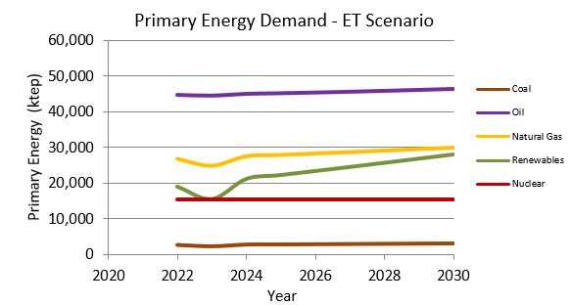
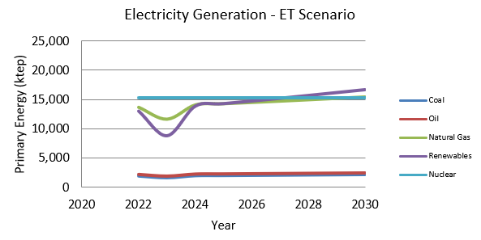
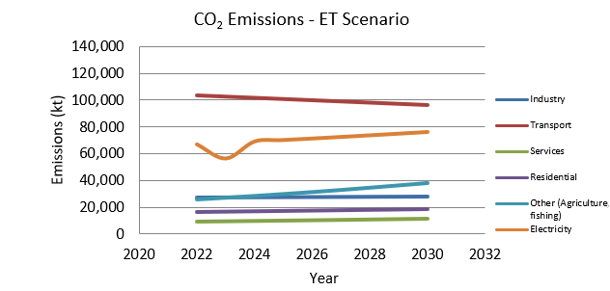
4.4 Tool sections
ESC-ET: Results Visualization
ET Energy Demand
ET Electricity Mix
ET CO2 Emissions
Visualizes the projected energy demand in the Energy Transition scenario.
Illustrates the projected electricity generation mix in the Energy Transition scenario.
Shows the projected CO2 emissions trend in the Energy Transition scenario.
47

Slide 48
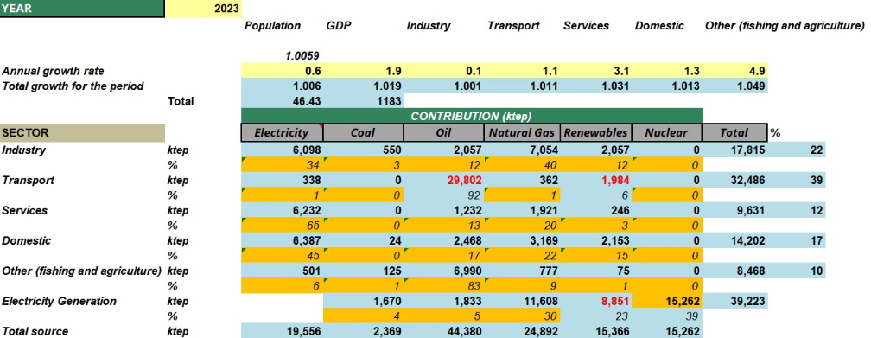
4.5 Application example
It is proposed as an example to create an energy transition scenario for Spain in which the following hypothesis is introduced:
Hypothesis
Introduce a 2% annual substitution of oil by biofuels in the energy mix.
Implementation
Modify the output section formulation to reduce oil use for fuel and replace it with renewable sources.
Goal
Demonstrate how small changes in energy policy can impact the overall energy transition scenario.
48

Slide 49
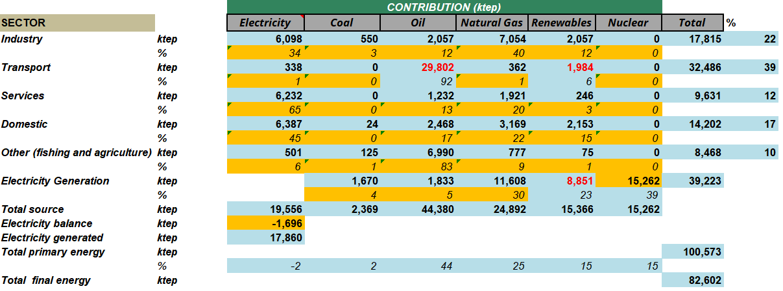
4.5 Application example
Therefore, the following equations must be entered for each year of calculation in the outputs section.
49

Slide 50
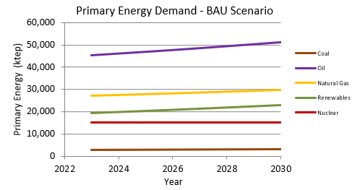
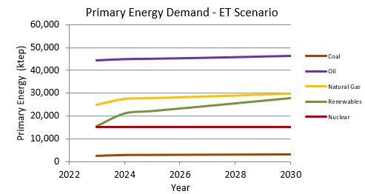
4.5 Application example
Energy Mix Comparison
Emissions Reduction
Visualizes the difference in energy mix between the Business As Usual and Energy Transition scenarios.
Illustrates the potential reduction in emissions achieved through the Energy Transition scenario.
50

Slide 51
Key Takeaways from the Energy
Planning Module
1
Scenario Comparison
The tool enables a clear comparison between Business As Usual and Energy Transition scenarios, highlighting potential benefits of policy changes.
2
Flexibility
Users can easily modify assumptions and inputs to model various energy transition strategies and their impacts.
3
Comprehensive Analysis
The tool provides insights into energy demand, electricity generation mix, and CO2 emissions, offering a holistic view of the energy system.
4
Decision Support
By visualizing potential outcomes, the tool aids policymakers in making informed decisions about energy transition strategies.
51

Slide 52
UNIT 5
GENERA TOOLS:
STRATEGY EVALUATION
MOOC 2: Energy transition measurement and monitoring tools
52

Slide 53
UNIT 5. GENERA TOOLS:
STRATEGY EVALUATION
INDEX
Strategy evaluation method
1
2
Calculation tool
Strategy evaluation tool
3
4
Selection of the most promising energy policies
53

Slide 54
5.1 Strategy evaluation method
Purpose
Key Components
Outcome
This unit focuses on tools and methodologies for evaluating different energy transition strategies using the GENERA framework.
Not only are the technical or economic parameters of the implementation of sustainability-related measures, such as photovoltaic solar energy in isolated communities, considered, but also the environmental, social and political variables involved in the final decision
The Analytical Hierarchical Process (AHP) method is proposed to be used to obtain the solutions that best meet the municipal needs. Participants will learn how to effectively compare and evaluate various energy transition pathways to inform policy decisions.
54

Slide 55
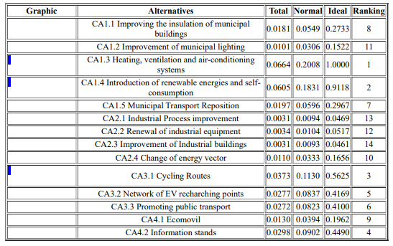
5.1 Strategy evaluation method
Method
The method proposed by the GENERA project consists of facilitating training in quantitative energy terms (calculation of energy saved per measure and CO2 emissions mitigated), as well as providing training in the use of multi-criteria techniques that allow the joint evaluation of quantitative and qualitative aspects.
1. Calculation Module
2. Strategy evaluation module
Qualitative and quantitative evaluation of actions
Ranking of the most promising measures
Actions to be included in the action plan
Quantitative results
Provides technical information to policymakers
55

Slide 56
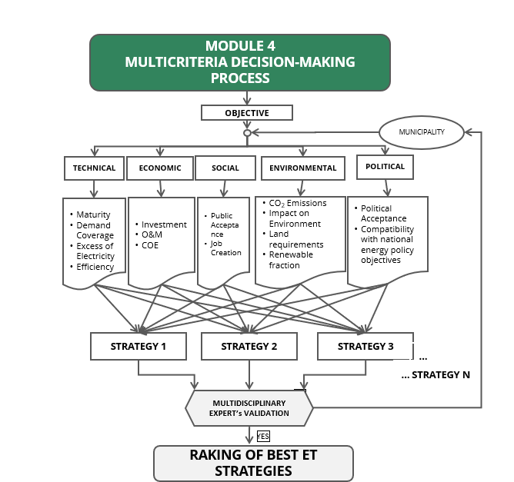
5.1 Strategy evaluation method
2. Strategy evaluation module
Representing the problem in a hierarchical structure allows to get an overview of the whole process and at the same time to analyze whether the model adequately represents the relative magnitude of each criterion.
Level 1: in reference to the different areas that affect the municipal level.
Level 2: the indicators that affect each level.
Level 3: each of the strategies is evaluated according to the previous levels.
56

Slide 57
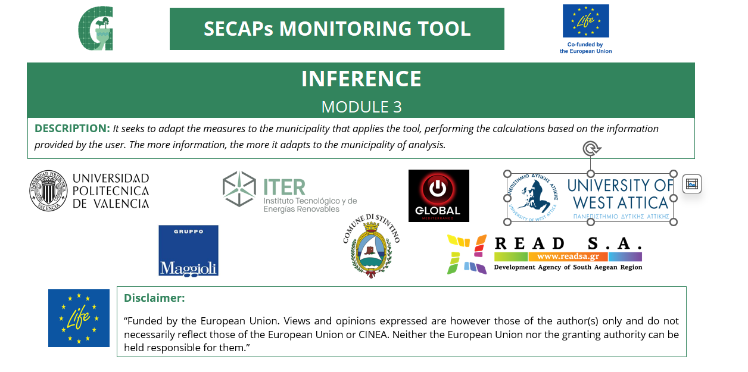
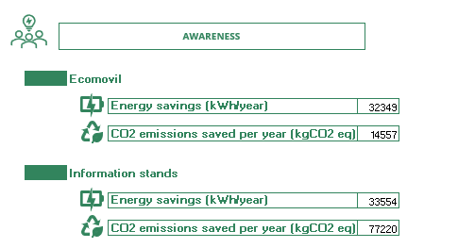
5.2 Calculation Tool
Method
Tool implemented in excel spreadsheet that allows to calculate emission and energy savings for certain measures of municipal interest, performing the calculations based on the information provided by the user. The more information, the more it adapts to the municipality of analysis.
Municipal Buildings and Public Facilities: This section includes all actions related to municipal buildings and equipment under the responsibility of the city council.
Industry: This section includes all industry-related actions and an incentive programme for energy saving and efficiency and the use of renewable energy in housing and SMEs. This section has the aim of reducing final energy consumption and CO2 emissions
Transport: This section includes information and actions related to the improvement of transport at municipal level.
Awareness: This section includes information and actions related to recycling and environmental awareness of citizens
57

Slide 58
5.2 Calculation Tool
Input Data
Municipal Buildings and Public Facilities
Window’s materials and isolation
Nº of Bulbs and replacements
Heating and cooling Demand
Type of heating/cooling systems, Fuel, Equipment available, coolant, fans etc.
Annual Electrical Demand: type of building, Surface, DHW Demand etc.
RE Available and technologies
Vehicles to replace with EV
Industry
Incentive lines depending on the industry sector
Actions to be implementend througout the sector: equipment, efficiency, energy generation, type of process etc.
58

Slide 59
5.2 Calculation Tool
Input Data
Transport
Inhabitants
Distance of the cycleway to be builted-up
Nº of EV Chargers and power
Measures related to promotion of public transport: speed zones, fees, tolls etc.
Awareness
Inhabitants
Awareness plan
Events: school, associations, citizens etc.
Recycling points
Bonuses for self-consumption
59

Slide 60
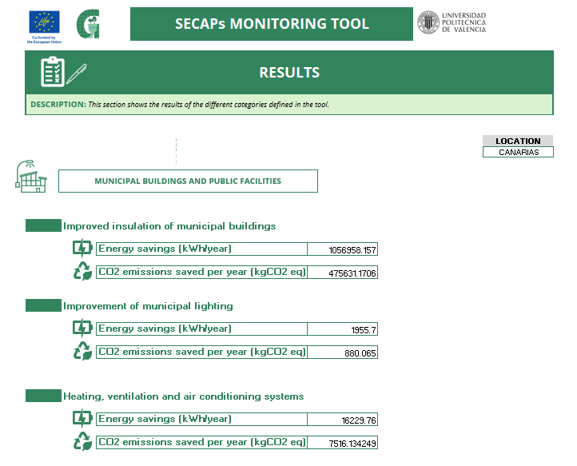
5.2 Calculation Tool
Results
For each action is obtained:
Energy Savings (kWh/year)
CO2 emissions saved (kgCO2 eq)
The results will be used as quantitative information for the next module.
60

Slide 61
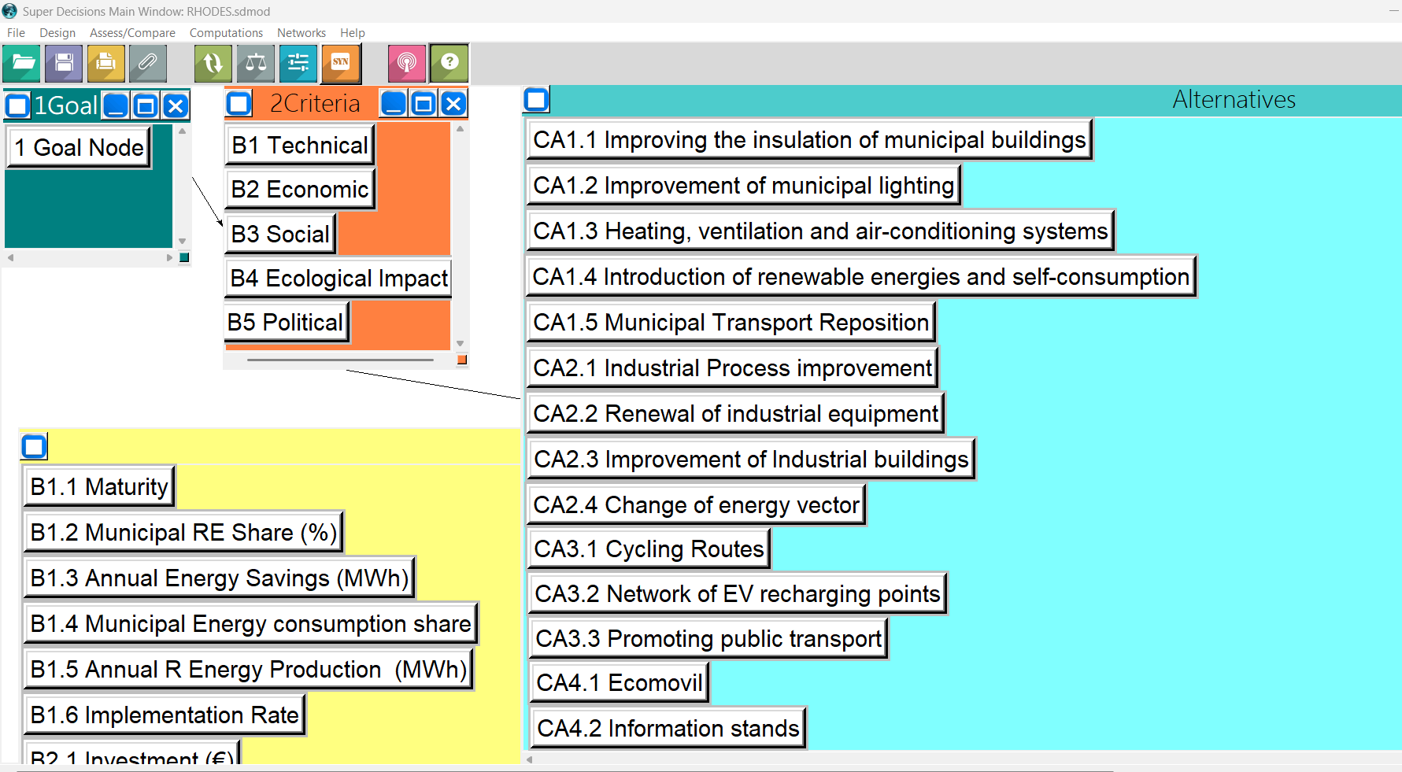
5.3 Strategy evaluation tool
Tool
As a support tool, the “Super Decisions” software is used as a decision support method that implements the AHP. The objective would be to achieve a planning of measures according to the municipal casuistry.
Features
Free software
Allows you to easily define the elements, their relationships, enter the importance of the relationships and obtain the results.
The program is implemented in Spanish and English, selectable from the menu
61

Slide 62
5.3 Strategy evaluation tool
Indicator | Criteria to which it applies
Maturity
Municipal RE Share (%)
Annual Energy Savings (MWh)
Annual RE Production (MWh)
Implementation Rate
Investment
Annual Profitability (kWh/€)
Available Funding and Grants
Public Acceptance
Job Creation
CO2 Emissions Reduction (tCO2)
Biodiversity Impact
Land Change of Use
Political Acceptance
Compatibility with national Policies
Compatibility with regional Policies
Compatibility with EU Policies
Level 1 and 2 are entered into the tool, and the corresponding connections are made between them according to the following table.
Technical
Ecological impact
Economic
Social
Political
62

Slide 63
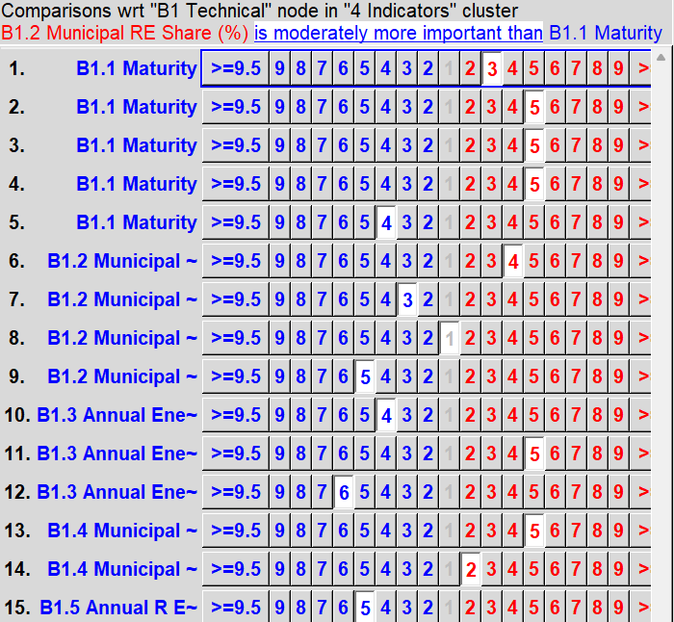
5.3 Strategy evaluation tool
Evaluation
Each of the indicators should be evaluated and weighted according to the relative importance of each criterion (technical, ecological, social, economic and political impact).
Weighting
For this purpose, weights (from 1 to 10) are assigned to each of the indicators.
Procedure
The same procedure is carried out for each of the alternatives or proposed actions.
63

Slide 64
5.4 Selection of the most promising energy policies
After performing the simulation or synthesizing the whole model, the results will be obtained for each of the alternatives or actions in this case.
The Normal column presents the results in the form of priorities. This is the usual way of reporting the results.
The Ideals column is derived from the Normals column by dividing each of its entries by the highest value in the column.
The ranking column shows the final result of the order of alternatives.
64

Slide 65
5.4 Selection of the most promising energy policies
The results can be exported and more visual graphs can be obtained.
65

Slide 66
UNIT 6
CASE STUDIES USING THE MONITORING TOOL
MOOC 2: Energy transition measurement and monitoring tools
66

Slide 67
UNIT 6. CASE STUDIES USING THE MONITORING TOOL
INDEX
Introduction to case studies
1
2
Case study in Spain
Case study in Italy
3
4
Case study in Greece
67

Slide 68
6.1 Introduction to Case Studies
Purpose
Learning Objectives
Outcome
This unit presents real-world case studies demonstrating the application of the GENERA Monitoring Tool in various contexts.
Understand how the tool is used in practice, interpret results, and apply insights to different scenarios.
Gain practical knowledge on using the GENERA tool for energy transition planning and monitoring in diverse settings.
Case Studies
Sardinia (Italy)
The case studies to be evaluated are located on the island of Ibiza (Spain), Sardinia (Greece) and Rhodes (Greece).
Ibiza (Spain)
Rhodes (Greece)
68

Slide 69
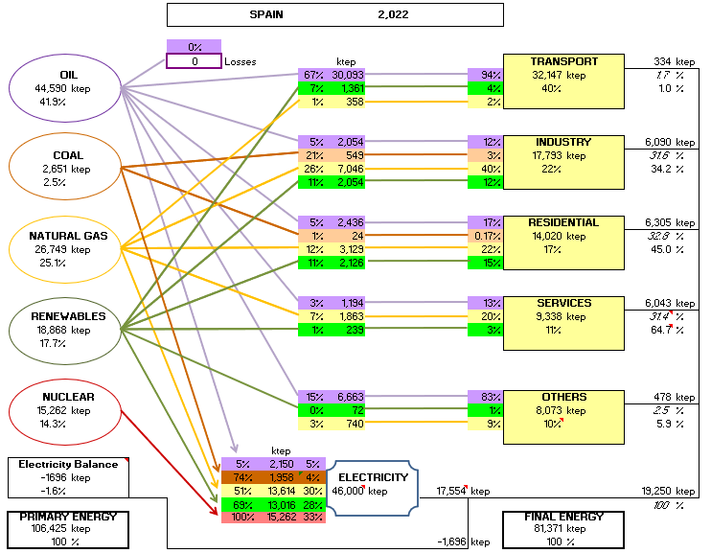
6.2 Case Study 1: Ibiza (Spain)
Study of the Spanish National Context
GENERA tool
Application of GENERA's energy planning tool
Reference Data
Data entered in the tool take 2022 as the reference year (since 2023 is incomplete for some sectors) (International Energy Agency).
Energy Balance
Oil is the main source in the transport sector and in other sectors such as agriculture, fishing, etc. On the other hand, natural gas is more involved in the industry, residential and service sectors. In addition, in electricity production, natural gas and renewables are the main producers.
69

Slide 70
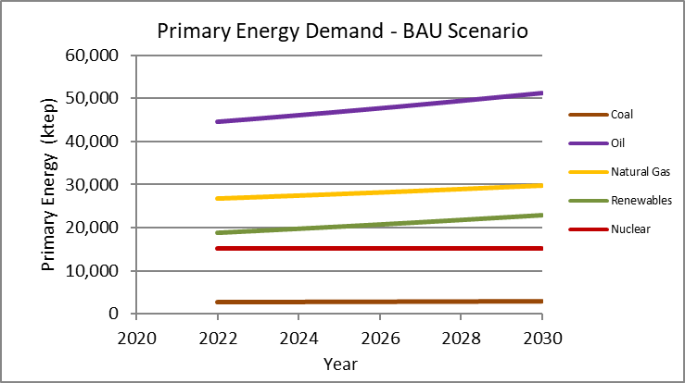
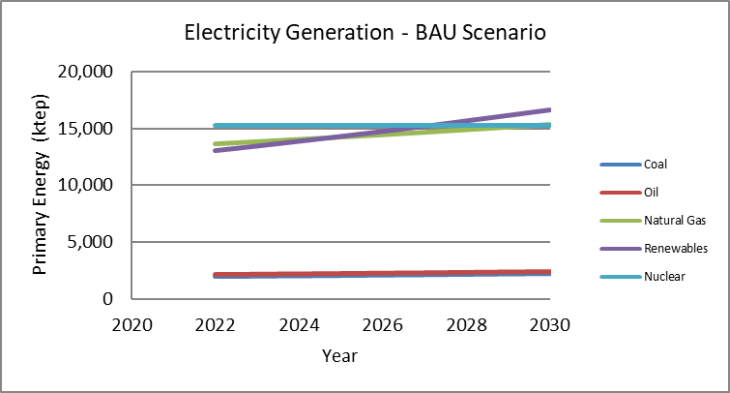
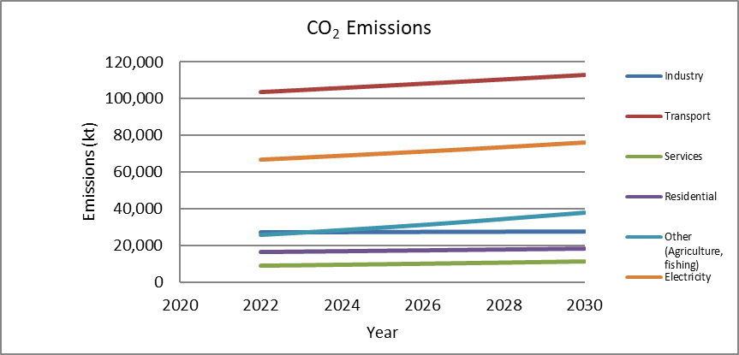
6.2 Case Study 1: Ibiza (Spain)
Study of the Spanish National Context
Spain's energy context is characterized by the use of oil mainly for the transport sector, which in turn generates most of the country's emissions. There is a growing trend towards the use of renewable energy, mainly for electricity production, but also for residential use.
Natural gas also shows a growing trend and greater involvement in the industrial, residential and service sectors.
In terms of emissions, the most damaging sector is transport, followed by electricity generation.
70

Slide 71
6.2 Case Study 1: Ibiza (Spain)
Summary of actions of Sant Antoni de Portmany (Ibiza)
Context
Challenges
Located in the northwest of the island of Ibiza. The municipality has an area of 12,662 hectares and a population of 27,431 inhabitants.
After signing the Covenant, it should consider “the adaptation of structures including the allocation of adequate human and economic resources” as a formal commitment
It has set the promotion of renewable energies so that they represent at least 32% of the energy consumption of the municipality in the year 2030.
Increase the city's energy efficiency by 32.5% by the year 2030, with respect to 2005 energy consumption.
The global emissions reduction target for the year 2030 represents a reduction of 63,838.23 tons of CO2.
GENERA tool
Application of the GENERA inference module.
71

Slide 72
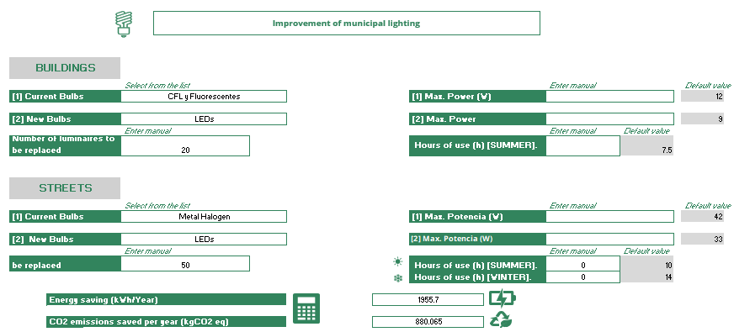
6.2 Case Study 1: Ibiza (Spain)
Summary of actions of Sant Antoni de Portmany (Ibiza)
Actions
The main actions included in the generation tool are as follows
Municipal Buildings And Public Facilities
Indoor lighting renovation
Substitution Of Lights For More Efficient Ones
Installation of aerothermal energy in municipal facilities
Photovoltaic solar energy installations
Replacement of municipal vehicles with more efficient ones
72

Slide 73
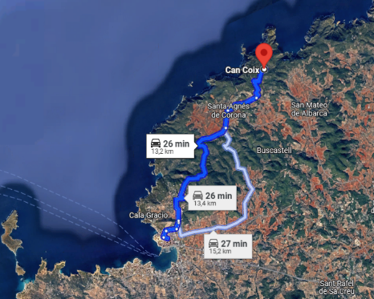
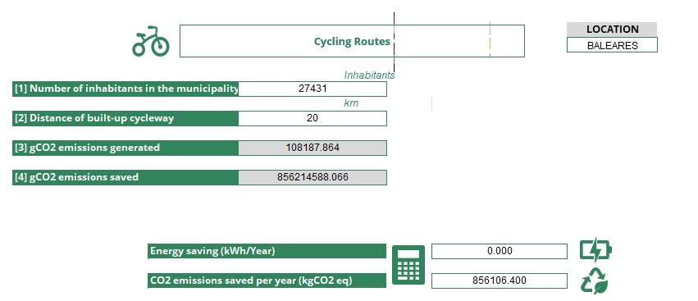
6.2 Case Study 1: Ibiza (Spain)
Summary of actions of Sant Antoni de Portmany (Ibiza)
Actions
Transport
Increase of cycling routes
Network of EV recharging points
Measures to promote public transport and reduce private vehicle use
Awareness
Awareness-raising information stands
73

Slide 74
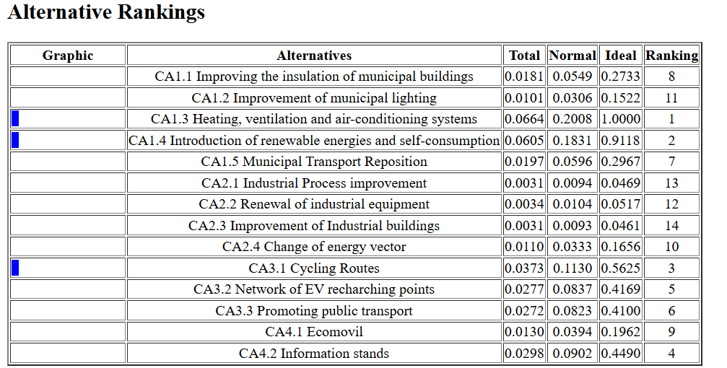
6.2 Case Study 1: Ibiza (Spain)
Multicriteria Decision in Sant Antoni
Municipal priorities
Considering the priorities established by the municipality, the criteria used to prioritize the different levels are as follows:
Raise awareness and educate citizens about climate change.
Promote energy efficiency and the use of renewable sources.
Encourage responsible resource management
Design a sustainable and efficient municipality
GENERA tool
Application of the multi-criteria module and software SuperDecisions
74

Slide 75
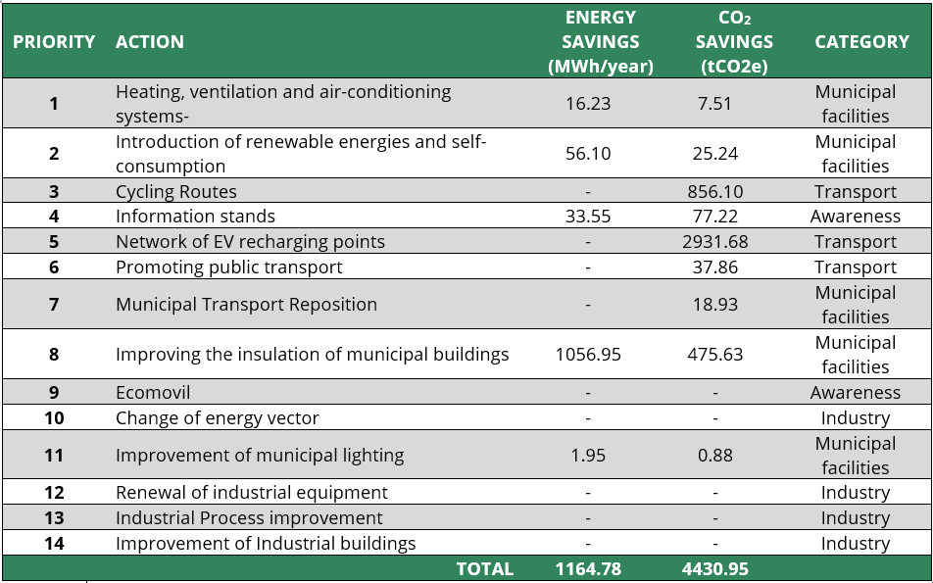
6.2 Case Study 1: Ibiza (Spain)
Results
75

Slide 76
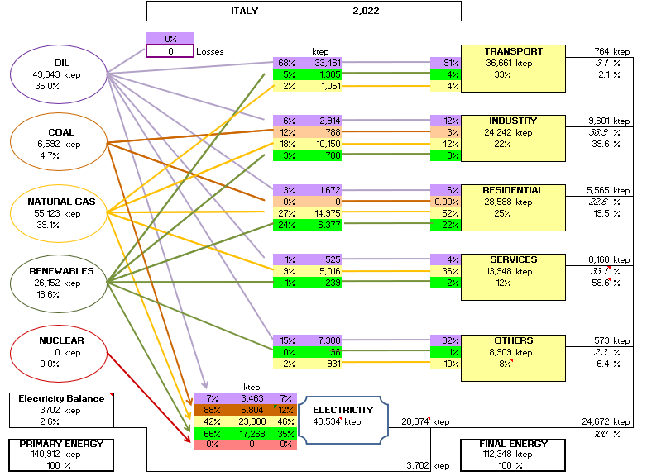
6.3 Case Study 2: Sardinia (Italy)
Study of the Italian National Context
GENERA tool
Application of GENERA's energy planning tool
Reference Data
Data entered in the tool take 2022 as the reference year (since 2023 is incomplete for some sectors) (International Energy Agency).
Energy Balance
The use of fossil fuels such as oil, mainly for the transport and agriculture/fishing sectors, and natural gas for the industrial, residential and services sectors, as well as for electricity generation, are particularly relevant. In addition, renewables are also especially significant in the residential sector
76

Slide 77
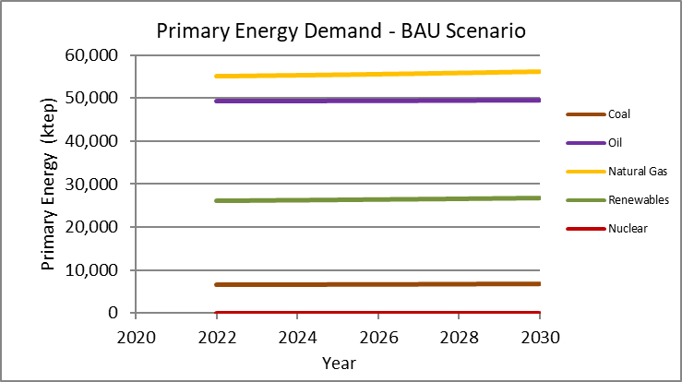
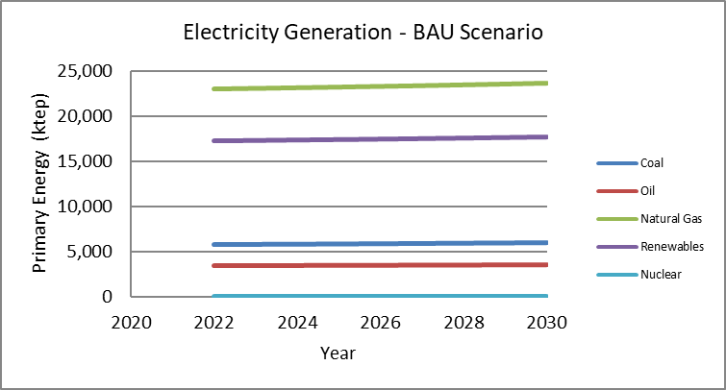
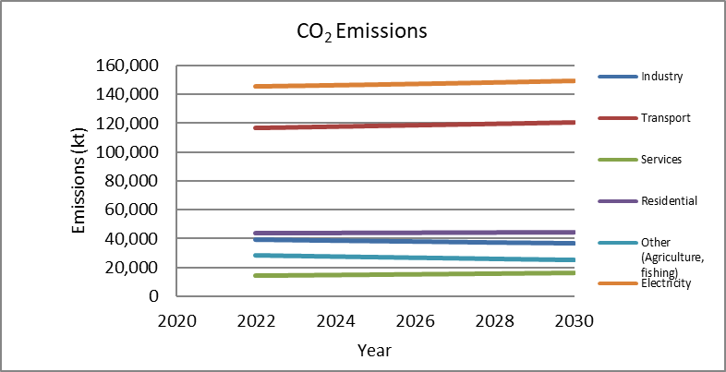
6.3 Case Study 2: Sardinia (Italy)
Study of the Italian National Context
Italian energy context is characterized by the use of natural gas and oil mainly, whose major contribution is divided between the transport and electricity generation sectors. Renewable energies are more involved in the residential and electricity sectors and there is a growing trend mainly for electricity production.
Natural gas also shows a growing trend and greater participation in the industrial, electricity generation, residential and services sectors.
The most damaging sector in term of emissions is electricity generation, followed by transport.
77

Slide 78
6.3 Case Study 2: Sardinia (Italy)
Summary of actions of Stintino (Sardinia)
Context
Challenges
Stintino is a town in the Italian province, region of Sardinia, with 1,212 inhabitants.
The municipality of Stintino joined the Covenant of Mayors initiative with the main objective of reducing CO₂ emissions by 20%.
Actions planned in relation to new buildings and the increase of existing buildings with higher performance.
Improvement of accessibility conditions in the urban area: transportation methods, bicycle lanes and pedestrian areas.
Reduced dependence on conventional energy sources.
Implementation of awareness, training and citizen participation processes to improve sustainability and education in terms of energy consumption.
GENERA tool
Application of the GENERA inference module.
78

Slide 79
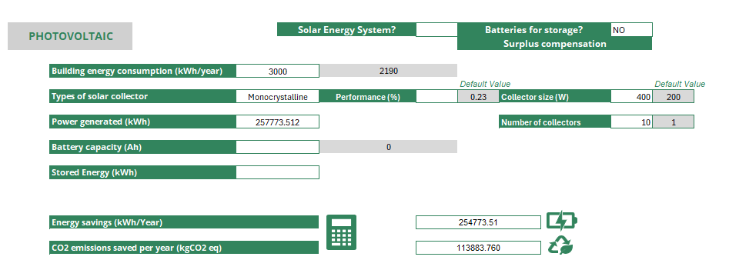
6.3 Case Study 2: Sardinia (Italy)
Summary of actions of Stintino (Sardinia)
Actions
The main actions included in the generation tool are as follows
Municipal Buildings And Public Facilities
Improving energy efficiency in municipal buildings
Substitution Of Lights For More Efficient Ones
Improvement of building conditioning
Introduction of renewable energies in public buildings
Replacement of municipal vehicles with more efficient ones
79

Slide 80
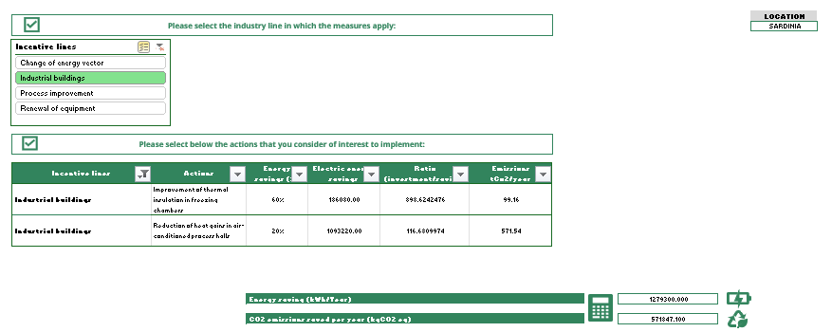
6.3 Case Study 2: Sardinia (Italy)
Summary of actions of Stintino (Sardinia)
Actions
Industry
In the tertiary and productive sector, measures and promotion of environmental management tools are also introduced to improve industrial buildings.
Transport
Increase of cycling routes
Network of EV recharging points
Measures to promote public transport and reduce private vehicle use
80

Slide 81
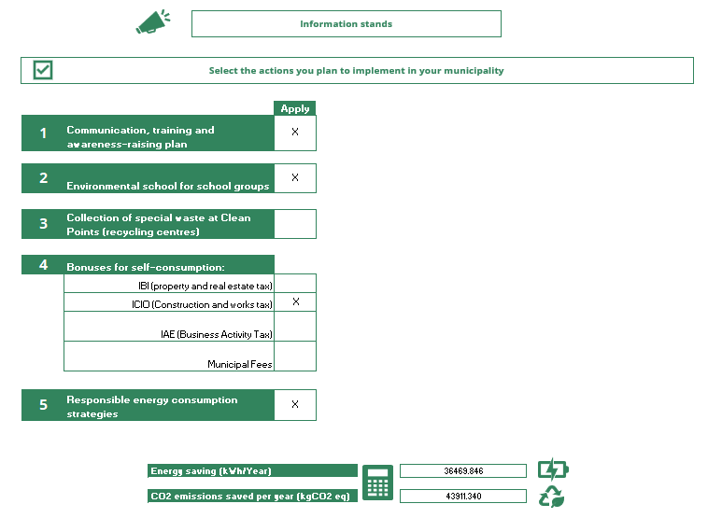
6.3 Case Study 2: Sardinia (Italy)
Summary of actions of Stintino (Sardinia)
Actions
Awareness
This category includes raising public awareness, creating communication and awareness plans, workshops for schools and energy consumption reduction strategies.
In addition, discount rates for sustainable bioclimatic constructions are also proposed.
81

Slide 82
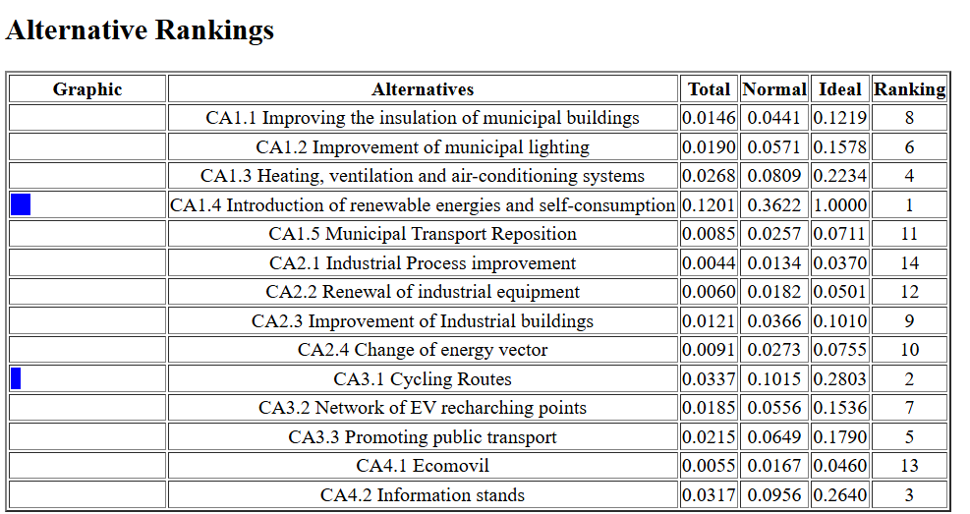
6.3 Case Study 2: Sardinia (Italy)
Multicriteria Decision in Stintino
Municipal priorities
Considering the priorities established by the municipality, the criteria used to prioritize the different levels are as follows:
Adapt the municipality's public facilities.
Involve civil society to develop and improve the action plan with citizen awareness.
Reduce energy consumption through actions in municipal buildings.
Inclusion of PV systems in buildings and land in the municipality, as well as promoting their installation at the individual level.
Development of heating with cogeneration plants.
GENERA tool
Application of the multi-criteria module and software SuperDecisions
82

Slide 83
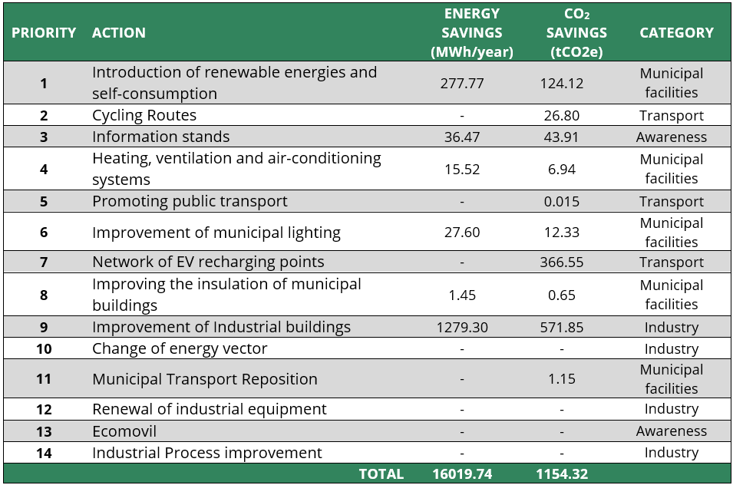
6.3 Case Study 2: Sardinia (Italy)
Results
83

Slide 84
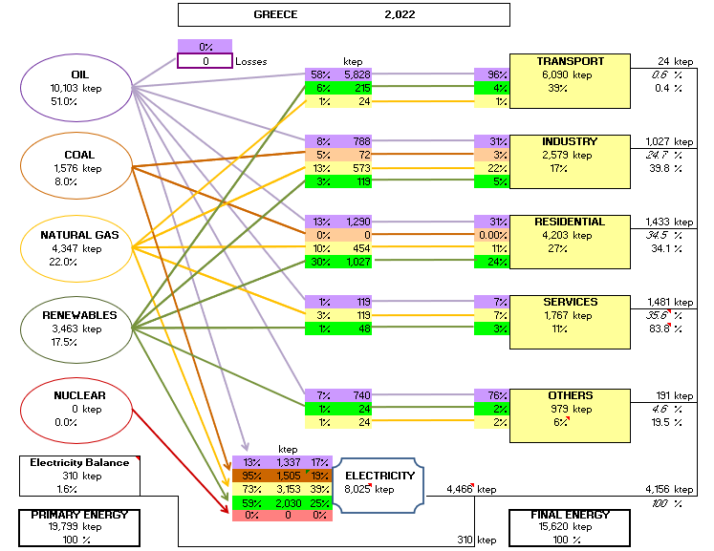
6.4 Case Study 3: Halki (Greece)
Study of the Greek National Context
GENERA tool
Application of GENERA's energy planning tool
Reference Data
Data entered in the tool take 2022 as the reference year (since 2023 is incomplete for some sectors) (International Energy Agency).
Energy Balance
High presence of oil in all sectors, although it stands out mainly in the transport sector, and others such as agriculture and fisheries. Natural gas is most involved in electricity generation, followed by the industrial and residential sectors. Renewable energies are also producers of electricity and have a great impact on the residential sector
84

Slide 85
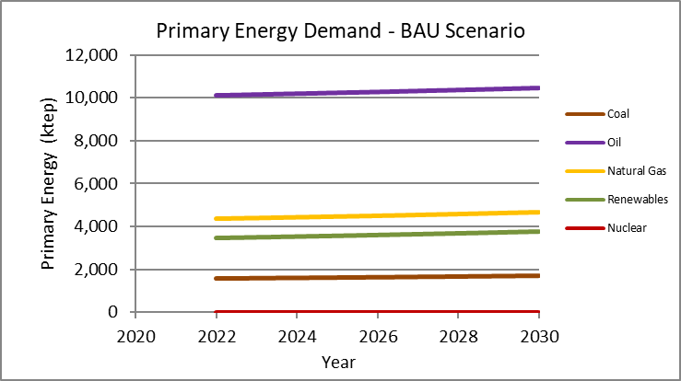
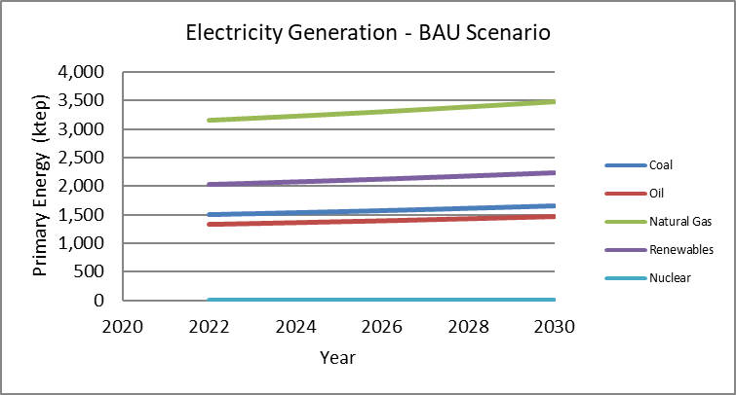
6.4 Case Study 3: Halki (Greece)
Study of the Greek National Context
The Greek energy context is mainly characterized by the use of oil and natural gas in sectors such as transport and agriculture and fishing.
Renewable energies are more involved in the residential and electricity sectors. There is a growing trend in the use of renewable energies, mainly for electricity production.
The sector that emits the most emissions is the electricity generation sector due mainly to coal, and it is followed by transport.
85

Slide 86
6.4 Case Study 3: Halki (Greece)
Study of the Greek National Context
Context
Challenges
Smallest inhabited island of the Dodecanese with an area of 28 km2. It is part of the regional unit of Rhodes. It has a permanent population of 330 inhabitants (increasing during the summer months).
It has a large photovoltaic park and the installation of solar energy facilities is planned. It is estimated that the island's energy needs can be covered.
The municipality has set itself the target of reducing CO₂ by 105% by 2030, which exceeds the required 40% by far, so the emissions must be very demanding.
GENERA tool
Application of the GENERA inference module
86

Slide 87
6.4 Case Study 3: Halki (Greece)
Summary of actions of Halki (Greece)
Actions
The main actions included in the generation tool are as follows
Municipal Buildings And Public Facilities
Improving energy efficiency in municipal buildings
Substitution Of Lights For More Efficient Ones
Improvement of building conditioning
Introduction of photovoltaic solar energy for power production
Replacement of municipal vehicles with more efficient ones
87

Slide 88
6.4 Case Study 3: Rhodes (Greece)
Summary of actions of Halki (Greece)
Actions
Transport
Increase of cycling routes
Promoting public transport
Awareness
Implementation of Ecomovil
Awareness-raising information stands
88

Slide 89
6.4 Case Study 3: Halki (Greece)
Multicriteria Decision in Halki
Municipal priorities
Considering the priorities established by the municipality, the criteria used to prioritize the different levels are as follows:
Promotion of recycling and organics reduction.
Energy audit in municipal buildings.
Information to users to improve the behaviour and optimal use of the different equipment.
Substitution of LED lamps in lighting systems.
Development of heating with cogeneration plants.
GENERA tool
Application of the multi-criteria module and software SuperDecisions
89

Slide 90
6.4 Case Study 3: Halki (Greece)
Results
90

Slide 91
Key Lessons from Case Studies
Purpose of the GENERA Tool
Developed to assist municipalities, particularly on islands, in creating energy transition action plans with national, regional, and local insights.
Modular and Tailored Approach
The tool includes different modules, allowing qualitative data integration for better adaptability to smaller municipalities.
Comprehensive Data Management
It provides precise context through national, regional, and local data, helping policymakers set clear sustainability goals.
Usability and Future Improvements
Designed to be user-friendly but could benefit from enhancements, such as a manual and improved information visibility.
Pilot Testing and Expansion
Tested in several island municipalities in Spain, Italy, and Greece, yielding energy-saving measures and CO2 reductions, with plans for further refinement and expansion
91

Slide 92
MOOC 2 Energy transition measurement and monitoring tools

