Slide 1


MOOC 1
Energy sustainability and municipal roadmaps

Slide 2


Index
UNIT 1: INTRODUCTION
UNIT 2: CURRENT ENERGY CONTEXT
UNIT 3: METHODOLOGIES FOR THE CREATION OF ROADMAPS
UNIT 4: LOCAL ENERGY TRANSITION PACKAGE
UNIT 5: SELECTION OF THE MOST PROMISING ET SOLUTIONS
UNIT 6: ROADMAP DEVELOPMENT
MOOC 1: Energy sustainability and municipal roadmaps

Slide 3



Energy sustainability and municipal roadmaps
Energy sustainability
Municipal roadmaps
EU Financing
Main focus of MOOC 1
Key tools for energy transition
Project supported by European funds
MOOC 1: Energy sustainability and municipal roadmaps

Slide 4
UNIT 1
INTRODUCTION
MOOC 1: Energy sustainability and municipal roadmaps

Slide 5
UNIT 1. INTRODUCTION
INDEX
Climate Situation
1
Explore the current landscape of climate change and its implications.
2
Europe's energy challenges: island territories
Analyse the specific challenges facing European islands in terms of energy.
The key role of the municipalities
3
Examine how local governments can lead the energy transition
MOOC 1: Energy sustainability and municipal roadmaps

Slide 6



1.1 Climate Situation
Global warming
Greenhouse gas
emissions emissions
2
1.5°C increase (2030-2052).
The main cause of climate change, altering rainfall, transforming ecosystems and affecting our economy, health and quality of life.
1
Transformation towards a
Sustainable Economy
Fundamental transformation of our economies, promoting the appropriate use of natural resources and the development of clean and safe energy sources.
3
MOOC 1: Energy sustainability and municipal roadmaps

Slide 7
1.1 Climate Situation
1
2
2015: Paris Agreement
2019: European Green Pact
Main objective: to contain the global average temperature increase to below 2°C above pre-industrial levels, with efforts to limit it to 1.5°C.
Communication from the European Commission to achieve climate neutrality for the European continent by 2050.
European energy and climate policy is currently defined by the Paris Agreement. The European Green Deal, on the other hand, seeks to boost the economy, improve health and the quality of life of citizens through these key areas:
🔋 Clean Energy
🚗 Mobility
🌿 Ecosystems
Clean, affordable and secure energy supply
Accelerating the transition to sustainable and smart mobility
Preservation and restoration of ecosystems and diversity
🏗️ Building
🏭 Industry
Energy and resource efficiency in construction and renovation
Mobilising industry for a clean and circular economy
MOOC 1: Energy sustainability and municipal roadmaps

Slide 8
1.2 Europe's energy challenges:
island territories
Studying Energy Transition (ET) at different levels requires attention to island territories, as they vary enormously in terms of electricity grids, geographical specificities, local population, tourism and other aspects, all of which affect the stability of the energy grid and create energy planning challenges.
The European Union (EU) has a wide variety of islands and is therefore paying particular attention to studying them as they offer specific opportunities well suited for modern energy planning, both in terms of potential for energy efficiency, renewable energy and innovative solutions, and for creating a broad and strong community-driven transition process.
Variations in island territories
Energy planning challenges
Electricity grids, geographical specificities, local population, tourism
Energy grid stability and specific planning
Opportunities on EU islands
Community-driven transition
Energy efficiency, renewable energies, innovative solutions
Comprehensive and robust transition process in island territories
MOOC 1: Energy sustainability and municipal roadmaps

Slide 9
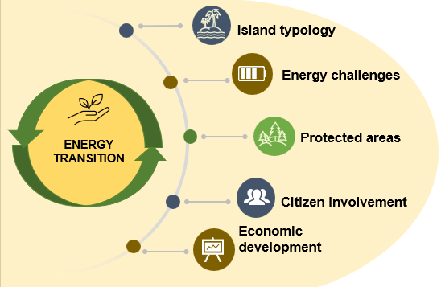
1.2 Europe's energy challenges:
island territories
The “Clean Energy for EU Islands” initiative or the “Smart Islands” initiative are proof that the EU is taking a special interest in island regions. Some of the energy challenges facing tourist islands are:
Island typology in terms of distance from the mainland, available resources, accessible renewable energy sources, climate, etc.
Energy challenges such as limited space for the implementation of renewable energy sources, energy dependence, etc.
Protected areas in natural spaces such as environmental parks.
Citizen participation in ET through awareness-raising measures, existing initiatives to promote self-consumption, etc.
Economic development represented through variations in tourist flow, productive capacity of the island, port and maritime connections, land use, etc.
MOOC 1: Energy sustainability and municipal roadmaps

Slide 10

1.2 Europe's energy challenges: key actors
Cities are at the core of the transition to a sustainable economy, being crucial actors in the energy transformation.
The Covenant of Mayors for Climate and Energy represents the highest commitment to this transition, creating an alliance of local governments dedicated to facilitating access to sustainable and affordable energy for all.
Cities as a Base
1
Rationale for sustainable transition
Adaptation and Mitigation
2
Clean energy and sustainable mobility
Covenant of Mayors
3
Climate and Energy Alliance
MOOC 1: Energy sustainability and municipal roadmaps

Slide 11


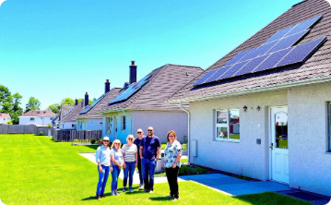

1.3 The key role of the municipalities
Moving towards ET, decarbonization and the smart cities of the future involves a series of key actors such as prosumers; people capable of producing and consuming energy. This is a term that emerged in 1980 and is set to lead the energy transformation. Citizens will take on the role of prosumers by bringing flexibility to the power grid and ultimately becoming a stakeholder that addresses societal challenges.
There are different concepts into which prosumers can be classified:
Individual households
SMEs and public institutions
Collective prosumers
Energy communities and cooperatives
Families installing solar panels on their roofs to generate their own electricity.
Businesses implementing energy efficiency measures and own generation.
Groups of citizens coming together to produce and consume energy collectively.
Democratic organisations that manage renewable energy projects for their members.
MOOC 1: Energy sustainability and municipal roadmaps

Slide 12
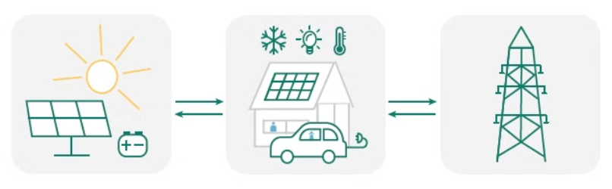
1.3 The key role of the municipalities
Individual households
1
Installation of photovoltaic panels
2
Own heat production
Individual households have installed PV panels on the roof or on the balcony, possibly in combination with a battery.
The energy from the solar panels can be used to power a heat pump, so that the consumer produces his own heat.
3
Flexibility to the electricity system
4
Participation in energy communities
Such battery-powered homes capable of feeding energy into the grid offer flexibility to the electricity system.
In addition, they can also be part of an energy community.
MOOC 1: Energy sustainability and municipal roadmaps

Slide 13
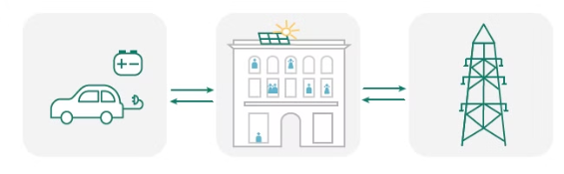
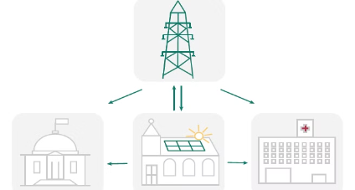
1.3 The key role of the municipalities
Collective prosumers in a building
SMEs and public institutions
This is another case in which the residents of a building or complex install solar panels and batteries and benefit from the consumption of their own energy, in addition to contributing to the self-consumption and demand services of the electricity grid.
Companies and public institutions can install panels on their roofs for self-consumption of their energy. This energy can be shared between different public buildings or exchanged with the grid.
MOOC 1: Energy sustainability and municipal roadmaps

Slide 14
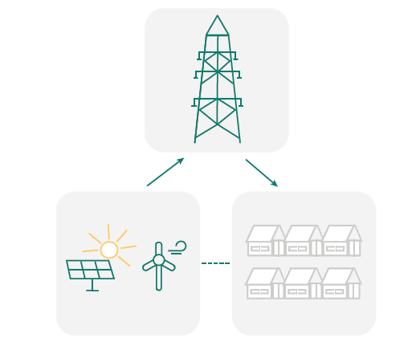
1.3 The key role of the municipalities
Energy communities and cooperatives
This is the most diverse group of prosumers that varies in different forms and ranges. In both cases the community must invest in its own Renewable Energy Sources (RES).
Model contribution
Energy community where members pay regular contributions to the community itself to maintain and develop shared energy resources.
Shareholding model
Structured energy community with shareholders who own and control the entity, participating directly in decision making and profits.
MOOC 1: Energy sustainability and municipal roadmaps

Slide 15
UNIT 2
CURRENT ENERGY CONTEXT
MOOC 1: Energy sustainability and municipal roadmaps

Slide 16

UNIT 2. CURRENT ENERGY CONTEXT
INDEX
Energy objectives
1
Analysis of established energy targets and commitments
2
Factors in determining the national energy context
Assessment of the key elements defining the country's energy situation
Comprehensive energy planning
3
Development of comprehensive energy management strategies
4
Case study
Practical application of the concepts studied
MOOC 1: Energy sustainability and municipal roadmaps

Slide 17




2.1 Energy objectives
Decarbonisation of the electricity system
Substitution of fossil fuels
Increase in renewable energies
Promoting green hydrogen
The EU has set ambitious targets such as decarbonisation of the electricity system by 2030 or carbon neutrality by 2050, as presented in 2019 in the European Green Deal.
Eliminate and gradually replace fossil fuel assets with clean alternatives, especially renewables, accompanied by incentives to achieve TE solutions.
Increasing the share of renewables in electricity generation to 65% by 2030 as the most realistic pathway to halving emissions by 2030.
Promote green hydrogen from niche to mainstream by 2030, as well as bioenergy.
MOOC 1: Energy sustainability and municipal roadmaps

Slide 18




2.1 Energy objectives
Promotion of electric vehicles
Efficient buildings
Innovation and recycling
Awareness
Achieve energy-efficient building requirements.
Innovation, recycling and the circular economy will play an important role in the search for efficiency in the medium and long term.
Raise awareness to reduce travel demand and encourage the use of public transport and cycling wherever possible.
Increase electric car sales by 2030, as well as financial and fiscal incentives to promote the adoption of electric vehicles, charging mandates and bans on combustion vehicles.
MOOC 1: Energy sustainability and municipal roadmaps

Slide 19
2.2 Factors to determine the national energy context
Analyzing the sustainability of a study region is done on the basis of a series of indicators, which allow quantitative measurement of energy sustainability, including CO2 emissions, and its evolution over time.
1
Energy chain
2
Primary energy
3
Secondary energy
Energy flow from primary production to final energy use.
energy that has not undergone a conversion or transformation process.
Energy that has been produced by conversion or transformation of primary energy (“energy vectors” or “energy carriers”).
4
Final energy
5
Useful energy
energy made available to the consumer before final conversion.
Energy made available to the consumer after its final conversion.
MOOC 1: Energy sustainability and municipal roadmaps

Slide 20
2.2 Factors to determine the national energy context
In order to determine the national energy context, it is important to collect some data such as:
Performance and sustainability indicators
1
Fraction of electricity in final energy and total CO2 emissions
Energy consumption metrics
2
External dependence, consumption per capita and consumption normalised to GDP
Basic economic indicator
Gross Domestic Product (GDP) as a key macroeconomic measure. On this basis, energy consumption is analysed, culminating in performance and sustainability indicators such as CO2 emissions and the share of electricity in final consumption.
3
Besides understanding the energy context, strategic energy planning is necessary.
MOOC 1: Energy sustainability and municipal roadmaps

Slide 21





2.3 Comprehensive energy planning
Energy planning consists of forecasting future energy needs and the actions to be carried out to ensure their coverage.
It is crucial to analyze and quantify all the influencing mechanisms (demographics, economics, politics, learning curves, etc.). The transition to a low carbon society will mean living in energy neutral buildings, integrated electric vehicles, etc.
Classical energy demand planning used to focus on establishing the relationship between economic variables and energy consumption. This is usually done based on the analysis of different historical data and processing them in a relatively simple method.
Forecasting future energy needs
Analysis of mechanisms of influence
Classic planning
Analysis of historical data
MOOC 1: Energy sustainability and municipal roadmaps

Slide 22



2.3 Comprehensive energy planning
Short-term planning
Medium-term planning
Long-term planning
Over a 5–10-year period with known technologies and known system efficiency (for electricity and power system up to one year).
New technologies can have an impact on production and consumption within a reasonable timeframe of 10 to 20 years.
In this case, technologies that are in the research and development phase can play a big role, but most of the technologies in use will be used significantly in 20-30 years.
MOOC 1: Energy sustainability and municipal roadmaps

Slide 23







2.3 Comprehensive energy planning
Points to consider in planning:
Energy balances
Sectoral balance
Reliable data
Mainly energy balances, consumption, supply, production, specific areas, specific time periods, etc.
Sectoral energy balances or growth rates (industry, residential, services, agriculture, construction, transport etc.)
Use of reliable methodologies and databases.
Political and economic variables
Reference scenario
Future scenarios
These types of variables must be considered
holistic view of the different sectors that impact
on the sector. different sectors that have an
impact on the sector.
Obtain a reference scenario, also called ‘Business As Usual’.
Possible future political scenarios.
MOOC 1: Energy sustainability and municipal roadmaps

Slide 24




2.4 Case study:
Spain's energy context
In order to understand in essence the process of analysing the energy context, a case study is proposed to analyse the energy context in Spain. The methodology chosen consists of
1. Data collection
2. Future projections
3. Reference scenario
4. Analysis of results
Obtain data for Spain in relation to primary energy, final energy, the contribution of each energy source in each sector etc. The source to be used is the International Energy Agency (IEA).
Obtaining indicators and upcoming trends in each sector, following current policies and actions.
Obtaining future growth rates for each of the sectors.
Definition of the reference scenario or ‘Business As Usual’ with recent baseline data and current policies in place.
A graphic of the proposed methodology is shown in the next slide.
MOOC 1: Energy sustainability and municipal roadmaps

Slide 25


2.4 Case study:
Spain's energy context
The methodology for analysing Spain's energy context consists of the following steps:
Sector
Industry
Transport
Services
Domestic
Current rate scenario
Country / region data
Estimate growth rates
Reference scenario
Analysis of results
Data from the International Energy Agency (IEA)
Methodology for the development of sustainable scenarios
MOOC 1: Energy sustainability and municipal roadmaps

Slide 26
2.4 Case study:
Spain's energy context
After obtaining input data, the hypotheses that make up the reference scenario or BAU for Spain are studied and proposed.
BAU HYPOTHESIS
The percentage contribution of each source to the consumption of each demand sector remains constant over time.
The electricity balance remains constant over time.
Electricity is generated with an average generation output deducted from the base year data.
The contribution of nuclear power remains constant at the starting year value, given the impossibility of increasing installed capacity.
The increase that nuclear should contribute is allocated to renewables.
MOOC 1: Energy sustainability and municipal roadmaps

Slide 27
2.4 Case study:
Spain's energy context
This table shows the evolution of indicators proposed to analyze the energy transition, continuing the policies outlined in the previous slide during the forecast time period.
INDICATORS
TIMELINE OF ACTION
Indicators
Units
Inhabitants
GDP per capita
Electricity consumption
CO2 emissions
Primary Energy
BAU
Primary Energy Generated
Exported-Imported
Electricity generated
External dependence
GDP per capita/inhab
TEP/inhab
TEP/GDP
Electricity/capita
CO2/TEP
CO2/GDP per capita
CO2/Inhab
% Renewable energy in PE
% Renewable energy in EE
MOOC 1: Energy sustainability and municipal roadmaps

Slide 28
2.4 Case study:
Spain's energy context
Considering all the values collected in the indicators, graphs can be made that visually show the trend over the set period. An example is the graph shown in this slide. The trend of each energy source in primary energy production under current policies can be observed.
BAU
MOOC 1: Energy sustainability and municipal roadmaps

Slide 29
UNIT 3
METHODOLOGIES FOR THE CREATION OF ROADMAPS
MOOC 1: Energy sustainability and municipal roadmaps

Slide 30
UNIT 3. METHODOLOGIES FOR THE CREATION OF ROADMAPS
INDEX
Need for roadmaps at the municipal level
1
Explore why it is crucial to develop energy roadmaps at the municipal level.
2
Covenant of Mayors and Roadmaps
Analyse how the Covenant of Mayors influences the creation of energy roadmaps.
Existing tools for roadmap development
3
Review the tools and resources available to create effective roadmaps.
4
Model for the creation of a municipal roadmap
Introduce a practical model for developing energy roadmaps at the municipal level.
MOOC 1: Energy sustainability and municipal roadmaps

Slide 31
3.1 Need for roadmaps at the municipal level
In 2019, the EU launched the energy regulation “Clean Energy for all Europeans” in favor of clean energy and the reduction of fossil fuels. Its objectives include:
  Prioritize energy efficiency, increase renewable energies and present new opportunities to decarbonize the entire EU economy.
  Create synergies between the different member countries, which will result in a balanced legislative impact at all levels: EU, national and local.
The visualization and planning of the 2050 goals (climate neutrality) greatly affect all governance processes and schemes, and cities are collaboratively developing cross-cutting roadmaps that affect all areas and sectors of society.
MOOC 1: Energy sustainability and municipal roadmaps

Slide 32
3.1 Need for roadmaps at the municipal level
Energy planning is an essential technique for achieving EU objectives, but it also has two other main objectives:
1
Guidance and discussion
2
Support to policy makers
Energy planning provides guidance and material for discussion of future energy systems.
It supports policy makers in the development of short- and long-term energy strategies.
3
Scope of EU objectives
4
Energy models
Energy planning is an essential technique for achieving EU objectives.
Several authors have studied the use of energy models to aid policy decision making, and the classification of energy models dates back to the 1990s.
MOOC 1: Energy sustainability and municipal roadmaps

Slide 33
3.2 Covenant of Mayors and Roadmaps
The Covenant of Mayors for Climate and Energy brings together local and regional authorities that voluntarily commit to implementing the European Union's climate and energy objectives on their territory.
Objective of the Covenant of Mayors for Climate and Energy
Signatories' commitments
Scope of the initiative
Increase support for local action at the municipal level.
Reducing CO2 emissions by at least 40% by 2030
Creating decarbonized and resilient cities
Providing a coherent and transparent platform to involve more cities
Citizen access to safe, sustainable and affordable energy
Increasing its resilience to the effects of climate change
Increasing public awareness
Proposed as an action as part of the European adaptation strategy
MOOC 1: Energy sustainability and municipal roadmaps

Slide 34



3.2 Covenant of Mayors and Roadmaps
In order to achieve the objectives, the Covenant of Mayors for Climate and Energy encourages the elaboration of a Sustainable Climate and Energy Action Plan (SECAP). This consists of a roadmap to define priorities at the municipal level, in line with the vision of regional public authorities. Some interesting facts:
The SECAP should clearly specify the Covenant's mitigation target (i.e., a reduction of at least 40% of CO2 emissions by 2030) and adaptation target.
The SECAP should be based on and include the results of a comprehensive Baseline Emission Inventory (BEI) and a Climate Risk and Vulnerability Assessment (CRA).
Covenant of Mayors for Climate and Energy
Municipal Roadmap
PACES Objectives
Encourages the development of a Sustainable Energy and Climate Action Plan (SECAP).
Defines priorities at the municipal level, in line with the vision of the regional public authorities.
It specifies the Covenant's mitigation target (reduction of at least 40% of CO2 emissions by 2030) and adaptation target.
MOOC 1: Energy sustainability and municipal roadmaps

Slide 35

3.2 Covenant of Mayors and Roadmaps
PACES Presentation and Update
Framework Flexibility
Updating or New Plan
Minimum Data
The Covenant framework in Europe will continue to be flexible enough to adjust to the local context and municipal procedures.
PACES Presentation
In addition to the Action Plan document itself, you will be asked to report a minimum data set in MyCovenant in English.
It is up to the signatory to decide whether an update of the existing plan is sufficient or whether a new action plan should be developed to achieve its renewed objectives.
PACES must be submitted through the MyCovenant reporting platform..
MOOC 1: Energy sustainability and municipal roadmaps

Slide 36
3.3 Existing tools for roadmap development
Classifications to address existing methods for roadmapping date back to the 1990s and since then, there have been considerable revisions and modifications to date.
Several authors have studied the use of energy models to aid policy decision making and their classifications.
All this has given rise to a large number of energy models classified according to criteria such as purpose, analytical approach, mathematical approach, geographic coverage, time horizon, etc.
This section names those methods that are considered to be of interest to islands, policy makers and, in general, to the Energy Transition (ET).
MOOC 1: Energy sustainability and municipal roadmaps

Slide 37



3.3 Existing tools for roadmap development
Governance Method
An example of this method would be the Methodological Manual created by the Clean Energy for EU Islands Secretariat as a methodological guide to steer projects in any of their phases towards ET and to initiate, restart and boost the decarbonization of islands.
Advantages
Targeted directly at policy makers and stakeholders
Provides clear and simple information
Valuable information for climate policy decisions
Methodologies available for islands
Inconveniences
Does not provide technical information on future scenarios
Does not reflect the impact of actions
MOOC 1: Energy sustainability and municipal roadmaps

Slide 38


3.3 Existing tools for roadmap development
Governance methods: initiative "Clean Energy for EU islands"
The methodology focuses mainly on three actions or phases: Explore, Form and Act.
Explore
Form
Act
The first phase of the methodology focuses on exploring options and possibilities for energy transition on EU islands.
The second phase involves shaping concrete ideas and plans for implementing clean energy solutions on the islands.
The third and final phase focuses on action, carrying out the plans and projects developed in the previous phases.
Provides islands with templates and technical assistance for energy system analysis, easy-to-access and user-friendly self-assessment tools that allow monitoring of actions.
MOOC 1: Energy sustainability and municipal roadmaps

Slide 39
3.3 Existing tools for roadmap development
Modeling Method
Advantages
Inconveniences
Suitable for prediction
Requires specific technical skills
Ventajas
Inconveniences
Simulation
Suitable for forecasting
Fast and detailed to compare different scenarios
More qualitative results of the studied scenario
Both models are advisable for energy planning, but the simulation model allows more variables to be included in the analysis and provides a more qualitative result of the scenario.
Represents a system and estimates its performance under given conditions.
Optimization
Prescribes the optimal future
Quantitative results of the scenario studied
Slow models
Minimizes or maximizes an objective function subject to constraints.
There are different methods such as linear programming or mixed integer linear programming.
MOOC 1: Energy sustainability and municipal roadmaps

Slide 40
3.3 Existing tools for roadmap development
Decision Making Method
Multi-criteria analysis method
Advantages
Decision support for complex problems where several criteria must be taken into account to arrive at a satisfactory solution. In particular, the Analytic Hierarchy Process (AHP) method can help policy makers obtain the best strategy for a given problem.
Analysis of the different scenarios
Emphasizes the value of the authority's decision
Takes into account the knowledge and experience of policy makers and stakeholders
Can be integrated with the above methods to create tools such as LEAP
Multi-objective analysis
Methodology used to illustrate the trade-off between parameters and help select a compromise solution.
Inconveniences
Fuzzy Cognitive Maps
Requires specific technical skills
Consists of fuzzy structures similar to neural networks and is often used as a powerful tool for modeling complex systems, such as climate change mitigation policies.
MOOC 1: Energy sustainability and municipal roadmaps

Slide 41

3.3 Existing tools for roadmap development
There are tools that integrate different methods to involve policy makers and stakeholders in energy modeling processes.
PLANNING TOOLS
Simulates the electrical and thermal sectors of a power system.
TRNSYS
EnergyPLAN software
Evaluation of different energy system alternatives by testing different energy combinations.
H2RES
LEAP
Planning tool for island energy systems
Estimate climate impacts, estimate different scenarios associated with health impacts of air pollution, explore mitigation scenarios.
MOOC 1: Energy sustainability and municipal roadmaps

Slide 42





3.4 Model for the creation of a
municipal roadmap
There is no single criterion for the creation of a municipal roadmap, however, it is necessary to address the following points:
Compilation of energy data and current municipal information
Identify the municipal sectors in which action measures should be taken (higher energy consumption, improvement of services, etc.).
Propose action measures in coherence with the municipal government plan and objectives set.
Temporary planning of measures according to municipal casuistry
Calculation of indicators and results (greenhouse gases, reduction of energy use, etc.)
MOOC 1: Energy sustainability and municipal roadmaps

Slide 43
3.4 Model for the creation of a
municipal roadmap
The GENERA project proposes the following methodology for the creation of a municipal roadmap.
It is important to involve the voices of policy makers in order to ensure a coherent implementation of measures, therefore, the last module is an innovative point that will characterize the roadmap.
National Energy Context
MACROANALYSISNational Level
Comparison between the Business-As-Usual scenario and the Energy Transition scenario.
Database
MICROANALYSIS
Municipal Level
Compendium of actions included in the Municipal Action Plans
Inference module
Calculation of the quantitative impact of the actions at the municipal level
Multi-criteria decision making
Most Promising Municipal Energy Transition Strategies
MOOC 1: Energy sustainability and municipal roadmaps

Slide 44
UNIT 4
LOCAL ENERGY TRANSITION PACKAGE
MOOC 1: Energy sustainability and municipal roadmaps

Slide 45
UNIT 4. LOCAL ENERGY TRANSITION PACKAGE
INDEX
Identification of local energy resources
1
2
Existing energy transition measures at the municipal level
Identification of energy transition indicators
3
4
Selection of local energy transition actions
Energy impact assessment
5
MOOC 1: Energy sustainability and municipal roadmaps

Slide 46



4.1 Identification of local energy resources
ELECTRICITY GENERATION
At the municipal level, it is of great importance to use the local resources available to them (wind, solar, biomass, etc.), which implies achieving good autonomy and decreasing dependence on external energy.
In order to manage its own energy and generate it efficiently and from renewable energy sources, it is important to identify electricity generation technologies that can be used for self-consumption, among other things
Solar Energy
Wind Energy
Biomass
Local renewable resource for electricity generation and self-consumption.
Harnessing wind as a clean, local energy source
Use of local organic resources to generate energy.
MOOC 1: Energy sustainability and municipal roadmaps

Slide 47







4.1 Identification of local energy resources
ELECTRICITY GENERATION
PHOTOVOLTAIC SOLAR ENERGY
Easy to install and simple implementation method.
Solar photovoltaic energy plays an important role, especially in a municipal context, where special consideration must be given to space constraints and particle emission level limitations.
Technology that requires mainly the solar resource and a correct installation of the panels (orientation, panel performance, etc.).
The energy generated can be used instantly for self-consumption, injected into the grid or stored in batteries.
Requires space for installation, but can take advantage of the roofs of existing buildings.
It is an inexpensive technology with very competitive prices.
The main existing ecological impact is that of panel manufacturing.
MOOC 1: Energy sustainability and municipal roadmaps

Slide 48

4.1 Identification of local energy resources
ELECTRICITY GENERATION
WIND ENERGY
The wind energy industry is mature in Europe, but the wind resource must first be studied.
Wind turbines come in many sizes, from small hand-held devices of a few watts to large multi-MW turbines reaching more than 150 m above the ground.
In addition, they can be classified according to the direction of the shaft, the number of blades, and whether they are located on land or at sea, so this versatility is beneficial for the local area.
Adequate resources are a function of both wind speed and, within the same region, the frequency of wind occurrence.
Technology that requires mainly the wind resource, so it is an intermittent source.
Wind turbines occupy a small area and the surrounding areas can be used for agriculture.
It represents one of the cheapest ways to generate electricity. Large systems produce electricity at a lower cost than small systems.
There are environmental impacts such as to the natural wildlife of the ecosystem.
MOOC 1: Energy sustainability and municipal roadmaps

Slide 49
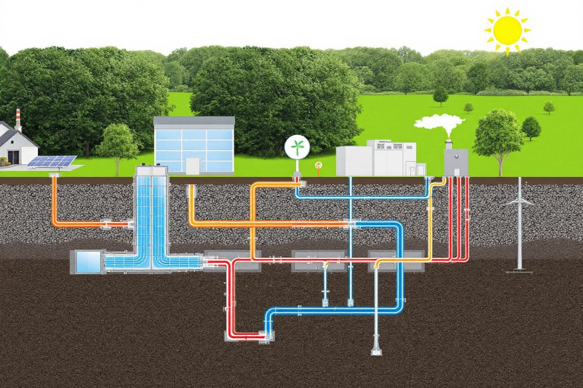
4.1 Identification of local energy resources
ELECTRICITY GENERATION
GEOTHERMAL ENERGY
Determining the potential of a particular reservoir requires geological knowledge and accurate measurements.
Geothermal energy is also available in the ground near the surface due to absorbed solar energy and thermal inertia.
The resources required depend on the heat of the earth, although it is limited to regions with shallow volcanic activity to make drilling costs affordable.
May be used for base load production or for industrial heating processes..
This energy can be used for heating spaces in winter or cooling in summer by means of geothermal heat pumps.
It occupies a relatively small land area, since it uses subway deposits and does not require fuel extraction or import from other areas.
They are characterized by high initial start-up costs and low operating costs.
Geothermal systems generate very low greenhouse gas emissions during their operation.
MOOC 1: Energy sustainability and municipal roadmaps

Slide 50
4.1 Identification of local energy resources
ELECTRICITY GENERATION
Energy consumption in the EU
Currently in the European Union, almost half of the energy consumed is used for heating and cooling. Energy generated from fossil fuels entails a high environmental cost associated with its production, as well as more pollutants in its final use.
European objectives
Following European regulations and objectives, both heating and cooling sectors must necessarily be more efficient, using 100% renewable sources and taking advantage of waste heat.
Urban district networks
Addressing the energy transition at the municipal level involves integrating urban district networks. They contribute to optimizing energy supply and reducing the environmental footprint. In addition, they integrate various energy sources, and allow consumers not to depend on a single source of supply (biomass, solar thermal, etc.).
MOOC 1: Energy sustainability and municipal roadmaps

Slide 51

4.1 Identification of local energy resources
HEATING AND COOLING GENERATION
BIOMASS
Biomass technologies can supply energy to a single building or, through district heating, to several buildings.
Biomass includes organic materials such as wood products, plants and waste (animal, agricultural and fishery). When it comes to generating heat, biomass can be used in centralized generation plants connected to district heating systems or in individual home heating systems.
The required resource/fuel supply must be predictable, sustainably sourced, low-cost, local and adequate in the long term.
Organic waste that cannot be recycled or reused can be used for energy purposes.
Biomass technology is usually planned in the existing district heating plan or waste management facility.
Biomass-based energy represents one of the cheapest renewable energy systems. The cost may increase if a new heating network needs to be installed. .
The ecological impact of the biomass source is the major concern.
MOOC 1: Energy sustainability and municipal roadmaps

Slide 52
4.1 Identification of local energy resources
HEATING AND COOLING GENERATION
COGENERATION PLANT
Cogeneration units usually fit in standard-sized containers, which facilitates their transport and deployment.
It consists of the simultaneous production of electricity and useful heat by an engine running on a single fuel. The heat is recovered instead of being released to the atmosphere or lost through the cooling system and can be used as hot water or steam for heating, cooling, domestic hot water or industrial processes.
Cogeneration units need a fuel to operate, which can be fossil, such as natural gas, or renewable, such as biogas and biomass.
Operating on the basis of the user's heat demand, as excess or curtailed heat is more complicated to manage than electricity.
The cogeneration units are compact and have a high power/volume ratio.
Cogeneration units offer economic and CO2 savings compared to separate production of heat and electricity in two different units. .
The ecological impact of cogeneration depends on the fuel used to run the engines.
MOOC 1: Energy sustainability and municipal roadmaps

Slide 53

4.1 Identification of local energy resources
HEATING AND COOLING GENERATION
HEAT PUMPS
They are usually easy to install in single installations, but can also do larger ones.
They can be used as individual units in dwellings or apartments or as district heating systems driven by heat pumps.
A heat pump transfers thermal energy to or from a renewable heat source, such as air, water or ground, with the help of external energy (electricity or gas).
Heat pumps consume electricity and need access to a heat source or sink, such as ambient or exhaust air, water (groundwater, lakes, sea, ocean, sewage) or ground (geothermal).
They provide at least twice as much energy as they consume.
Land is necessary in the case of district heating or geothermal technology.
Very cost-effective solution depending on the potential of the available energy source, electricity prices and the energy needs of the application.
Negative effects of heat pump appliances can come from refrigerant leakage.
MOOC 1: Energy sustainability and municipal roadmaps

Slide 54
4.1 Identification of local energy resources
HEATING AND COOLING GENERATION
They require distribution piping and are therefore relatively complex to implement unless the distribution piping system is already in place.
DISTRICT HEATING
Technology that supplies heating, hot water or cooling through a system of insulated pipes from a central or distributed generation plant to customers. They are mostly deployed in densely populated urban areas.
Recently, they are being increasingly adopted throughout Europe, as they allow the integration of different types of low-temperature heat sources with local renewable sources.
Can utilize local sources and even waste heat from existing industrial systems or commercial buildings, thus increasing energy efficiency.
Satisfy local heating/hot water/cooling needs, also as a storage system for renewable electricity generation.
Require land for the central plant and for the distribution piping system and are recommended for urban areas.
Economically it depends on the local resources available, the size and load of the system.
Allow the use of a local renewable resource or waste heat to meet heating/cooling energy needs, making a fully sustainable energy system possible.
MOOC 1: Energy sustainability and municipal roadmaps

Slide 55
4.1 Identification of local energy resources
HEATING AND COOLING GENERATION
THERMOSOLAR
Thermosolar technology can be incorporated into existing heating systems.
Most suitable for hot climates, although it can be implemented in existing infrastructure and used in cold climates to partially replace existing energy sources.
Thermosolar technologies extract heat from solar radiation and store it in liquid or gaseous form.
There are two main thermosolar systems: high temperature and low temperature.
High-temperature systems use concentrating technology that concentrates solar irradiation on a small surface area to increase energy absorption, and are most commonly used to generate electricity.
The low-temperature ones absorb the sun's energy through flat-plate collectors or vacuum tubes and are used in domestic and industrial applications.
Can operate independently to supply the heating or cooling needs of a stand-alone energy installation, or in an existing system.
Can be integrated into buildings, such as roof-mounted systems, or can be installed as ground-mounted systems.
Consist of mechanical and piping systems, which require a high capital cost. However, they offer good payback over the life of the project.
Very low ecological impact
MOOC 1: Energy sustainability and municipal roadmaps

Slide 56

4.1 Identification of local energy resources
TRANSPORT
The transport sector represents one of the largest consumers of energy, with a cycle that spans from the production of vehicles to their daily operation and eventual decommissioning. The transition to more sustainable models is transforming both consumption patterns and the necessary infrastructure.
Energy end use
Energy consumption in the transportation sector represents one of the largest energy end uses
Vehicle operation
Daily operation constitutes the main energy consumption in transportation systems.
Electrical infrastructure
Development of new infrastructure needed to support electric vehicles
MOOC 1: Energy sustainability and municipal roadmaps

Slide 57
4.1 Identification of local energy resources
TRANSPORT
CHARGERS FOR EV
The EV charging infrastructure can have a significant impact on the local electricity grid. In case of smart (bi-directional) charging, the EV fleet can contribute to balancing the grid.
Technical Aspects and Network
Benefits and Opportunities
The energy used for recharging can be produced locally by renewable energy sources.
Electric vehicles require high charging power (3.6 kW - 11 kW) compared to typical domestic consumption (2-3 kW). In cases of bi-directional smart charging, they can help to balance the local power grid.
Recharging by local renewable energies
EVs offer a sectoral coupling between the transport and energy sectors.
Transport without direct air pollution
The charging infrastructure does not require a large area of land. The chargers are small (< 1 m²) and can be integrated into existing buildings or parking lots.
Coupling between transportation and energy sectors
Improved battery technology
The initial investment costs may be significant (about 1,000 euros/charger), but they guarantee the coordination of the charging system and operation of EVs.
Allow road transport without direct atmospheric pollution.
MOOC 1: Energy sustainability and municipal roadmaps

Slide 58
4.1 Identification of local energy resources
TRANSPORT
ELECTRIC BOATS AND FERRIES
Require a recharging infrastructure in the port or marina, which should be implemented in coordination with the grid operator and a local municipality.
Electric ships and ferries are very important for the decarbonization of maritime transport in the EU. Mainly important for island areas.
Electric ships have batteries on board and electric motors to propel them 100% of the time, while hybrids only use electric propulsion near coastal regions to reduce emissions and noise pollution.
All-electric boats are usually used as ferries, while hybrids are preferred for cruising or fishing.
Locally produced renewable electricity can be used as fuel, avoiding the import of fossil fuels.
Sustainable solutions for passenger transport, tourism and the island industry (fishing).
Recharging of electric boats can be organized in existing ports and marinas without the need for additional land use.
Electric vessels have higher initial costs due to the need for large batteries and their still low production numbers.
Lower environmental impact during operation by reducing emissions, noise pollution and vibrations.
MOOC 1: Energy sustainability and municipal roadmaps

Slide 59
4.1 Identification of local energy resources
TRANSPORT
HYDROGEN
Hydrogen offers higher energy density compared to electric storage systems, allowing for longer range transportation.
Green Hydrogen
Blue Hydrogen
Gray Hydrogen
It is produced by electrolysis, which splits water into hydrogen and oxygen using electricity. It is the only production process that is virtually carbon-free.
It is also produced by steam reforming, but the production plants are retrofitted with carbon capture, utilization and storage (CCUS) technology.
It is produced from fossil fuels by steam reforming, mainly from methane.
MOOC 1: Energy sustainability and municipal roadmaps

Slide 60

4.2 Existing energy transition measures at
the municipal level
Local Action Plans
Analysis of Island Municipalities
Categories of Actions Identified
Due to the need to create Local Action Plans, the different existing initiatives in which they are framed include different types of actions.
In reference to the Covenant of Mayors initiative, plans of municipalities located on tourist islands in Spain, Italy and Greece have been reviewed in order to identify the main actions proposed at the municipal level and specifically.
Based on the analysis of the plans, the actions were mainly divided into the following:
Municipal buildings and facilities
Industry
Lighting
Buildings
Local electricity production
Resource management
Transport and awareness
MOOC 1: Energy sustainability and municipal roadmaps

Slide 61



4.2 Existing energy transition measures at
the municipal level
It is important to consider the casuistry of the municipalities, i.e., in this case, since they are located on tourist islands, the following is considered:
Canary Islands
Greek Islands
Italian Islands
They are dependent on fossil fuels, so most of the actions are focused on improving energy efficiency, introducing renewable energies, promoting electric vehicles (EV) and energy communities, as well as raising awareness in society.
Their diversity in typology makes it difficult to identify needs, but there is an involvement in improving the energy efficiency of municipal buildings and lighting, as well as in promoting public transport and the purchase of EVs.
There is a greater interest in energy efficiency actions in municipal buildings and equipment, as well as in the promotion of sustainable transport and public awareness.
MOOC 1: Energy sustainability and municipal roadmaps

Slide 62
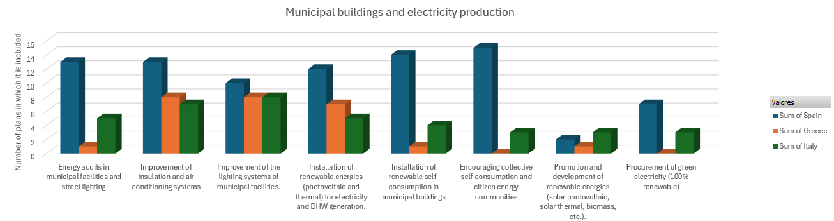
4.2 Existing energy transition measures at
the municipal level
Municipal buildings and electricity production
Municipal buildings are a crucial starting point for TE. Energy efficiency in these spaces is a model for the community, and renewable electricity production, through solar panels or wind turbines, can reduce dependence on fossil fuels.
MOOC 1: Energy sustainability and municipal roadmaps

Slide 63
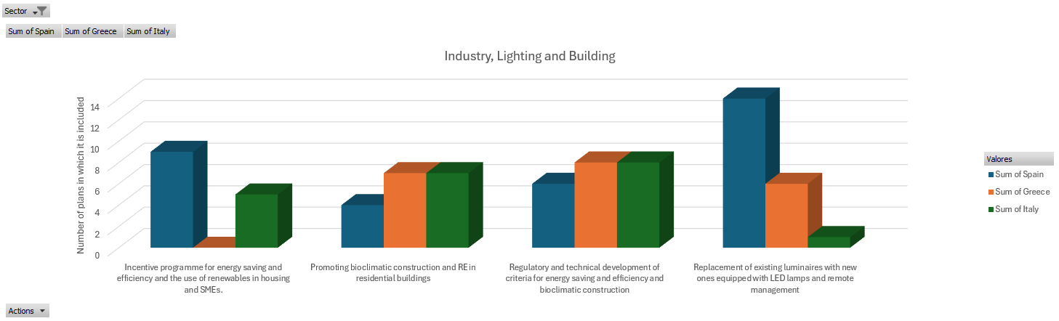
4.2 Existing energy transition measures at
the municipal level
  Industry, Lighting and Building
Industry is another key sector for the energy transition. The implementation of more efficient processes, the use of renewable energies and the reduction of emissions are vital for sustainable development. Energy efficiency measures in public lighting and buildings are equally important to reduce energy consumption.
MOOC 1: Energy sustainability and municipal roadmaps

Slide 64
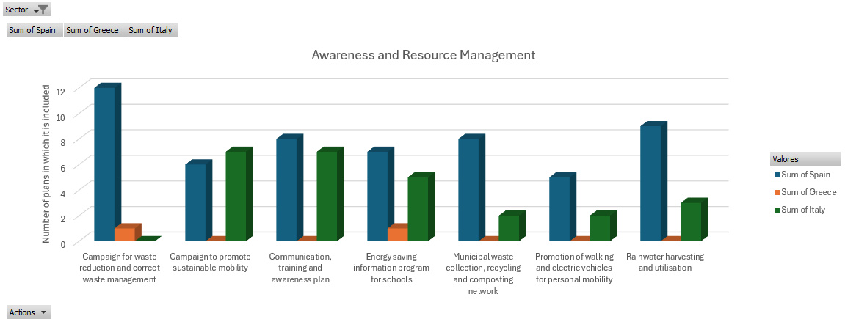
4.2 Existing energy transition measures at
the municipal level
  Awareness
Resource Management
Promoting awareness of the importance of the energy transition is essential. Information campaigns, training and public awareness are essential to encourage the efficient use of energy and the adoption of sustainable practices.
Efficient resource management is a key component of the energy transition. Optimizing water consumption, waste management and promoting recycling are crucial to reducing environmental impact and promoting a more sustainable development model.
MOOC 1: Energy sustainability and municipal roadmaps

Slide 65
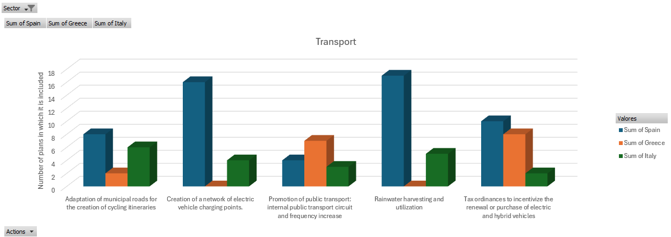
4.2 Existing energy transition measures at
the municipal level
  Transport
Encouraging the use of public transport is essential to reduce traffic and emissions. Improving the frequency and accessibility of public transport, as well as promoting electric vehicles, are important measures for the energy transition. Promoting active mobility, such as walking and cycling, is essential for public health and sustainability. Creating safe bike lanes and promoting cycling for short trips are key measures for the energy transition.
MOOC 1: Energy sustainability and municipal roadmaps

Slide 66

4.3 Identification of energy
transition indicators
1
Evaluating the effectiveness of energy transition plans is crucial to ensure that objectives are being met and to make informed adjustments.
It is important to review the initiatives and reports to study the measures implemented and the objectives to be achieved.
2
3
Identifying key indicators is critical to assessing the progress of the energy transition. Key indicators include energy savings, renewable energy production and CO2 reduction.
MOOC 1: Energy sustainability and municipal roadmaps

Slide 67
4.3 Identification of energy
transition indicators
Total electricity produced (GWh)
Total electricity produced per capita (GWh/person)
Average annual electricity production by source (GWh/time period)
Calculates the total energy produced annually on each island as the sum of the energy produced by each available energy source. It only includes the energy produced or, in other words, generated in the municipality itself.
It represents the amount of electricity produced per person and gives an idea of the total amount of energy generated per municipality per inhabitant. Therefore, this indicator will be influenced by climatic and social characteristics.
Calculates the average electricity production over a period of time by energy source, from both renewable and non-renewable sources.
MOOC 1: Energy sustainability and municipal roadmaps

Slide 68
4.3 Identification of energy
transition indicators
Energy independence (%)
Carbon Intensity (gCO₂eq/kWh)
Carbon intensity per capita (gCO₂eq/(kWh-person)
This indicator calculates the percentage of energy independence of either the island or the municipality, calculated as the total renewable electric energy over the total energy produced.
It refers to the grams of carbon dioxide released to produce one kilowatt hour of electricity. It is therefore an indicator of the degree of purity of the electricity. Depending on the generation sources, the electricity generated will be more or less carbon intensive.
This indicator is based on the previous “Carbon Intensity” and indicates the grams of carbon dioxide emitted to produce one kilowatt hour of electricity per inhabitant.
MOOC 1: Energy sustainability and municipal roadmaps

Slide 69

4.4 Selection of local energy transition actions
After studying different local action plans, a compilation was made of the main actions carried out.
The actions were grouped into different categories, according to those considered in the action plans.
To evaluate the actions, measurement indicators were used to measure annual energy savings, annual CO2 emissions savings and the cost of implementation per 1000 inhabitants.
The categories of actions analyzed are: awareness, industry, transportation and municipal buildings and facilities.
MOOC 1: Energy sustainability and municipal roadmaps

Slide 70

4.4 Selection of local energy transition actions
Energy savings (MWh/year)
CO₂ Savings (tCO2e)
Energy savings (MWh/year)
CO2 Savings (tCO2e)
Awareness actions
Cost (€)
Communication, training and awareness plan
22
8.3
666.67
Energy saving information program for schools
7
3.3
666.67
Campaign to promote sustainable mobility
500
80.0
833.33
Promotion of walking and electric vehicles for personal mobility
500
300.0
10000.00
MOOC 1: Energy sustainability and municipal roadmaps

Slide 71

4.4 Selection of local energy transition actions
Energy savings (MWh/year)
CO2 Savings (tCO2e)
Industry Actions
Cost (€)
Incentive programme for energy saving and efficiency and the use of renewables in housing and SMEs
57
42.9
1714.29
MOOC 1: Energy sustainability and municipal roadmaps

Slide 72

4.4 Selection of local energy transition actions
Energy savings (MWh/year)
CO2 Savings (tCO2e)
Transport Actions
Cost (€)
Creation of a network of electric vehicle charging points
1050
65.0
7500.00
Adaptation of municipal roads for the creation of cycling itineraries
153
49.4
43529.41
Promotion of public transport: internal public transport circuit and frequency increase
550
275.0
17500.00
Tax ordinances to incentivize the renewal or purchase of electric and hybrid vehicles
375
825.0
23125.00
MOOC 1: Energy sustainability and municipal roadmaps

Slide 73
4.4 Selection of local energy transition actions
Energy savings (MWh/year)
CO2 Savings (tCO2e)
Municipal buildings and facilities Actions
Cost (€)
Improvement of insulation and air conditioning systems
15
9.8
32500.00
Energy audits in municipal facilities and street lighting
2
6.3
1666.67
Improvement of the lighting systems of municipal facilities
1000
46.7
33333.33
Installation of renewable self-consumption in municipal buildings
10
45.0
40000.00
Replacement of existing luminaires with new ones equipped with LED lamps and remote management
17
8.0
20000.00
MOOC 1: Energy sustainability and municipal roadmaps

Slide 74

4.4 Selection of local energy transition actions
Energy savings (MWh/year)
Municipal buildings and facilities Actions
CO2 Savings (tCO2e)
Cost (€)
Renewal of the municipal fleet with electric or plug-in hybrid vehicles
57
42.9
1714.29
Procurement of green electricity (100% renewable)
17
9.0
2500.00
Installation of renewable energies (photovoltaic and thermal) for electricity generation and DHW
500
500.0
6666.67
Regulatory and technical development of energy saving and efficiency criteria and bioclimatic construction
533
333.3
2500.00
MOOC 1: Energy sustainability and municipal roadmaps

Slide 75

4.5 Energy impact assessment
1
Evaluating the locally available resources that have been seen throughout the unit allows to identify the input parameters that will give a first estimate of the local energy impact.
It is essential to evaluate the local area including factors such as climate, size of the municipality in terms of inhabitants and available territory, available energy sources and what the local economy is based on.
2
3
It is also important to consider the current governance policy, its priorities and how it intends to address the objectives set by the EU.
4
Define the indicators through which the progress of local actions and their contribution to the achievement of the objectives will be measured.
MOOC 1: Energy sustainability and municipal roadmaps

Slide 76
4.5 Energy impact assessment
4.5 Energy impact assessment
Weather
As a summary, the following outline is presented to represent the proposed methodology for assessing the energy impact of the local area.
The local characteristics will be used as input data for the indicators. The results will make it possible to evaluate the energy situation of the municipality.
Size of the municipality
Identify input values that impact the energy transition at the local level
Inhabitants
Energy sources
Economy
Governance
Total Electricity Produced /Produced per capita
Average annual electricity production by source
Energy independence
Carbon intensity indicator/per capita
Provides added value on the energy situation of the municipality.
In line with the objectives of the European Union.
Provides a current energy scenario at the municipal level
MOOC 1: Energy sustainability and municipal roadmaps

Slide 77
UNIT 5
SELECTION OF THE MOST PROMISING ET SOLUTIONS
MOOC 1: Energy sustainability and municipal roadmaps

Slide 78
UNIT 5. SELECTION OF THE MOST PROMISING ET SOLUTIONS
INDEX
Importance of decision making at the municipal level
1
2
The Analytical Hierarchical Process (AHP)
Definition of local characteristics
3
4
Selection of the most promising energy policies
MOOC 1: Energy sustainability and municipal roadmaps

Slide 79

5.1 Importance of decision making at
the municipal level
Multi-criteria decision making
Multi-criteria decision making is a methodology that considers the simultaneous analysis and evaluation of more than one criterion according to the preferences of the decision maker and the proposed objective.
It allows to obtain an analysis of the different scenarios generated, highlighting the value of the authority's decision, an important approach to address the issue of ET at the municipal level.
Sustainable development
MCDM techniques
The need for sustainable development means that the multi-criteria approach has a major impact on the EU. Sustainability and its implications for the environment are intertwined with decarbonization and climate change mitigation.
Specifically, multi-criteria decision making (MCDM) is applied using various techniques, such as WSM, WPM, PROMETHEE, ELECTRE or TOPSIS, although AHP is the most popular method.
MOOC 1: Energy sustainability and municipal roadmaps

Slide 80
5.2 The Analytical Hierarchical Process (AHP)
AHP is a discrete multi-criteria technique that aims to provide a quantitative evaluation for the alternatives inherent in multi-criteria problems, without the need for decision-makers to make their preferences explicit.
Preferences are inferred from successive comparisons coded according to a conventional scale. Judgments are aggregated into priority vectors within each level, and finally integrated to yield a final overall ranking.
Hierarchical decomposition
Comparative assessment
Synthesis
Target
Criteria
Alternatives
The judgments are aggregated into priority vectors within each level, and finally integrated to result in a final overall ranking.
The elements of the hierarchy are evaluated in pairs, comparing them in relation to the elements of the next higher level of the hierarchy; these comparisons are translated into judgments coded on a conventional scale that usually takes values between 1 and 9.
MOOC 1: Energy sustainability and municipal roadmaps

Slide 81



5.3 Definition of local characteristics
In the municipal case, the multi-criteria evaluation of alternatives is applied to analyze and evaluate feasible solutions to be implemented in SEAPs from a broader approach. Not only are the technical or economic parameters of the implementation of sustainability-related measures, such as photovoltaic solar energy in isolated communities, considered, but also the environmental, social and political variables involved in the final decision. The multi-criteria approach makes it possible to integrate quantitative and qualitative aspects of the solution in the evaluation process.
The main objective is to select the best set of solutions for the Municipal Action Plans to achieve sustainability and decarbonization of the municipality in accordance with municipal priorities and requirements.
For the municipal case, a first selection of alternatives has been proposed, classified according to the studies carried out in: municipal buildings, industry, transport and awareness-raising.
As for the criteria for the local level when classifying alternatives, the following are considered: technical, social, economic, environmental and political.
MOOC 1: Energy sustainability and municipal roadmaps

Slide 82


5.3 Definition of local characteristics
The criteria for weighting and weighting the different actions have been classified into the 5 types set out below. Specifically, at the local level, each criterion should take into account aspects such as those introduced in the following tables:
Technical
Urgency of action
Effectiveness in the face of climate change
Impact at the municipal level
Social
Impact and improvement for the municipality
Acceptability by the involved parties
Environmental
Innovation and progress for the municipal area
Relevance for the climate risk of the municipality
Economical
Political
Financing/cost ratio or financial capacity of the municipality.
Benefits generated in relation to the cost of the action.
Visibility from the point of view of the media
Possibility to collaborate with other companies and interested agents.
MOOC 1: Energy sustainability and municipal roadmaps

Slide 83





5.4 Selection of the most promising
energy policies
Selecting the most promising energy policies involves assessing the local criteria described above, for which a number of indicators have been defined. These indicators are also used in part as information within the SECAPs, and are therefore relevant information.
TECHNICAL
SOCIAL
Technology maturity
Percentage of renewable energies installed at the municipal level (%)
Annual energy savings (MWh)
Municipal Energy Consumption (%)
Annual renewable energy production (MWh)
Technology implementation rate (%)
Job creation
Public acceptance
POLITICAL
Political acceptance
Compatibility with national policies
Compatibility with regional policies
Compatibility with European policies
ECONOMICAL
Financing and funds available at the municipal level (m€)
Annual profitability (kWh/€)
Investment (m€)
ENVIRONMENTAL
Reduction of CO2 emissions (tCO2)
Impact on biodiversity
Change in land use
MOOC 1: Energy sustainability and municipal roadmaps

Slide 84

5.4 Selection of the most promising
energy policies
After studying different initiatives at the local level (Covenant of Mayors for Climate and Energy, Municipal Action Plans, Clean Energy for the EU Islands, etc.), as well as existing action plans, some of the most commonly used energy actions or policies are presented below. The actions have been classified according to the above mentioned classification: municipal buildings, industry, transport and awareness raising.
MUNICIPAL BUILDINGS
Improve insulation of municipal buildings. Window improvements (glass replacement) and facade insulation.
Improvement of municipal lighting. Replacement of lighting fixtures with more efficient ones.
Heating, ventilation and air conditioning systems. Upgrading of heating, cooling and DHW systems.
Introduction of renewable energies and self-consumption. Possibility of integrating renewable energies such as: solar thermal, photovoltaic and biogas, as well as introducing self-consumption at the municipal level.
Municipal vehicle fleet. Current municipal vehicles: retired versus acquired with new technologies (hybrid and electric).
MOOC 1: Energy sustainability and municipal roadmaps

Slide 85

5.4 Selection of the most promising
energy policies
INDUSTRY
Process improvement. Actions to improve energy measurement and control elements, as well as energy optimization.
Renewal of equipment. Replacement, renovation and improvement of process machinery with more energy efficient machinery.
Industrial buildings. Improvement of insulation, renovation of facilities, air conditioning and lighting systems.
Introduction of renewable energies and self-consumption. Possibility of integrating renewable energies such as: solar thermal, photovoltaic and biogas, as well as introducing self-consumption at the municipal level.
Change of the energy vector. Diversification of energy sources towards less polluting ones and replacement of heating and pumping equipment with more efficient sources.
MOOC 1: Energy sustainability and municipal roadmaps

Slide 86




5.4 Selection of the most promising
energy policies
TRANSPORT
Cycling routes. Emission savings per km cycled compared to conventional vehicles.
Network of EV charging points. Reduction of emissions per charging point installed.
Promotion of public transport. Municipal transport awareness measures.
AWARENESS
Ecomovil. Emissions savings per km traveled by bicycle compared to conventional vehicles.
Network of EV charging points. Reduction of emissions per recharging point installed.
Promotion of public transport. Municipal transport awareness measures.
MOOC 1: Energy sustainability and municipal roadmaps

Slide 87
UNIT 6
ROADMAP DEVELOPMENT
MOOC 1: Energy sustainability and municipal roadmaps

Slide 88
UNIT 6. ROADMAP DEVELOPMENT
INDEX
Compilation of ET objectives and strategies
1
2
Alignment with municipal objectives and available local resources
Planning of measures
3
4
Definition of the indicators needed to achieve and measure the strategies
Roadmaps Examples
5
MOOC 1: Energy sustainability and municipal roadmaps

Slide 89

6.1 Compilation of ET objectives
and strategies
1
To tackle climate change, energy transition, decarbonization and the demographic challenge, the role of small municipalities is essential.
2
It is important to be familiar with the right tools, since these municipalities are a key element in the change of energy model that we need so much, which also implies a social, cultural and environmental change.
3
All agencies and entities must be aligned and have the necessary tools to make quick and correct decisions that contribute to solving the problems we have in terms of pollution, energy dependence, inefficiency and increased resource costs.

Slide 90

6.1 Compilation of ET objectives
and strategies
Energy transition initiatives
Covenant of Mayors for Climate and Energy
Initiative launched by the European Commission to support municipalities. The aim is to encourage municipalities to make political commitments and begin to take measures to anticipate and adapt to the inevitable effects of climate change that are already occurring.
The commitments of the adhering municipalities include reducing CO2 emissions by 40% by 2030, increasing energy efficiency by 27%, increasing the use of energy from renewable sources by 27%, drawing up an inventory of emissions, creating an Action Plan for Climate and Sustainable Energy, as well as monitoring reports.
90

Slide 91
6.1 Compilation of ET objectives
and strategies
Energy transition initiatives
Clean Energy Package
Package of tools and new legislative proposals presented by the European Commission at the end of 2016, whose objectives in terms of matter and energy include:
40% reduction in GHG emissions, compared to 1990.
32% of renewables in the EU's gross final energy consumption in 2030.
26% reduction in EU primary energy consumption compared to 2005.
20% reduction in EU final energy consumption compared to 2005.
At least 32.5% improvement in energy efficiency compared to 2005 at EU level, expressed in primary or final energy consumption.
15% electricity interconnection of Member States
In addition, some directives were also included in the package:
Energy Efficiency in Buildings Directive (Directive 2018/844). This is a long-term strategy to support the renovation of the entire building stock, with the aim of achieving high energy efficiency and decarbonization by 2050.
MOOC 1: Energy sustainability and municipal roadmaps

Slide 92
6.1 Compilation of ET objectives
and strategies
Energy transition initiatives
Clean Energy Package
Energy Efficiency Directive (Directive 2018/2002). It proposes the improvement of energy efficiency to reach at least 32.5% at EU level by 2030.
Directive for the promotion of the use of energy from renewable sources (Directive 2018/2001). It proposes an important novelty, which is the recognition of self-consumers of renewable energies, both individual and collective, acquiring the right to be able to generate, consume, store, manage and sell their own electricity.
Regulation on the Governance of the Energy Union and Climate Action (Regulation 2018/1999). This regulation aims to lay the necessary legislative foundations for reliable, inclusive, integrated, cost-efficient, transparent and predictable governance, ensuring the achievement of the objectives set for 2030 and in the long term, through complementary, coherent and ambitious efforts, while limiting administrative complexity.
Directive on common rules for the internal electricity market (Directive 944/2019)3 and Regulation on the internal electricity market (Regulation 943/2019). It allows and encourages demand-side management through the aggregation of electricity markets thus facilitating that active citizens, through their consumption, storage capacity or self-generated electricity, can participate in the electricity markets alongside large producers, facilitating the flexibility of the electricity market.
MOOC 1: Energy sustainability and municipal roadmaps

Slide 93
6.1 Compilation of ET objectives
and strategies
Energy transition initiatives
European Green Deal
This is a long-term plan created in December 2019 to make Europe the first continent to achieve climate neutrality by 2050. Among the various actions, the following stand out:
NextGeneration EU Funds. NextGenerationEU temporary recovery instrument, subsequently approved and with more than €800 billion, which seeks to mitigate the effects caused by the pandemic and achieve a greener, more digital, resilient and better adapted Europe, both to current and future challenges.
Fit for 55” program. Following the COVID10 pandemic, new regulatory and legal tools were proposed that stand out for their relevance, impact and innovation to accelerate European climate action, such as:
    Increase in the financial amount of the Innovation and Modernization Funds.
    Revision of the Energy Taxation Directive proposing to align the taxation of energy products with EU energy and climate policies.
    The GHG emissions reduction target is raised by 55% by 2030.
    The Energy Efficiency Directive will be revised by increasing the current target from 32.5% to 36% for primary energy consumption and 39% for final energy from 2005..
MOOC 1: Energy sustainability and municipal roadmaps

Slide 94
6.1 Compilation of ET objectives
and strategies
Energy transition initiatives
European Green Deal
European Climate Law. Framework to make the commitment made in the “Paris Agreement” to achieve climate neutrality in the EU by 2050 a binding obligation for EU partners.
REPowerEU Plan. The energy crisis caused by the invasion of Ukraine, with the problem of the cessation of exports, forced the EU to reduce its dependence on fossil fuels from Russia, as well as to make rapid progress in the ecological transition. To this end, in May 2022 the EC presented this plan, the purpose of which is to further increase the energy efficiency targets set in the FF55, which proposed an improvement of 9%, from the projection made in 2020, to 13% by 2030, in addition to an advance in the generation of renewables in the electricity system from 40% to 45%.
    The EU Solar Energy Strategy, which aims to install more than 320 GW of solar PV and 600 GW by 2030.
    A rooftop solar initiative with a legal obligation to install solar panels on new public, commercial and new residential buildings.
    A Methane Action Plan to increase production to 35 million cubic meters by 2030.
MOOC 1: Energy sustainability and municipal roadmaps

Slide 95

6.1 Compilation of ET objectives
and strategies
Energy transition initiatives
Electrifying demand
Electrifying demand means replacing fossil fuels with electricity in all economic sectors and activities. This implies a series of benefits such as:
Reduction of CO2 emissions
Improved energy efficiency
Enables energy independence by not relying on fossil fuels from other regions, which can lead to political conflicts
Can cover different sectors: from transport, residential to industrial
It would allow to increase energy self-sufficiency with clean, efficient and cheap energy
MOOC 1: Energy sustainability and municipal roadmaps

Slide 96


6.1 Compilation of ET objectives
and strategies
Energy transition initiatives
Democratization of energy
Adaptation to climate change
Since energy is a scarce commodity and a basic necessity for all citizens, democratizing it would mean allowing all citizens to buy, sell, manage, generate and store their own energy.
It consists of taking measures that help and facilitate the management of the current consequences of climate change. In other words, anticipating possible impacts, such as heat waves, droughts, floods or desertification, implies adapting to climate change.
MOOC 1: Energy sustainability and municipal roadmaps

Slide 97
6.2 Alignment with municipal objectives and
available local resources
Energy sustainability
Lines of action
To achieve energy sustainability and decarbonization in municipalities, it is necessary to make energy consumption as efficient as possible, eliminate the use of fossil fuels and progressively replace them with clean and renewable energy sources.
The main lines of action proposed at the municipal level and on which each municipality should study the current status are as follows:
Distributed renewable energy generation and self-consumption. It allows obtaining one's own energy and managing it according to one's own needs, in addition to being sustainable and cheap, and thus ceasing to depend on fossil fuels. Distributed energy generation and self-consumption, unlike centralized generation, does not require large extensions of land.
Energy refurbishment. This consists of reducing the energy consumption of homes through efficiency measures, such as the replacement of gas boilers with heat pumps, and building renovation, such as insulation work on the building envelope.
Sustainable mobility. It intends to use active mobility as a substitute for own combustion vehicles, promoting public transportation and the use of electrified vehicles for when it is necessary to move to other more distant points.
Urban regeneration. Transversal line that is based on creating a correct connection between all the actions and that allows the integration of the rest of the measures within the urban space, conferring much more scope and strength.
MOOC 1: Energy sustainability and municipal roadmaps

Slide 98
6.3 Planning of measures
Each measure to be adopted within a roadmap must contain the necessary information to classify and temporarily organize the measure, understand its objective and the resources needed to implement it during the time required.
Categorization of measures
Information on each measure
This refers to the categories into which the measures can be classified, for example: those mentioned in unit 4 (municipal buildings and equipment, industry, lighting, buildings, local electricity production, resource management, transport and awareness) or the action lines in the previous slide.
The information to be included for each measure is:
Category or line of action
Duration, Objective and description of the measure
Investment
MOOC 1: Energy sustainability and municipal roadmaps

Slide 99



6.3 Planning of measures
Timeline
Sectors involved
Implementation considerations
Use of the Gantt Chart as a graphical tool to show the expected time commitment for different tasks to achieve the goals in 2030 or 2050.
Coordination between multiple sectors including:
Each measure requires a detailed analysis of:
Public Sector (administration)
Main benefits at the municipal level
Residential Sector
Primary sector
Possible difficulties during implantation
Secondary sector (industrial)
Resources required for implementation
Tertiary sector (services)
MOOC 1: Energy sustainability and municipal roadmaps

Slide 100

6.4 Definition of the indicators needed to
achieve and measure the strategies
These are the indicators or also called KPIs (Key Performance Indicator) that allow quantifying the evolution of the objective to be achieved. Depending on their scope, they can be classified as general or specific.
KPIs GENERALES
Son These are indicators that are transversal to all the measures and that together will give a general idea of the scope of the action plan. Some of them are:
Energy consumption savings (MWh): Savings in energy consumption with the implementation of the measure.
Emissions savings (tCO2): Reduction in greenhouse gas emissions with the implementation of the measure.
Economic savings (€): Economic savings achieved once the measure has been implemented.
Degree of self-sufficiency: Energy capacity of the municipality to meet its consumption demand.
MOOC 1: Energy sustainability and municipal roadmaps

Slide 101
6.4 Definition of the indicators needed to
achieve and measure the strategies
SPECIFIC KPIs
These are indicators specific to the measures that allow the development and progress of each of them to be evaluated. Depending on the measure, some of the indicators could be
Installed self-consumption capacity in the municipality (MW)
Self-consumption production in the municipality (GWh)
No. of self-consumption installations
Installed power of renewable energy in the municipality (MW)
Buildings rehabilitated in full (No. and %)
Boilers in vulnerable buildings (no., % and fuel type)
Industry
Municipal buildings and facilities
Number of computer equipment with programmed shutdown.
Number of companies with energy management system or monitored.
No. of buildings with optimized air conditioning demand.
No. of industries adhered to a local energy community.
Energy consumption of equipment and facilities (kWh/year).
No. of contracts that include clauses with environmental and energy efficiency criteria.
Transport
Awareness
Vehicles replaced (No. and %)
Diesel and gasoline vehicles replaced (no. and %)
Vehicles registered annually (no. and growth/decrease previous year)
Electric bicycles (no. and % of population)
Bicycle lanes (km and % of total)
No. of citizens trained in energy saving and efficiency.
No. of courses carried out.
No. of self-consumption installations.
Installed power of renewable energy in the municipality (MW)
Buildings fully rehabilitated (No. and %)
Boilers in vulnerable buildings (no., % and fuel type)
MOOC 1: Energy sustainability and municipal roadmaps

Slide 102
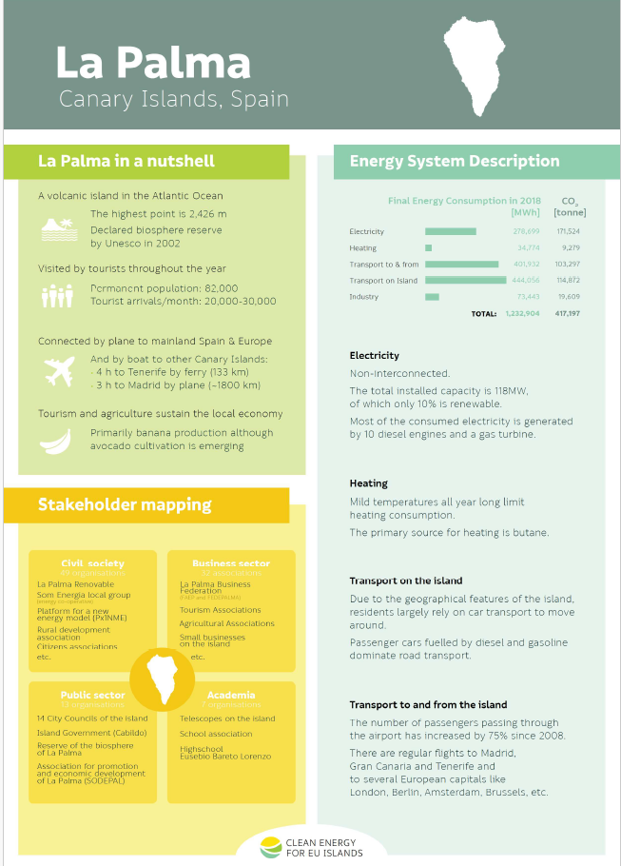
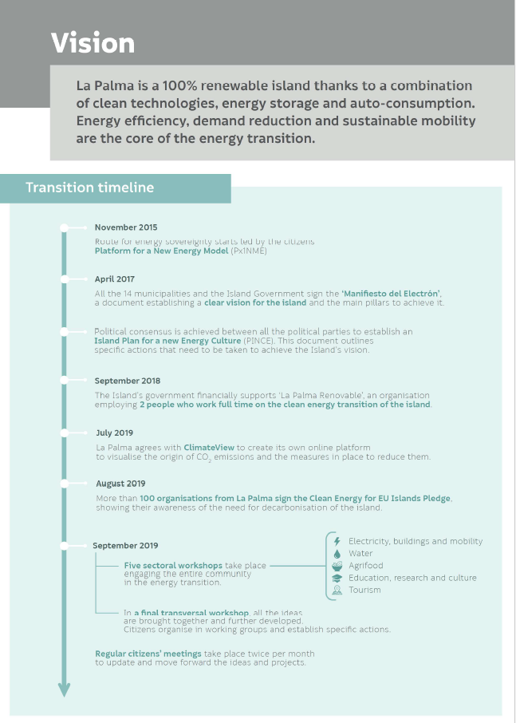
6.4 Definition of the indicators needed to
achieve and measure the strategies
6.5 Roadmaps Examples
As we have seen throughout the course, a roadmap can be given and developed in different ways, its scope can be at island, regional, city or municipal level, and it includes actions that favor the achievement of objectives.
The format of representation depends on the initiative in which it is framed, if applicable. For example, for the “Clean Energy for the EU Islands” initiative, the format adopted is the one shown on the right for the island of La Palma (Canary Islands, Spain).
MOOC 1: Energy sustainability and municipal roadmaps

Slide 103
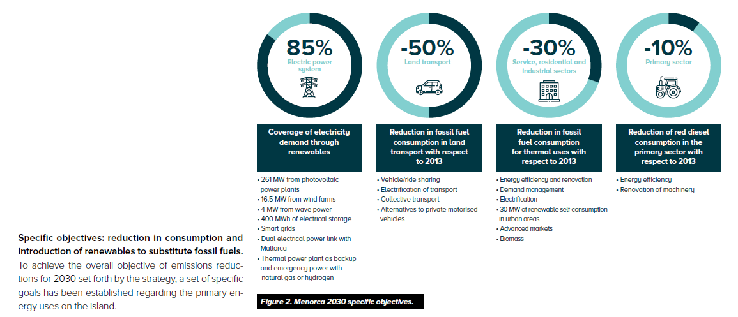
6.4 Definition of the indicators needed to
achieve and measure the strategies
6.5 Roadmaps Examples
Another context in the creation of a roadmap is framed in order to achieve a specific objective.
This is the example of the decarbonization of the energy system of the island of Menorca (Balearic Islands, Spain). It is a roadmap created in conjunction with the European Commission, the Clean Energy Initiative for EU islands and other local companies, to achieve the transformation of the current energy model to one based on renewables by 2030. In this case, specific actions are proposed as shown in the image on the right.
MOOC 1: Energy sustainability and municipal roadmaps

Slide 104
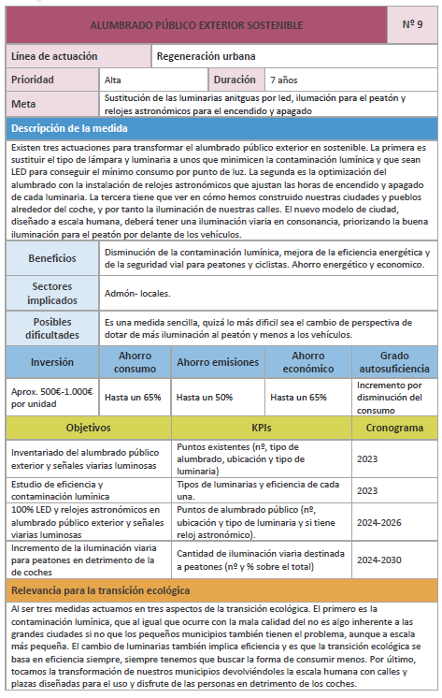
6.4 Definition of the indicators needed to
achieve and measure the strategies
6.5 Roadmaps Examples
Finally, another way to approach a roadmap is to make a detailed description of each of the actions proposed within the action plan. On the right is an example of one of the actions at the municipal level of Sant Antoni de Portmany on the island of Ibiza (Balearic Islands, Spain).
Describing in detail each of the actions allows to define responsibilities, to carry out a correct monitoring of the action, to properly manage the necessary resources, to know all the stakeholders involved and their implication throughout the implementation of the action.
MOOC 1: Energy sustainability and municipal roadmaps

Slide 105








MOOC 1
Energy sustainability and municipal roadmaps

