Slide 1
CASE STUDY 1
Decision-Making Process with a multi-criteria approach

Slide 2
MOOC 2 - CASE STUDY 1
Case study to use the multi-criteria decision method to select municipal alternatives.
STEPS
Selection of municipal alternatives to be included in the action plan
Identify municipal priorities in terms of sustainability
Allocate weights according to municipal priorities and obtain a list of the most promising actions

Slide 3
MOOC 2 - CASE STUDY 1
Selection of municipal alternatives to be included in the action plan
Any action related to the municipal level can be included in the Action Plan, and will result in municipal savings in terms of energy and emissions. However, some actions are proposed from the GENERA project that have been studied and can be selected for the case study.
The actions in this case have been divided according to categories.
To evaluate the actions, measurement indicators were used to measure annual energy savings, annual CO2 emissions savings and the cost of implementation per 1000 inhabitants.

Slide 4
MOOC 2 - CASE STUDY 1
Selection of municipal alternatives to be included in the action plan
Awareness
Actions | Energy savings (MWh/year) | CO₂ Savings (tCO2e) | Cost (€)
Communication, training and awareness plan | 22 | 8.3 | 666.67
Energy saving information program for schools | 7 | 3.3 | 666.67
Campaign to promote sustainable mobility | 500 | 80.0 | 833.33
Promotion of walking and electric vehicles for personal mobility | 500 | 300.0 | 10000.00
Industry
Actions | Energy savings (MWh/year) | CO₂ Savings (tCO2e) | Cost (€)
Incentive programme for energy saving and efficiency and the use of renewables in housing and SMEs | 57 | 42.9 | 1714.29

Slide 5
MOOC 2 - CASE STUDY 1
Selection of municipal alternatives to be included in the action plan
Transport
Actions | Energy savings (MWh/year) | CO₂ Savings (tCO2e) | Cost (€)
Creation of a network of electric vehicle charging points | 1050 | 65.0 | 7500.00
Adaptation of municipal roads for the creation of cycling itineraries | 153 | 49.4 | 43529.41
Promotion of public transport: internal public transport circuit and frequency increase | 550 | 275.0 | 17500.00
Tax ordinances to incentivize the renewal or purchase of electric and hybrid vehicles | 375 | 825.0 | 23125.00

Slide 6
MOOC 2 - CASE STUDY 1
Selection of municipal alternatives to be included in the action plan
Municipal buildings and facilities
Actions | Energy savings (MWh/year) | CO₂ Savings (tCO2e) | Cost (€)
Improvement of insulation and air conditioning systems | 15 | 9.8 | 32500.00
Energy audits in municipal facilities and street lighting | 2 | 6.3 | 1666.67
Improvement of the lighting systems of municipal facilities. | 1000 | 46.7 | 33333.33
Installation of renewable self-consumption in municipal buildings | 10 | 45.0 | 40000.00
Replacement of existing luminaires with new ones equipped with LED lamps and remote management | 17 | 8.0 | 20000.00

Slide 7
MOOC 2 - CASE STUDY 1
Selection of municipal alternatives to be included in the action plan
Municipal buildings and facilities
Actions | Energy savings (MWh/year) | CO₂ Savings (tCO2e) | Cost (€)
Renewal of the municipal fleet with electric or plug-in hybrid vehicles | 57 | 42.9 | 1714.29
Procurement of green electricity (100% renewable) | 17 | 9.0 | 2500.00
Installation of renewable energies (photovoltaic and thermal) for electricity generation and DHW | 500 | 500.0 | 6666.67
Regulatory and technical development of energy saving and efficiency criteria and bioclimatic construction | 533 | 333.3 | 2500.00

Slide 8
MOOC 2 - CASE STUDY 1
STEPS
2. Identify municipal priorities in terms of sustainability
The next step consists of identifying priorities at the municipal level. This will depend on the municipality's objectives, the time period and the resources available to achieve them.
Some of the priorities that may be considered at the municipal level are:
MUNICIPAL PRIORITIES
- Raise awareness and educate citizens about climate change
- Promote energy efficiency and the use of renewable sources
- Conducting energy audits in municipal buildings and schools
- Inclusion of photovoltaic systems in buildings and land in the municipality, as well as promoting their installation at the individual level
- Assistance to local companies to create new job opportunities related to energy efficiency
- Promotion of recycling and organics reduction

Slide 9
MOOC 2 - CASE STUDY 1
3. Allocate weights according to municipal priorities and obtain a list of the most promising actions
Once the priorities have been identified at the municipal level, it is interesting to establish an order of importance, as it will be important to know it for the following steps.
MUNICIPAL PRIORITIES
1 | - Raise awareness and educate citizens about climate change
2 | - Promote energy efficiency and the use of renewable sources
3 | - Conducting energy audits in municipal buildings and schools
4 | - Inclusion of photovoltaic systems in buildings and land in the municipality, as well as promoting their installation at the individual level
5 | - Assistance to local companies to create new job opportunities related to energy efficiency
6 | - Promotion of recycling and organics reduction

Slide 10
MOOC 2 - CASE STUDY 1
3. Allocate weights according to municipal priorities and obtain a list of the most promising actions
Following this, it is proposed to use the “SuperDecisions” software to obtain the final list of actions with the most promising ones according to the priorities identified.
The different clusters in which the items to be taken into account will be classified must be defined. In this case, three are proposed, but as many levels as necessary can be included according to the defined needs:
Target: in this case the target will be the list of the most promising measures.
Categories or criteria: includes the different areas of interest of the municipal sector. Each municipality may have different areas, in this case it is proposed: building improvements, social, transportation and industry.
Alternatives: the different actions to be evaluated at the municipal level.

Slide 11
MOOC 2 - CASE STUDY 1
3. Allocate weights according to municipal priorities and obtain a list of the most promising actions
In order to add this to the software, 3 “Clusters” must be created and the corresponding “Nodes” must be added to each cluster as shown in the following figure.

Slide 12
MOOC 2 - CASE STUDY 1
3. Allocate weights according to municipal priorities and obtain a list of the most promising actions
Then, within each cluster, each node must be related to those considered appropriate. That is, in the social area may include the promotion of public transport and electric vehicles, but not the improvement of municipal facilities.
This is performed by clicking on each node and clicking on: “Node connexions from”. Once this is completed, each cluster will have relationships with other clusters represented by an arrow.
It is possible to observe the relationships of each node by selecting “Highlight connections from this node”.

Slide 13
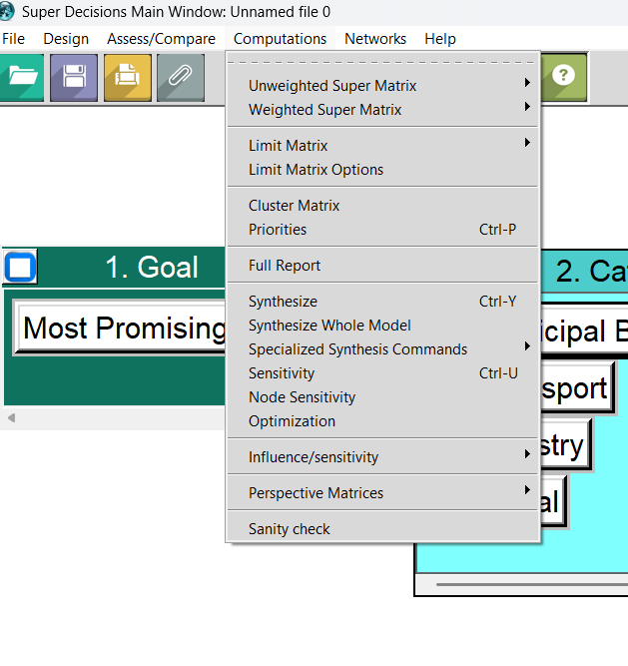
MOOC 2 - CASE STUDY 1
3. Allocate weights according to municipal priorities and obtain a list of the most promising actions
When all clusters have been prioritized, the “synthesize complete model” option must be selected in the computations tab.
Once they have been synthesized, the option to obtain the “Full Report” can be selected, which provides complete information on the generated model.
2
1

Slide 14
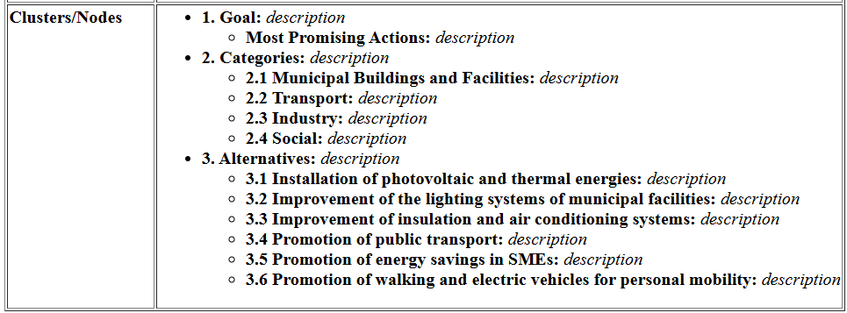
MOOC 2 - CASE STUDY 1
3. Allocate weights according to municipal priorities and obtain a list of the most promising actions
Finally, the final ranking is obtained according to the priorities implemented.

Slide 15
MOOC 2 - CASE STUDY 1
Afterwards, create your own ranking appropriate to the municipality you are studying.
Selection of municipal alternatives to be included in the action plan
CATEGORIES | MEASURES
 | - - -
 | - - -

Slide 16
MOOC 2 - CASE STUDY 1
2. Identify municipal priorities in terms of sustainability
Enter the priorities identified at the municipal level in the municipality of study.
MUNICIPAL PRIORITIES

Slide 17
MOOC 2 - CASE STUDY 1
3. Allocate weights according to municipal priorities and obtain a list of the most promising actions
Using the “SuperDecisions” software, generate your own ranking of municipal actions.
…
…
…
…
…

Slide 18
MOOC 2 Energy transition measurement and monitoring tools

