Slide 1
MOOC 3: BUSINESS AND REGULATORY ETHICAL ASPECTS UNIT 1: INTRODUCTION
Prof. Constantinos S. Psomopoulos, UniWA
June 2024

Slide 2
MOOC 3: BUSINESS AND REGULATORY ETHICAL ASPECTS UNIT 1: INTRODUCTION
Description of the Unit
This unit is targeting the business sector and its role on addressing the Ethical, Societal and Justice issues of Energy and Energy Transition (ET).
Target Audience is mainly the businesses involved in the delivery of solutions to support ET (e.g., equipment provides, services’ providers, etc) and companies that will benefit from the ET.
Learning Outcomes
Provide an overview of the role of business in ethical and social justice of ET, both in terms of providers and beneficiaries.
2

Slide 3
MOOC 3: BUSINESS AND REGULATORY ETHICAL ASPECTS UNIT 1: INTRODUCTION
Introduction
Energy abundance in the so called Western world, as well as the relatively low energy prices, has led to the consideration of Energy as not not having any ethical or social aspects related to it.
However, electrification of a country is one of the basic indices for measuring the level of development. For instance, electricity availability to households, is a contributor to accounts for approximately 5,5% in the Multidimensional Poverty Index (MPI) of United Nations Development Program (United Nations Development Program, 2023).
Energy is considered a common good and this depicts the fact that is strongly related to ethical and social issues.
3

Slide 4
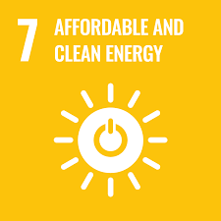
MOOC 3: BUSINESS AND REGULATORY ETHICAL ASPECTS UNIT 1: INTRODUCTION
Introduction
Several theoretical works explain and detail the subject of the social and ethical implications of Energy. We will elaborate on this, by explaining how this is articulated in the United Nations framework for Sustainable development.
Social Development is one of the three elements of Sustainable Development, together with environmental and economic Development. Energy is included in the United Nations 27 goals for sustainable development. Specifically goal No7, is about affordable and clean energy (United Nations, n.d.).

Slide 5
MOOC 3: BUSINESS AND REGULATORY ETHICAL ASPECTS UNIT 1: INTRODUCTION
Socio-Energy System Design
Thus transformation of the energy systems in order to deliver affordable clean energy following the SDG7 is more than technology and includes ethics.
In literature are recognized generally three key facts about energy systems that are particularly significant in the context of large-scale energy transitions.
The first is that energy systems are not merely technological systems but rather systems that closely intertwine technologies with a wide range of people: investors, workers, engineers, industrialists, customers, users, citizens, etc.
Energy transitions, therefore, are not simply shifts in fuel or the technological basis of energy production and/or consumption.
5

Slide 6
MOOC 3: BUSINESS AND REGULATORY ETHICAL ASPECTS UNIT 1: INTRODUCTION
Socio-Energy System Design
Instead, these technical changes occur in parallel, and in relation to and exchange with, changes in values, decisions, behaviors, relationships, practices, and institutions.
Past transitions make clear, in fact, that often the most important aspects of major energy transitions are the accompanying social, economic, and political reorganization.
The second key fact follows from the first. Energy transitions not only reorganize energy production and consumption, they also redistribute power, wealth, risk, vulnerability’ resilience, etc.
The ethics of energy transitions is thus bound up with the reallocation of important societal outcomes, on scales from the individual to the globe.
6

Slide 7
MOOC 3: BUSINESS AND REGULATORY ETHICAL ASPECTS UNIT 1: INTRODUCTION
Socio-Energy System Design
In imagining and fashioning energy systems for the future, therefore, it is crucial to design and plan for integrated socio-energy systems and not just for energy technologies.
Unfortunately, this is far from our current practice, either in energy engineering or energy policy.
The third key fact is that energy technologies are flexible in design, especially as they are incorporated into larger social, economic, and technological systems.
7

Slide 8
MOOC 3: BUSINESS AND REGULATORY ETHICAL ASPECTS UNIT 1: INTRODUCTION
Socio-Energy System Design
For example PV systems are not all alike, but far more importantly, the organization of PV system into a working energy delivery system can take strikingly different forms, ranging from small solar and/or rooftop systems to utility-scale power plants.
Around each of these technologies, different social and business models are possible.
The net result is a wide range of opportunities for socio-energy system design, often with radically distinct ethical profiles.
8

Slide 9
MOOC 3: BUSINESS AND REGULATORY ETHICAL ASPECTS UNIT 1: INTRODUCTION
Energy Transition Ethics
Ethics is the practice of judging right and wrong.
In modern societies, this is inevitably a complex, multi-faceted, and context dependent exercise-and energy transitions are no exception.
Diverse traditions of ethical analysis approach this complexity from distinct perspectives, bringing important questions to bear on considerations of the ethics of energy transitions.
9

Slide 10
MOOC 3: BUSINESS AND REGULATORY ETHICAL ASPECTS UNIT 1: INTRODUCTION
Energy Transition Ethics
One important set of questions emphasizes distribution:
who benefits, who bears the burden?
Another asks about voice and authority:
who participated, in what ways, and to what effect?
Still a third focuses on injustice, especially when injustice is systematic and seeming integrated into the design of processes or outcomes.
10

Slide 11
MOOC 3: BUSINESS AND REGULATORY ETHICAL ASPECTS UNIT 1: INTRODUCTION
Energy Transition Ethics
Finally, a fourth attends to organizational values and practices, especially with regard to the rights and responsibilities of professionals, employers, employees, contractors, clients, and so forth.
In all of these dimensions, ethics operates at the level of individuals (what has come to be understood as micro-ethics) as well as at the level of organizations, professions, and societies (what has come to be understood as macro-ethics).
Ethical questions permeate the planning and execution of energy transitions.
11

Slide 12
MOOC 3: BUSINESS AND REGULATORY ETHICAL ASPECTS UNIT 1: INTRODUCTION
Energy Transition Ethics
At the most macro-scale, a range of questions could be, for example:
how much longer continuing to pump carbon into the atmosphere can be justified, given its projected impacts on future generations;
who is responsible for taking action to reduce carbon emissions;
who will pay for those reductions; and
what other sacrifices are justified or required in the face of impending climate change.
Meso-scale questions directly impact energy system design and thus the work of engineers transforming the energy system. These are applying in the island scale and impacts the most
12

Slide 13
MOOC 3: BUSINESS AND REGULATORY ETHICAL ASPECTS UNIT 1: INTRODUCTION
Energy policy
Energy policy is the framework that addresses all of the aspects related to energy: type of energy, production, pricing, distribution and availability. Policy is developed usually on country level, since main policy is applied on country/states level. But energy policy is also developed on global or regional level by relevant institutions (United nations, European Union) , A country energy policy can be detailed in policies for specific regions in the country.
Some typical differentiation of policies for energy, can apply between
rural and urban areas
areas with different economic activities, eg agriculture, industrial, touristic
off shore/remote areas :islands, overseas, out of borders).

Slide 14
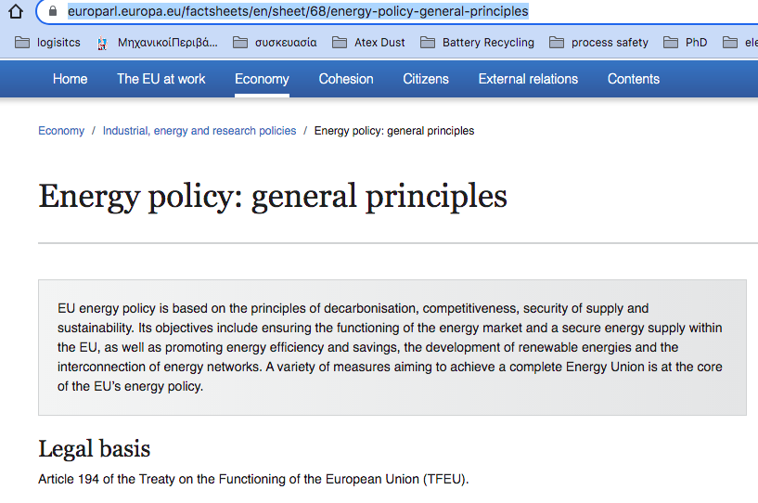
MOOC 3: BUSINESS AND REGULATORY ETHICAL ASPECTS UNIT 1: INTRODUCTION
Energy policy
Energy policy is drafted based on values and aims to a scope.
You can discover yourself the general policy of European Union about Energy:
https://www.europarl.europa.eu/factsheets/en/sheet/68/energy-policy-general-principles
Can you find the four principles that is based on?

Slide 15
MOOC 3: BUSINESS AND REGULATORY ETHICAL ASPECTS UNIT 1: INTRODUCTION
Energy policy
The Energy policy of European Union is based on the following four principles :
decarbonization,
competitiveness,
security of supply,
sustainability.
https://www.europarl.europa.eu/factsheets/en/sheet/68/energy-policy-general-principles

Slide 16
MOOC 3: BUSINESS AND REGULATORY ETHICAL ASPECTS UNIT 1: INTRODUCTION
Energy policy
The objectives of the EU Energy Policy include :
ensuring the functioning of the energy market
a secure energy supply within the EU,
promoting energy efficiency and savings,
the development of renewable energies
the interconnection of energy networks.
A complete Energy Union in EU.
https://www.europarl.europa.eu/factsheets/en/sheet/68/energy-policy-general-principles

Slide 17
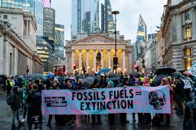
MOOC 3: BUSINESS AND REGULATORY ETHICAL ASPECTS UNIT 1: INTRODUCTION
Energy policy
Energy policy is a holistic framework, based on somehow abstract and ethical ideas. However, it is of vital importance and should not be overlooked or described in generic terms (Coca Cola policy, fits to all). Policy drives all actions for managing energy matters.
It has to balance social and ethical values, with the demands of economy and the technological progress and achievements.
A wrong or unclear or ill structured or incomplete energy policy, will lead to bad energy management. Apart from the harm to society and economy, it will lead to objections to innovation and technological advance and the immersion of energy activism.
A proper Energy policy is vital, especially in times of Energy Transformation.

Slide 18
MOOC 3: BUSINESS AND REGULATORY ETHICAL ASPECTS UNIT 1: INTRODUCTION
Values of Energy Policy
Energy justice is verifying the ways in which benefits and deficits are distributed, remediated and victims are recognized.
Energy justice evaluates (Kirsten Jenkins et al., 2016):
(a) where injustices emerge,
(b) which affected sections of society are ignored,
(c) which processes exist for their remediation in order to reveal, and reduce such injustices.

Slide 19
MOOC 3: BUSINESS AND REGULATORY ETHICAL ASPECTS UNIT 1: INTRODUCTION
Values of Energy Policy-Energy Justice
Energy justice is deployed in three pilars (Kirsten Jenkins et al. , 2016):
Procedural justice
Distributional justice
Recognition-based justice

Slide 20
MOOC 3: BUSINESS AND REGULATORY ETHICAL ASPECTS UNIT 1: INTRODUCTION
Values of Energy Policy-Procedural Energy Justice (Kirsten Jenkins et al. , 2016)
Procedural Energy Justice is revealing and remediating inequalities that relate to the ways in which decision makers have sought to engage with communities.
An example is local agricultural communities, with a strong relation to the ecosystem, for their income. Decision on energy maters, should include an honest and in depth communication and negotiations with local communities and should respect their opinion and their interests.

Slide 21
MOOC 3: BUSINESS AND REGULATORY ETHICAL ASPECTS UNIT 1: INTRODUCTION
Values of Energy Policy-Recognition-based Energy Justice (Kirsten Jenkins et al. , 2016)
Recognition-based Energy Justice relates to the ways in which energy harms specific areas or groups of people, like the elder or indigenius.
It relates to respect to the individuals, which must have complete and equal rights and can take their decision with physical threats and that they must be offered complete and equal political rights.
A typical example, is forgetting (not recognizing) the elders and omitting to provide enough power to them, since they need more energy especially for heating.

Slide 22
MOOC 3: BUSINESS AND REGULATORY ETHICAL ASPECTS UNIT 1: INTRODUCTION
Values of Energy Policy-Distributional Energy Justice (1/2) (Kirsten Jenkins et al. , 2016)
Distributional Energy Justice relates to the ways in which energy is located (spatially) in a specific region.
This applies not only to the sitting of new or existing power production units, but also to the access to power.
A typical and well known example of Distributional Energy justice, is the nature of energy production that affect distribution of energy:
Large production installations ( like fossil fuel or nuclear),
or
smaller renewables sites that are more evenly distributed in a specific area.

Slide 23
MOOC 3: BUSINESS AND REGULATORY ETHICAL ASPECTS UNIT 1: INTRODUCTION
Values of Energy Policy-Distributional Energy Justice (2/2) (Kirsten Jenkins et al. , 2016)
For instance, in Greece, the old power system of the mainland, was located in one great and one smaller energy area (energy centers). The new Greek mainland power system that is based on renewables and natural gas, is based on several smaller sites, distributed almost everywhere in Greece.
How fair do you think, is the citing of energy production sites in small islands, that depend of tourism and on the other hand have a relatively (per capita) higher demand for energy?

Slide 24
MOOC 3: BUSINESS AND REGULATORY ETHICAL ASPECTS UNIT 1: INTRODUCTION
Social problems of energy transition
Energy transition is a major change in the infrastructure, which is the backbone of economy and society. In this manner, it creates challenges for addressing the social problems that arise from it.
The most evident social problems from energy transition are (University of Sussex, 2023):
loss of fossil fuel industry jobs,
the decline of industrial communities,
impacts on personal identities and family histories, in the old industries.
We may add to the above, any injusticies that may happen due to energy transformation. Some of the injustices, may not be evident from the beginning and may need some time to be recognized.

Slide 25
MOOC 3: BUSINESS AND REGULATORY ETHICAL ASPECTS UNIT 1: INTRODUCTION
Social problems of energy transition
The social problems of Energy Transition depend on the region that they occur. For instance, loss of jobs in the oil and gas sector may be a small problem in a developed region, where other job opportunities exist and there are also provisions for re-training the job seekers in new jobs.
However, it is a big problem in areas where development is poor and none of the above remedies are in place. In this case, unemployed people, will have to immigrate or live in poverty.

Slide 26
MOOC 3: BUSINESS AND REGULATORY ETHICAL ASPECTS UNIT 1: INTRODUCTION
Conclusion
Energy is a basic human need and as such, is related to ethical and social problems.
Energy poverty is significant in developed countries, as well as in developing.
Energy transformation from fossil fuels to renewables sources, creates serious questions about ethical and social problems, in smaller or wider regions.
When planning for the Energy Transformation, technological and financial aspects should not obscure the ethical and social ones.

Slide 27
MOOC 3: BUSINESS AND REGULATORY ETHICAL ASPECTS UNIT 1: INTRODUCTION
References
United Nations , 2023, 2023 GLOBAL MULTIDIMENSIONAL POVERTY INDEX (MPI), available from https://hdr.undp.org/content/2023-global-multidimensional-poverty-index-mpi#/indicies/MPI
United Nations, n.d., The 17 goals, https://sdgs.un.org/goals
Kirsten Jenkins, Darren McCauley, Raphael Heffron, Hannes Stephan, Robert Rehner, Energy justice: A conceptual review, Energy Research & Social Science, Volume 11, 2016, Pages 174-182, ISSN 2214-6296, available from https://doi.org/10.1016/j.erss.2015.10.004.
European Union, Energy poverty, 2024, available from https://energy.ec.europa.eu/topics/markets-and-consumers/energy-consumer-rights/energy-poverty_en
Steve Pye, Audrey Dobbins, Claire Baffert, Jurica Brajković, Ivana Grgurev, Rocco De Miglio and Paul Deane, 2015, Energy poverty and vulnerable consumers in the energy sector across the EU: analysis of policies and Measures-Policy Report , Insight_E project, available from https://energy.ec.europa.eu/document/download/f3806eda-321a-414e-886e-44759d3ec448_en?filename=INSIGHT_E_Energy%20Poverty-Main%20Report.pdf
Miller, Clark. The ethics of energy transitions. 2014 IEEE international symposium on ethics in science, technology and engineering. IEEE, 2014 available from https://ieeexplore.ieee.org/document/6893445

Slide 28
Prof. Dr. C.S. Psomopoulos, cpsomop@uniwa.gr
Thank you very much !!!
Social Media Accounts:
https://twitter.com/....
www.linkedin.com/......

