Slide 1
MOOC 3: BUSINESS AND REGULATORY ETHICAL ASPECTS UNITS 2: ETHICAL & SOCIETAL ASPECTS of ENERGY & ET
Prof. Constantinos S. Psomopoulos, UniWA
June 2024

Slide 2
MOOC 3: BUSINESS AND REGULATORY ETHICAL ASPECTS UNIT 2: ETHICAL and SOCIETAL ASPECTS of ENERGY and ET
Description of the Unit
This unit provides the ethical questions arisen and impacts in the society and environment from the energy production, transmission and distribution transitions while also presents the significant questions of ethics and justice that energy transition raises.
The ET requires contemplate large-scale transformations of energy systems: the greening of energy production, the construction of smart grids and the rise of big data in energy services, the creation of electric and hybrid-electric vehicles, and the rise of unconventional oil and gas.
These transitions have the potential to influence not only energy production and delivery but also the social, economic, and political organization of the energy sector. This potential is presented and addressed in the scale of islands where the geographical restrictions and conditions can have even more high impact.
Learning Outcomes
To analyse the current ethical and societal issues related to energy context and the energy transition, focusing on islands.
2

Slide 3
MOOC 3: BUSINESS AND REGULATORY ETHICAL ASPECTS UNIT 2: ETHICAL and SOCIETAL ASPECTS of ENERGY and ET
Introduction
The majority of global greenhouse gas emissions arise from energy conversion and consumption.
Transitioning towards carbon-free and affordable energy resources following the UN SDG7 is expected to be among the most important decisions we will make to protect human habitability on Earth.
Energy decisions have many ethical dimensions, including significant effects for members of present and future generations.
In some cases, energy decisions can determine who lives and dies, cause irreversible changes to the planet, or lock societies into harmful infrastructures or socio-economic arrangements that perpetuate for centuries.
3

Slide 4
MOOC 3: BUSINESS AND REGULATORY ETHICAL ASPECTS UNIT 2: ETHICAL and SOCIETAL ASPECTS of ENERGY and ET
Introduction
Therefore, these decisions should not be made without regard to ethics.
In response to recognizing the ethical dimensions of energy decisions, a growing number of energy scientists and scholars have called for greater attention to ethics in energy research, ethics training for energy workers, and an effort from energy decision makers to “do no harm”.
Researchers have responded to these calls with a set of “energy justice” principles, and at the same time propose principles of energy ethics to serve as a practical guide for energy decision-making.
4

Slide 5
MOOC 3: BUSINESS AND REGULATORY ETHICAL ASPECTS UNIT 2: ETHICAL and SOCIETAL ASPECTS of ENERGY and ET
Who Benefits and who loses?
During the energy transition, as in all transition faces in the history, there are those who benefits and those who lose.
The energy transition is a decline of carbon-intensive energy resources, as well as the industries that produce these resources.
During the energy transition the business related to old fossil energy approach will face significant impact, especially the ones that are involved in fossil energy production will lose.
The energy transition will create a huge redistribution of wealth towards the renewables and sustainable energy practices and will create new pathways for the wealth as every energy transition in history.
5

Slide 6
MOOC 3: BUSINESS AND REGULATORY ETHICAL ASPECTS UNIT 2: ETHICAL and SOCIETAL ASPECTS of ENERGY and ET
Who Benefits and who loses?
As a characteristic example, the people working in fossil fuels industry and those that support fossil-based electricity production, will lose market share and employment opportunities.
Former fossil-electricity industry employees may be able to find replacement jobs, where they are offered, but often with a sacrifice as the recent studies have shown and the examples from EU decarbonizing areas.
Typical issues are:
a lower salary that introduce skills and wage gaps,
requirement to commute long distances to find employment opportunities since fossil jobs and replacement renewable energy jobs or other, non-energy jobs may not align geographically.
6

Slide 7
MOOC 3: BUSINESS AND REGULATORY ETHICAL ASPECTS UNIT 2: ETHICAL and SOCIETAL ASPECTS of ENERGY and ET
Who Benefits and who loses?
It is proven from different studies that clean energy industries provide more job opportunities than fossil fuel industries.
But the decline of fossil fuel jobs nonetheless significantly affects those that held the jobs, as well as the economies in which they reside.
Meanwhile, pension funds through the fossil fuels industry are severely underfunded due to the economic decline of the industry, resulting on significant losses and consequently lower pensions to the elderly that would received those.
7

Slide 8
MOOC 3: BUSINESS AND REGULATORY ETHICAL ASPECTS UNIT 2: ETHICAL and SOCIETAL ASPECTS of ENERGY and ET
Who Benefits and who loses?
The economic and social consequences of such labor disruptions are broader than individual job losses.
Studies globally have found and the real conditions in EU have shown that, as a result of fossil fuels mining or power plant operation closures, surrounding communities experience a significant loss of other retail and commercial employment, since laid-off coal industry employees reduce their demand for other local services and commodities.
Power plants and mining operations are also often located in remote areas or in isolated locations and are associated with a lower percentage of adults with college education and greater income volatility.
The boom and bust nature of fossil fuels mining, paired with then mono-industrial composition of these regions, may suppress small business formation and cause people to move away from such regions.
8

Slide 9
MOOC 3: BUSINESS AND REGULATORY ETHICAL ASPECTS UNIT 2: ETHICAL and SOCIETAL ASPECTS of ENERGY and ET
Who Benefits and who loses?
The economic and social consequences of such labor disruptions are broader than individual job losses.
The regions where the fossil fuels industry is operating will also lose their revenues from these activities, directly and indirectly. Tax revenues from these operation that were return to the local communities are lost, as well access to low cost or even free energy.
As an example the closing of fossil power plants usually results in losing low cost or free district heating from the steam of the plant in the surrounding communities.
We must stress out that the economic costs of fossil fuel job and revenue decreases may be offset by the benefits of cleaner air and water for these communities.
9

Slide 10
MOOC 3: BUSINESS AND REGULATORY ETHICAL ASPECTS UNIT 2: ETHICAL and SOCIETAL ASPECTS of ENERGY and ET
Who Benefits and who loses?
Many studies have presented and document that the economic costs of fossil fuel job and revenue decreases will be offset by the benefits of cleaner air and water for these communities relaying in fossil-energy related jobs.
But the energy transition, beyond job losses and the direct implications to the fossil-fuels related economy, seems to have additional impacts.
Studies executed from many countries and OECD also have document another form of personal hardship related to the energy transition: enhanced energy insecurity.
It is possible that the energy transition will result in a higher cost of energy, at least in the short- and medium-term, due to the need to cover new infrastructure and technology costs, for example, for smart meters, power lines and battery storage technologies.
10

Slide 11
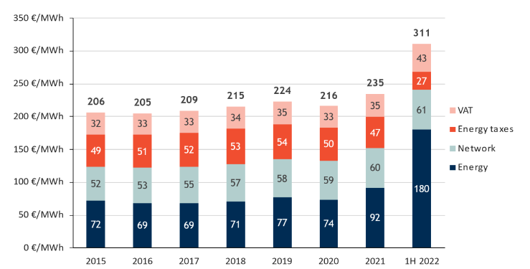
MOOC 3: BUSINESS AND REGULATORY ETHICAL ASPECTS UNIT 2: ETHICAL and SOCIETAL ASPECTS of ENERGY and ET
Who Benefits and who loses?
Average household retail electricity prices for EU27 (excl. CY & MT)
Source: VaasaETT for the latest retail prices. Other parts of the report rely on Eurostat, which can lead to (slightly) different results.
11

Slide 12
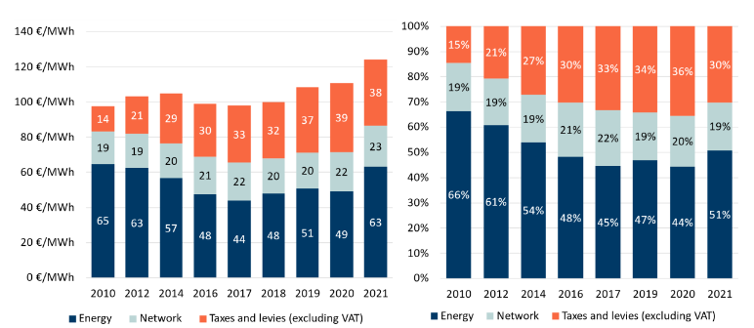
MOOC 3: BUSINESS AND REGULATORY ETHICAL ASPECTS UNIT 2: ETHICAL and SOCIETAL ASPECTS of ENERGY and ET
Who Benefits and who loses?
Evolution and composition of the EUR 27 industrial retail prices (ID band; medium-sized enterprises), absolute (left), share (right). Source: DG ENER in-house data collection, Eurostat
12

Slide 13
MOOC 3: BUSINESS AND REGULATORY ETHICAL ASPECTS UNIT 2: ETHICAL and SOCIETAL ASPECTS of ENERGY and ET
Who Benefits and who loses?
Many studies based in Organization for Economic Cooperation and Development (OECD) countries, such as New Zealand.
Some OECD countries such as Greece have much higher rates of energy insecurity;
These statistics reveal that energy costs produce a significant financial burden for some households, and require many to confront difficult trade-offs such as ‘heat or eat’ financial decisions and an increasing likelihood of electric utility disconnection.
All of these consequences have the potential to compromise mental and physical health, and lead to further personal hardships.
13

Slide 14
MOOC 3: BUSINESS AND REGULATORY ETHICAL ASPECTS UNIT 2: ETHICAL and SOCIETAL ASPECTS of ENERGY and ET
Who Benefits and who loses?
Rural low-income residents, for example, pay around 9-10% to cover their energy needs. In contrast, urban higher income residents pay 2-3% and the average for all households is 3.3%.
Other measures of energy insecurity reveal similarly concerning trends after the adoption of Energy Transition actions :
A significant percentage of population reported difficulty paying their household energy bills or maintaining adequate temperatures in their house;
From this part of the population over 50% reported that, due to high energy bills, it is necessary to forego buying other necessary household items such as food;
and a non negligible percentage reported that they have faced the threat of disconnection from their electric utility.
Approximately half of all US households that face energy insecurity—that is, the inability of a household to adequately meet energy consumption needs—are African American.
14

Slide 15
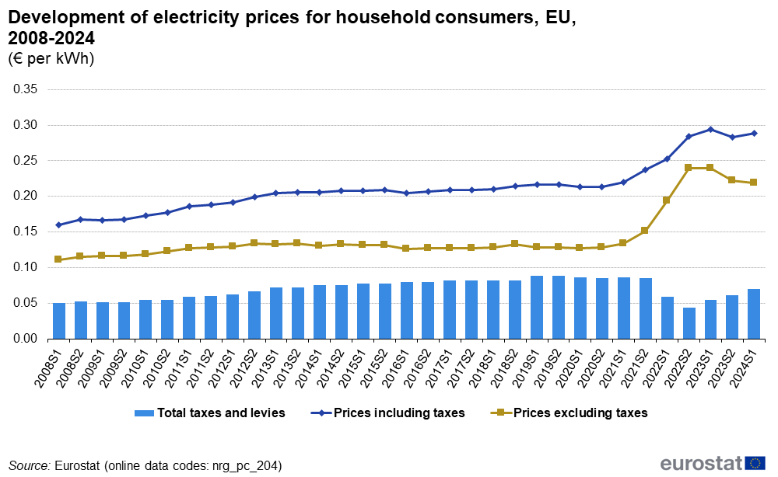
MOOC 3: BUSINESS AND REGULATORY ETHICAL ASPECTS UNIT 2: ETHICAL and SOCIETAL ASPECTS of ENERGY and ET
Who Benefits and who loses?
15

Slide 16
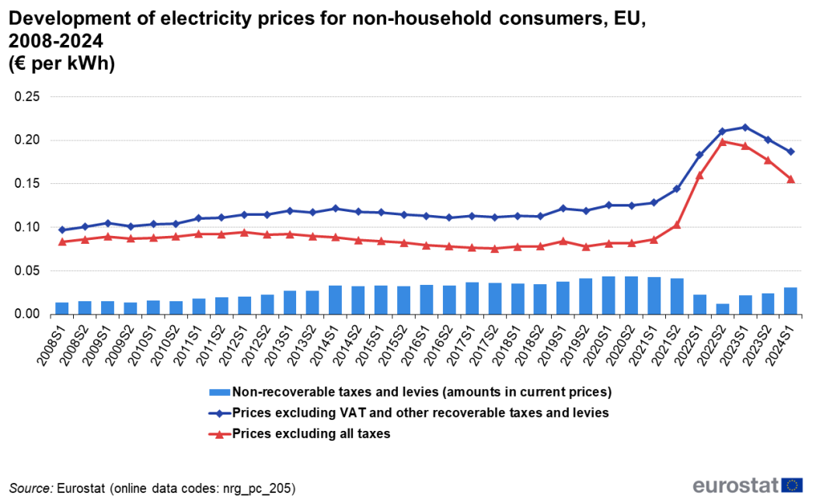
MOOC 3: BUSINESS AND REGULATORY ETHICAL ASPECTS UNIT 2: ETHICAL and SOCIETAL ASPECTS of ENERGY and ET
Who Benefits and who loses?
16

Slide 17
MOOC 3: BUSINESS AND REGULATORY ETHICAL ASPECTS UNIT 2: ETHICAL and SOCIETAL ASPECTS of ENERGY and ET
Who Benefits and who loses?
Studies find that low-income households are more likely to live in energy inefficient dwelling units, have inefficient appliances, or poorer structural building conditions, all of which requires more energy to heat or cool to adequate living conditions.
These conditions both exacerbate energy insecurity and, where the costs of energy rise as a result of the energy transition, these populations may be further disproportionately burdened, and potentially face more severe circumstances such as utility financial burden and the threat of utility disconnection.
17

Slide 18
MOOC 3: BUSINESS AND REGULATORY ETHICAL ASPECTS UNIT 2: ETHICAL and SOCIETAL ASPECTS of ENERGY and ET
Who Benefits and who loses?
In addition, as climate change continues to alter weather patterns, and affect residential thermal conditions, vulnerability toward energy insecurity may continue to grow.
For example, hotter summers and more excessive heat days will likely increase the amount of time that people use fans or run their air conditioners, which can in turn increase their energy bills.
This example highlights the possibility that climate change has the potential to exacerbate energy justice concerns over time.
18

Slide 19
MOOC 3: BUSINESS AND REGULATORY ETHICAL ASPECTS UNIT 2: ETHICAL and SOCIETAL ASPECTS of ENERGY and ET
Who Benefits and who loses?
Lack of access to energy transition opportunities.
The justice implications of the energy transition are not exclusively attributed to an uneven distribution of burdens.
Potential benefits of the transition— including but not limited to :
new employment opportunities,
involvement in decision-making processes,
and access to advanced, low-carbon and efficient technologies
are also unevenly spread across populations, as well as across socioeconomic groups.
19

Slide 20
MOOC 3: BUSINESS AND REGULATORY ETHICAL ASPECTS UNIT 2: ETHICAL and SOCIETAL ASPECTS of ENERGY and ET
Who Benefits and who loses?
The energy transition facilitates a shift toward more efficient and lower-carbon energy resources, employment opportunities in related fields will increase, including jobs in manufacturing, construction and installation, operations and maintenance, sales and distribution, fuel extraction and supply, and transmission.
Studies from across the world provide evidence that net employment will increase due to renewable energy and energy efficiency development, and policies that are in place to facilitate a lower-carbon economy.
Recent reports demonstrate that employment in low-carbon energy industries is rising.
As of 2017, renewable energy industries employed about 10.3 million people across the world, up from 7.14 million in 2012.
Approximately 33% of these jobs are concentrated in the solar photovoltaic industry and 19% in the liquid biofuels industry.
20

Slide 21
MOOC 3: BUSINESS AND REGULATORY ETHICAL ASPECTS UNIT 2: ETHICAL and SOCIETAL ASPECTS of ENERGY and ET
Who Benefits and who loses?
Following the findings of the 22nd EurObserv’ER Report for the state of Renewable Energies in EU Ed. 2023 :
The total direct and indirect employment from the renewable sectors is estimated at 1.69 million full-time equivalents by 2022. This figure is 15% higher than in 2021. The leading sector was heat-pumps with 416 200 full-time equivalents.
The economic activity around renewable energies in 2021 is estimated at €210 billion (+ 13% compared to 2021). As for jobs, heat pumps are the sector that has generated the highest turnover with €57.4 billion.
21

Slide 22
MOOC 3: BUSINESS AND REGULATORY ETHICAL ASPECTS UNIT 2: ETHICAL and SOCIETAL ASPECTS of ENERGY and ET
Who Benefits and who loses?
Following the findings of the 22nd EurObserv’ER Report for the state of Renewable Energies in EU Ed. 2023 :
In 2022, EU MS invested $180 billion in renewable energy technologies, retaining second place behind China and followed by the US. The top EU investing countries were Germany, France, Spain, and Italy, with a notable shift towards electric vehicles, especially in Germany and France.
In the wind energy sector, most countries invested less as compared to previous years. The offshore wind sector especially was influenced by major macroeconomic circumstances, with difficult economic and financing conditions increasing the risks for projects.
Within the EU, the distribution of EU PV investments varies considerably. Germany maintained its position as the top investor in solar PV, investing €8.5 billion in 2021 and increasing to €9.4 billion in 2022. Spain, with a 2022 investment of €6.4 billion, ascended to second place, surpassing the Netherlands. Overall, investment costs of PV dropped slightly between 2021 and 2022
22

Slide 23
MOOC 3: BUSINESS AND REGULATORY ETHICAL ASPECTS UNIT 2: ETHICAL and SOCIETAL ASPECTS of ENERGY and ET
Who Benefits and who loses?
Following the findings of the 22nd EurObserv’ER Report for the state of Renewable Energies in EU Ed. 2023 :
€817 million of public investment in R&D was invested in 2021 in the EU27 for renewable technologies. €2 221 million were committed by private actors in 2020 (latest year available).
The EU filed 1 325 patents in renewable energy in 2020 with Germany being the most active country (359 patents). China remains the world leader in number of patents filed in renewable energy with 10004 patents.
The trade balance (difference between imports and exports) of the renewable energy sectors in the EU27 as a whole shows a negative balance in 2022 of EUR €15018 million. The main partner remains China, which exported €21559 million of goods and services in renewable technologies to the EU27.
23

Slide 24
MOOC 3: BUSINESS AND REGULATORY ETHICAL ASPECTS UNIT 2: ETHICAL and SOCIETAL ASPECTS of ENERGY and ET
Who Benefits and who loses?
Following the results of many studies in the clean energy economy related employment, energy jobs are infrequently held by women, as is also traditionally the case with fossil fuel industries.
Reports from Europe, and surveys conducted across the world by the International Renewable Energy Agency, also confirm that women tend to hold somewhere between than 30% and 35% of jobs in renewable energy industries.
These female-held jobs tend to be lower paid, and more administrative, non-technical and public relations oriented, than jobs in the same industries held by male
counterparts.
24

Slide 25
MOOC 3: BUSINESS AND REGULATORY ETHICAL ASPECTS UNIT 2: ETHICAL and SOCIETAL ASPECTS of ENERGY and ET
Who Benefits and who loses?
The fairness of energy processes as well as equitable opportunities for participation in energy decision-making processes is very well analyzed in different studies along the world.
Several studies have revealed that decision-making procedures involving the energy transition are not currently inclusive of communities that host the new infrastructure.
These cases persist despite significant evidence that public participation can lend
important local knowledge, inform policy or other solutions, and lead local citizens to perceive the result of decisions more positively.
One study on US wind turbine siting, for instance, found that when citizens that live near the turbines believe that the planning process was fair, they are more likely to perceive positive benefits of the turbines, and vice versa.
25

Slide 26
MOOC 3: BUSINESS AND REGULATORY ETHICAL ASPECTS UNIT 2: ETHICAL and SOCIETAL ASPECTS of ENERGY and ET
Who Benefits and who loses?
Low income people have been found that merely participate in the decision-making processes, or involve in the leadership of and planning for such processes. The same applies for the majority of the people
Researchers have also identified many cases in which access to low-carbon and efficient technologies that accompany the energy transition is not universal and, in most cases, is exclusively seized by higher income households.
The same conclusions are drawn about low-emissions and electric vehicles, residential solar photovoltaic panels, community solar, smart meters, efficient appliances and many other clean energy technologies.
26

Slide 27
MOOC 3: BUSINESS AND REGULATORY ETHICAL ASPECTS UNIT 2: ETHICAL and SOCIETAL ASPECTS of ENERGY and ET
Who Benefits and who loses?
This lack of technological availability or access across all demographics is typically attributed to :
the high upfront costs of these technologies,
incentives for purchase of the technologies that reduce eligibility of those that do not have strong credit or do not pay taxes, for example,
a misalignment between required installation and use of the technology with living conditions (for example, rental properties).
27

Slide 28
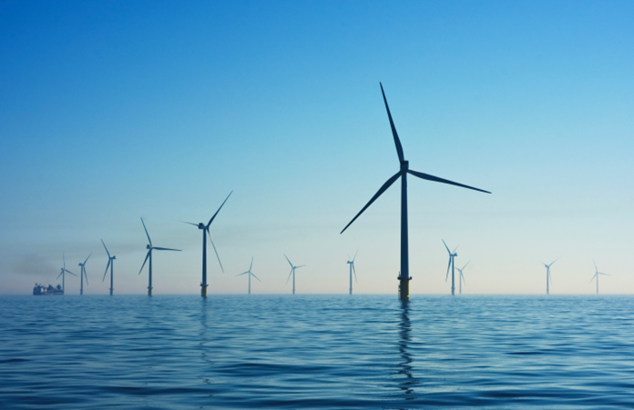
MOOC 3: BUSINESS AND REGULATORY ETHICAL ASPECTS UNIT 2: ETHICAL and SOCIETAL ASPECTS of ENERGY and ET
Who Benefits and who loses?
28

Slide 29
MOOC 3: BUSINESS AND REGULATORY ETHICAL ASPECTS UNIT 2: ETHICAL and SOCIETAL ASPECTS of ENERGY and ET
Who Benefits and who loses?
The energy transition requires land to develop RES. Facts are clear and hard:
RES are substantially more land intensive. For example, typical ranges of net power density found in the literature are: 2–10 W_{e}/m² for solar power plants, 0.5–7 W_{e}/m² for large hydroelectric, 0.5–2 W_{e}/m² for wind; and ~0.1 W_{e}/m² for biomass
Wind farms are partially compatible with other uses (e.g., agriculture) or can be located offshore,
biomass plantations, hydroelectric reservoirs and solar farms tend not to allow double use, that is, in practice they monopolize the occupied land.
29

Slide 30
MOOC 3: BUSINESS AND REGULATORY ETHICAL ASPECTS UNIT 2: ETHICAL and SOCIETAL ASPECTS of ENERGY and ET
Who Benefits and who loses?
The energy transition requires land to develop RES :
In the case of solar power, the potential in urbanized areas is limited due to the fact that cities are currently not designed to maximize solar reception.
The dedication of land to produce energy has been identified as a potential concern not only for preserving natural ecosystemsand biodiversity, but also because of its competition with land use to cover human needs (i.e., food, fiber, shelter and infrastructure)
In many cases the loss of land for agricultural activities concerned high productivity zones of land.
30

Slide 31
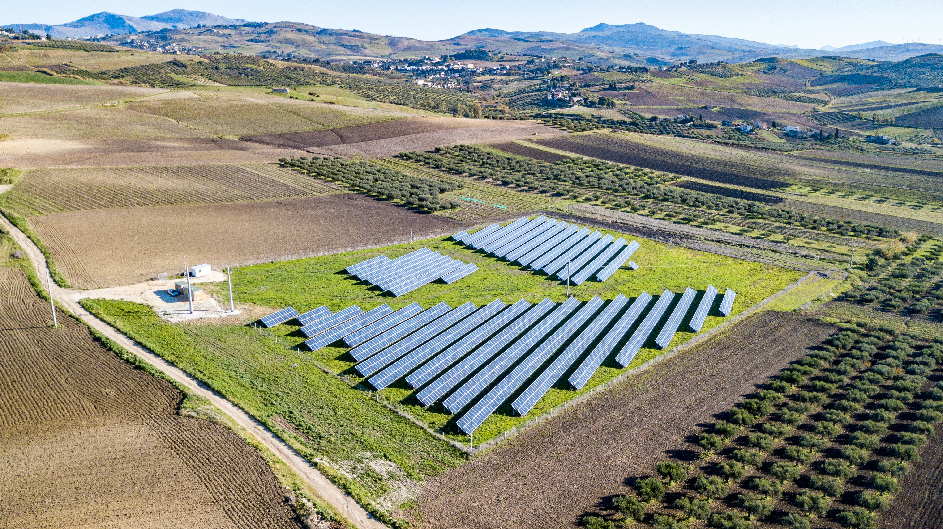
MOOC 3: BUSINESS AND REGULATORY ETHICAL ASPECTS UNIT 2: ETHICAL and SOCIETAL ASPECTS of ENERGY and ET
Who Benefits and who loses?
31

Slide 32
MOOC 3: BUSINESS AND REGULATORY ETHICAL ASPECTS UNIT 2: ETHICAL and SOCIETAL ASPECTS of ENERGY and ET
Who Benefits and who loses?
The energy transition requires land to develop RES :
These concerns arise in parallel with the current rapid expansion of modern RES technologies and the steady decrease in their costs over recent years.
Thus, this transition could aggravate existing vulnerabilities and create new ones in terms of energy security, biodiversity loss, and food sovereignty, among others.
As a recent example, the occupation of just ~0.1% of Italian agricultural surface area by PV systems provoked an intense debate in the country that ultimately lead to the ban of incentives for this technology on agricultural soil.
32

Slide 33
MOOC 3: BUSINESS AND REGULATORY ETHICAL ASPECTS UNIT 2: ETHICAL and SOCIETAL ASPECTS of ENERGY and ET
Who Benefits and who loses?
33

Slide 34
MOOC 3: BUSINESS AND REGULATORY ETHICAL ASPECTS UNIT 2: ETHICAL and SOCIETAL ASPECTS of ENERGY and ET
Who decides?
In ethics parlance, the question of who decides is a major element in the consideration of procedural justice.
The history of energy development in much of the world over the second half of the twentieth century has seen energy decisions devolve into the hands of a narrow group of energy experts and business and political leaders.
This is largely a consequence of the stability of energy systems during this period, both in the electricity and fuels sectors.
At the same time, it reflects a public sensibility to neglect what happens behind the electrical outlet or the fuel pump.
34

Slide 35
MOOC 3: BUSINESS AND REGULATORY ETHICAL ASPECTS UNIT 2: ETHICAL and SOCIETAL ASPECTS of ENERGY and ET
Who decides?
This should not be confused, however, with a view that energy decisions have always taken this form.
Indeed, in the early twentieth century, numerous energy policy developments, including, e.g., anti-trust legislation and the creation of public utility commissions and regulated, monopolistic utilities, were subject to widespread social and political deliberation and debate.
The enormous social, political, and economic consequences and conflicts surrounding late nineteenth and early twentieth century energy transitions around oil, railroads, and electricity grids demanded careful consideration of the design, operation, and ethics of socio-energy systems.
35

Slide 36
MOOC 3: BUSINESS AND REGULATORY ETHICAL ASPECTS UNIT 2: ETHICAL and SOCIETAL ASPECTS of ENERGY and ET
Who decides?
The coming energy transformation will be no different. Already, publics are demanding a stronger role in energy decision making around both renewable energy and unconventional fossil fuels.
Gas wells, wind turbines, solar fields, and oil pipelines have all generated significant episodes of social protest over the past few years. Indeed, the challenge is greater even than these public controversies suggest.
Given the social and economic restructuring that will accompany energy systems change, a key ethical question will be what responsibility the energy sector has to engage diverse communities in deliberations about their energy futures—and, to the extent they do have such responsibilities—how to accomplish this task effectively.
36

Slide 37
MOOC 3: BUSINESS AND REGULATORY ETHICAL ASPECTS UNIT 2: ETHICAL and SOCIETAL ASPECTS of ENERGY and ET
Who decides?
At present, by contrast, regulatory and permitting processes are largely designed to exclude public participation in energy planning, except in narrow, highly structured ways that limit considerably the influence of community voices.
These include limited time for public input, evidentiary frameworks that limit non-technical contributions, and beliefs that non-experts do not know enough to contribute meaningfully to energy decisions.
37

Slide 38
MOOC 3: BUSINESS AND REGULATORY ETHICAL ASPECTS UNIT 2: ETHICAL and SOCIETAL ASPECTS of ENERGY and ET
Who decides?
Millions of individuals are involuntarily resettled due to energy projects every year in ways that violate modern notions of due process or procedural justice: planners are imposing on the free choice of individuals.
Annually, about 4 million people are displaced by activities relating to hydroelectricity construction or operation, with 80 million displaced in the second half of the last century by the construction of 300 large dams.
In many instances, this happens without consent, without advance notification and without an opportunity to seek redress for damages.
38

Slide 39
MOOC 3: BUSINESS AND REGULATORY ETHICAL ASPECTS UNIT 2: ETHICAL and SOCIETAL ASPECTS of ENERGY and ET
Who decides?
Generally, these ideas center on the following interrelated ethical justice issues:
who gets to decide and set rules and laws, and which parties and interests are recognized in decision-making?
By what process do they make such decisions?
And how impartial or fair are the institutions, instruments and objectives involved?
Procedural theories of justice are all concerned with process — with the fairness and transparency of decisions, the adequacy of legal protections, and the legitimacy and inclusivity of institutions involved in decision-making.
39

Slide 40
MOOC 3: BUSINESS AND REGULATORY ETHICAL ASPECTS UNIT 2: ETHICAL and SOCIETAL ASPECTS of ENERGY and ET
Who decides?
Procedural theories of ethical justice are all concerned with process — with the fairness and transparency of decisions, the adequacy of legal protections, and the legitimacy and inclusivity of institutions involved in decision-making:
recognition (who is recognized),
participation (who gets to participate) and
power (how is power distributed in decision-making forums).
It pushes for concepts similar to those in environmental and risk policy, discussions known as the ‘deliberative turn’ towards democracy and engagement.
40

Slide 41
MOOC 3: BUSINESS AND REGULATORY ETHICAL ASPECTS UNIT 2: ETHICAL and SOCIETAL ASPECTS of ENERGY and ET
Who decides?
Procedural ethical justice issues are arisen and are required to ensure that the potential for stakeholder participation in the energy policymaking process at least roughly matches the importance (in aggregate and to each person affected) of the matter at stake and the irrevocability of any decisions that may be reached.
It also necessitates effective recourse through judicial and administrative remedies and forms of redress.
41

Slide 42
MOOC 3: BUSINESS AND REGULATORY ETHICAL ASPECTS UNIT 2: ETHICAL and SOCIETAL ASPECTS of ENERGY and ET
Who decides?
It suggests that communities must be involved in deciding about projects that will affect them.
Thus environmental and social impact assessments must involve genuine community consultation;
and neutral arbitration should be available to handle grievances.
It can, through free, prior, informed consent, demand proper representation of communities (including marginalized groups) and true power-sharing and it has facilitated further protections over the past few decades known as impact–benefit agreements, social licenses to extract and social licenses to operate.
42

Slide 43
MOOC 3: BUSINESS AND REGULATORY ETHICAL ASPECTS UNIT 1: INTRODUCTION
Conclusion
Energy transition is related to ethical and social problems.
Energy transformation from fossil fuels to renewables sources, creates serious questions about ethical and social problems, in smaller or wider regions.
When planning for the Energy Transision, technological and financial aspects should not obscure the ethical and social ones.

Slide 44
MOOC 3: BUSINESS AND REGULATORY ETHICAL ASPECTS UNIT 1: INTRODUCTION
References
United Nations, n.d., The 17 goals, https://sdgs.un.org/goals
Kirsten Jenkins, Darren McCauley, Raphael Heffron, Hannes Stephan, Robert Rehner, Energy justice: A conceptual review, Energy Research & Social Science, Volume 11, 2016, Pages 174-182, ISSN 2214-6296, available from https://doi.org/10.1016/j.erss.2015.10.004.
Miller, Clark. The ethics of energy transitions. 2014 IEEE international symposium on ethics in science, technology and engineering. IEEE, 2014 available from https://ieeexplore.ieee.org/document/6893445 .
Steve Pye, Audrey Dobbins, Claire Baffert, Jurica Brajković, Ivana Grgurev, Rocco De Miglio and Paul Deane, 2015, Energy poverty and vulnerable consumers in the energy sector across the EU: analysis of policies and Measures-Policy Report , Insight_E project, available from https://energy.ec.europa.eu/document/download/f3806eda-321a-414e-886e-44759d3ec448_en?filename=INSIGHT_E_Energy%20Poverty-Main%20Report.pdf
Capellán-Pérez, I., De Castro, C., & Arto, I. (2017). Assessing vulnerabilities and limits in the transition to renewable energies: Land requirements under 100% solar energy scenarios. Renewable and Sustainable Energy Reviews, 77, 760-782 https://doi.org/10.1016/j.enpol.2022.112951
Sovacool, B., Heffron, R., McCauley, D. et al. Energy decisions reframed as justice and ethical concerns. Nat Energy 1, 16024 (2016). https://doi.org/10.1038/nenergy.2016.24

Slide 45
Name email
Thank you very much !!!
Social Media Accounts:
https://twitter.com/....
www.linkedin.com/......

