Slide 1
CASE STUDY 2
Application of GENERA Tools

Slide 2
MOOC 2 - CASE STUDY 2
Case study 2 for the use of GENERA tools: Energy Planning, Inference Module and Multicriteria Decision Method.
STEPS
Identification of the region and municipality of study
Application of the Energy Planning module (National Level)
Identification of best practices through GENERA’s Database Module (GENERA's Digital Social Platform)
Application of the Inference module (Local Level)
Multi-criteria decision Module and ranking of measures

Slide 3
MOOC 2 - CASE STUDY 2
Case study 2 for the use of GENERA tools: Energy Planning, Inference Module and Multicriteria Decision Method.
This case study shows an example of application of GENERA tools to study a municipality and proposes the application to another one.
Case proposed and analyzed: The municipality of El Rosario (Tenerife, Spain).
The second one can be chosen by the user or one of those proposed in the exercise or in the GENERA MOOC2.

Slide 4
MOOC 2 - CASE STUDY 2
Case study in El Rosario (Tenerife, Spain).
National Analysis (Energy Planning Module)
1
2
Identification of Best Practices (Database Module)
Proposed measures and calculations (Inference Module)
3
4
Ranking of most promising measures (Multicriteria Module)

Slide 5
MOOC 2 - CASE STUDY 2
Case study in El Rosario (Tenerife, Spain).
Identification of the region and municipality of study
Reference Data
Context
Challenges
Data entered in the tool take 2022 as the reference year (since 2023 is incomplete for some sectors) (International Energy Agency).
The municipality has a total of 17,983 inhabitants and its municipal area covers an area of 39.43 square kilometers. It occupies an intermediate position with respect to the size of the rest of the municipalities of the Island (it is larger than 12 of the 31 municipalities of Tenerife).
The city council of El Rosario (Tenerife) signed on May 15, 2013 the adhesion to the Covenant of Mayors.
Reduce CO₂ emissions, in their respective territorial areas, by at least 20%, through the implementation of a Sustainable Energy Action Plan.
Energy Balance
Oil is the main source in the transport sector and in other sectors such as agriculture, fishing, etc. On the other hand, natural gas is more involved in the industry, residential and service sectors. In addition, in electricity production, natural gas and renewables are the main producers.

Slide 6
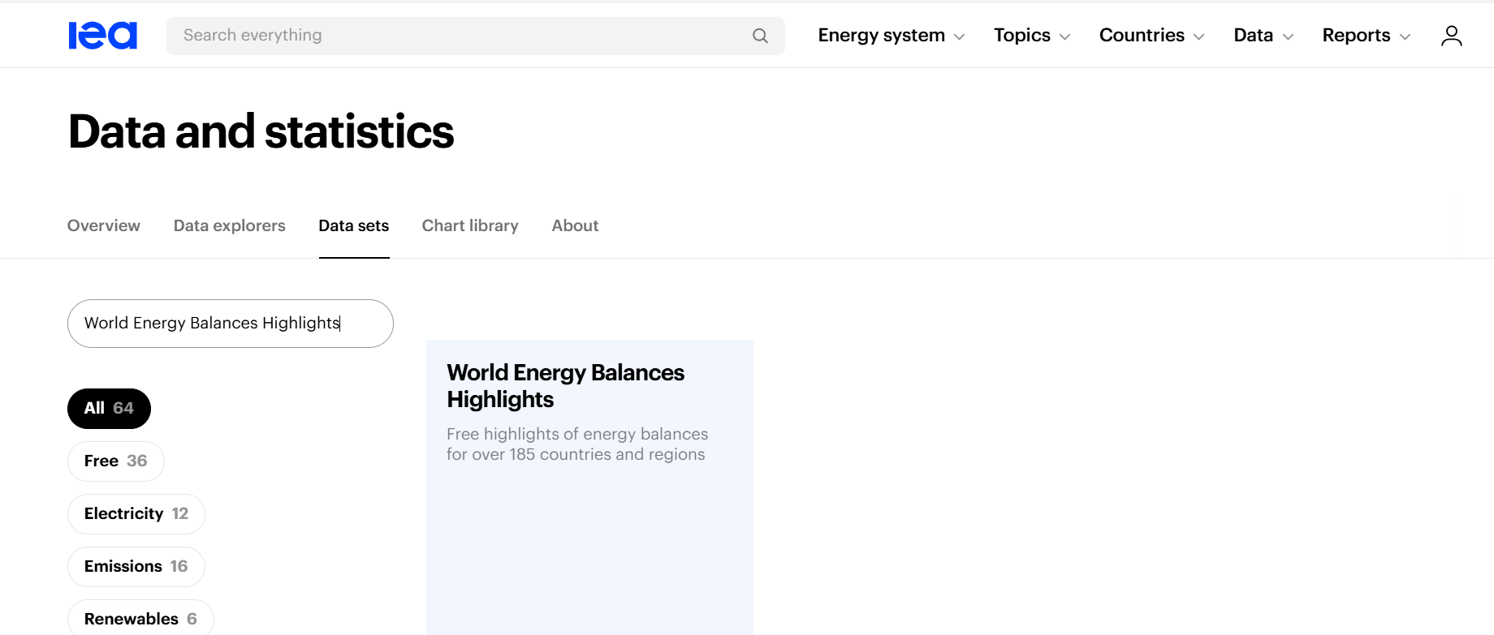
MOOC 2 - CASE STUDY 2
Case study in El Rosario (Tenerife, Spain).
2. Energy Planning Module
Recommended Database
The tool is adapted to use information from the IEA's "World Energy Balances Highlights" database.

Slide 7
MOOC 2 - CASE STUDY 2
Case study in El Rosario (Tenerife, Spain).
2. Energy Planning Module
World Energy Balances Highlights
A report will be obtained in an excel sheet and filtered by country to obtain the data related to the country of study.
Data Selection
Use the latest year containing the most complete information possible for accurate analysis.

Slide 8
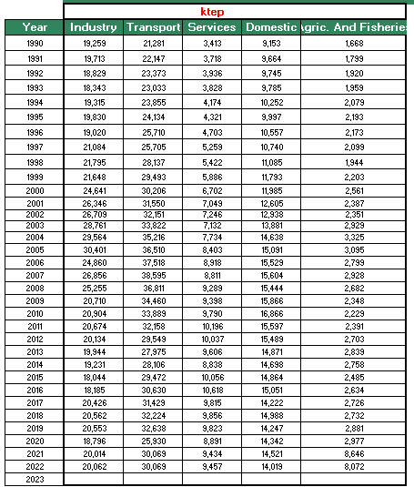
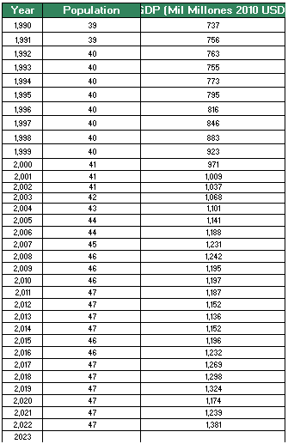
MOOC 2 - CASE STUDY 2
Case study in El Rosario (Tenerife, Spain).
2. Energy Planning Module
Growth Rate Input
In the Energy Planning Module, the growth ratios are entered first.
Data entering
The data for each of the sectors is obtained from the IEA report, but must be entered into the tool in ktep, so it is important to make the unit conversion considering:

Slide 9
MOOC 2 - CASE STUDY 2
Case study in El Rosario (Tenerife, Spain).
2. Energy Planning Module
Data entering
The rest of the information is entered in PJ in the tool and the conversion to ktep is automatically performed to obtain results.

Slide 10
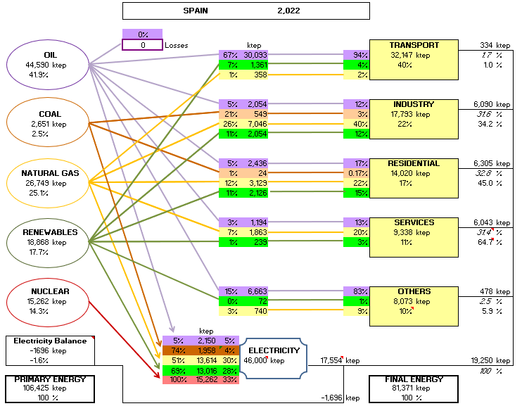
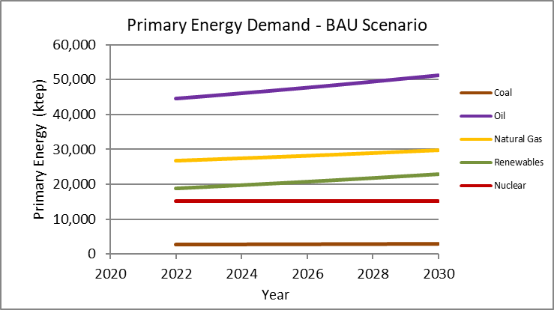
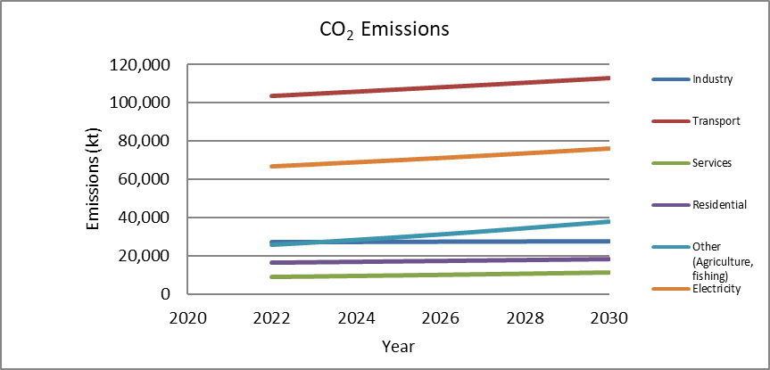
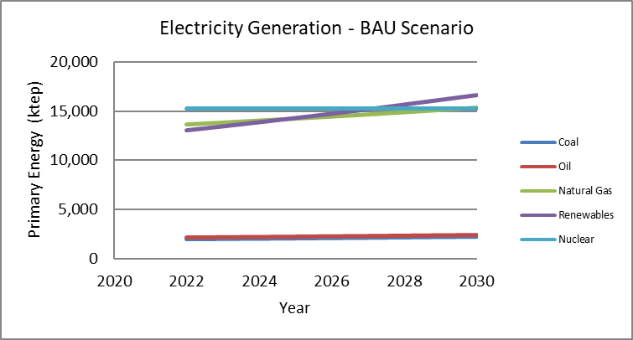
MOOC 2 - CASE STUDY 2
Case study in El Rosario (Tenerife, Spain).
2. Energy Planning Module
Results

Slide 11
MOOC 2 - CASE STUDY 2
Case study in El Rosario (Tenerife, Spain).
2. Energy Planning Module
Conclusions
Spain's energy context is characterized by the use of oil mainly for the transport sector, which in turn generates most of the country's emissions. There is a growing trend towards the use of renewable energy, mainly for electricity production, but also for residential use.
Natural gas also shows a growing trend and greater involvement in the industrial, residential and service sectors.
In terms of emissions, the most damaging sector is transport, followed by electricity generation.

Slide 12
MOOC 2 - CASE STUDY 2
Case study in El Rosario (Tenerife, Spain).
3. Identification of best practices
https://dsp.life-genera.eu/energy-transition
According to GENERA's DSP, some of the most commonly used measures in Spain are as follows:
Renewal of the municipal fleet with electric or plug-in hybrid vehicles
Establishment of a network of electric vehicle charging points
Promoting collective self-consumption and citizen energy communities
Replacement of existing luminaires with new ones equipped with LED lamps and remote management
Installation of renewable self-consumption in municipal buildings
Improvement of Insulation and Air Conditioning Systems
Campaign for waste reduction and correct waste management

Slide 13
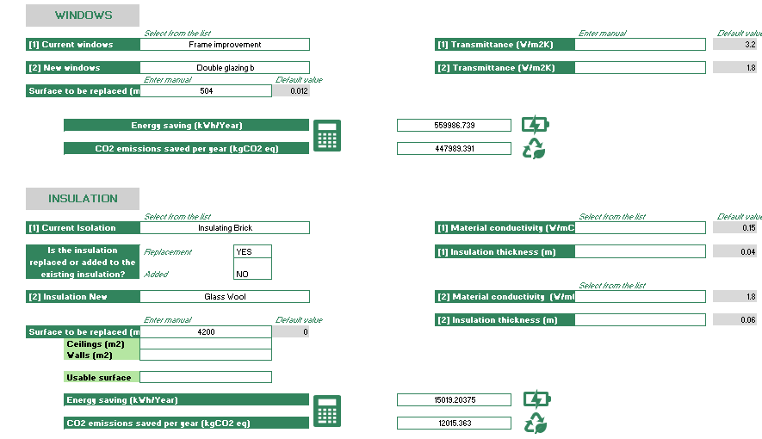
MOOC 2 - CASE STUDY 2
Case study in El Rosario (Tenerife, Spain).
4. Inference module
GENERA tool
Application of the GENERA inference module.
Main actions:
Improving energy efficiency in municipal buildings
It is proposed to improve the energy efficiency of buildings, specifically of a total of 7. To this end, the tool allows improving the building envelopes such as windows an insulation. In relation to the windows, a change with double glazing is proposed, which will improve the energy consumption of the buildings. An average of 600 square meters per building is estimated, with 12% of windows. On the other hand, glass wool is added to the insulation on different surfaces.

Slide 14
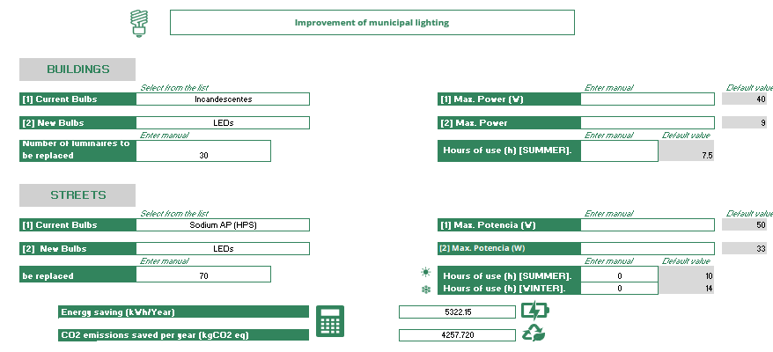
MOOC 2 - CASE STUDY 2
Case study in El Rosario (Tenerife, Spain).
4. Inference module
GENERA tool
Application of the GENERA inference module.
Main actions:
Indoor lighting renovation

Slide 15
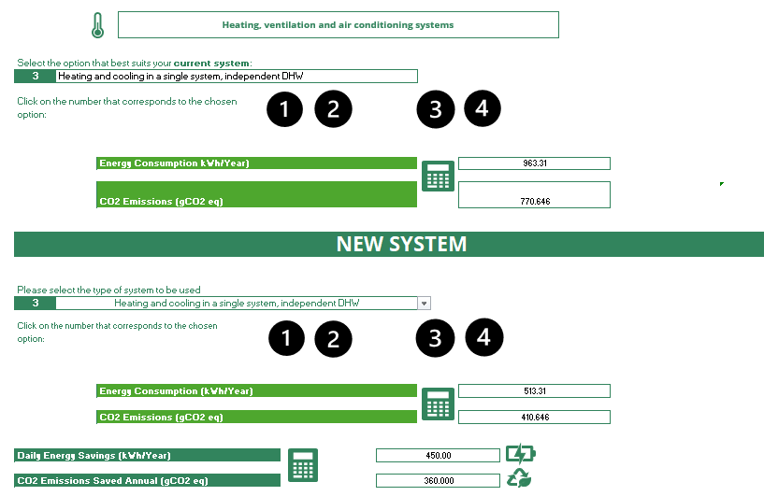
MOOC 2 - CASE STUDY 2
Case study in El Rosario (Tenerife, Spain).
4. Inference module
GENERA tool
Application of the GENERA inference module.
Main actions:
Improvement of building conditioning
The same system is then calculated but improving the energy certificate of the air conditioning equipment, as shown in the following figure. It is assumed that the domestic hot water system is independent.

Slide 16
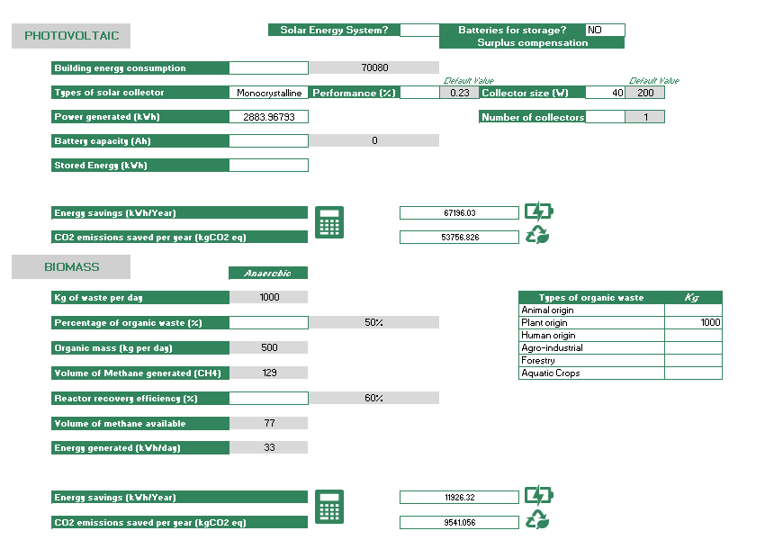
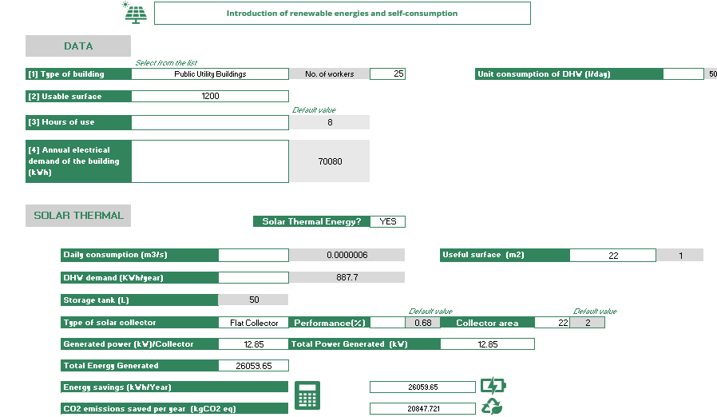
MOOC 2 - CASE STUDY 2
Case study in El Rosario (Tenerife, Spain).
4. Inference module
Main actions:
Introduction of renewable energies in public buildings

Slide 17
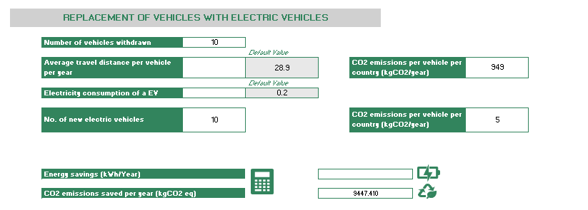
MOOC 2 - CASE STUDY 2
Case study in El Rosario (Tenerife, Spain).
4. Inference module
Main actions:
Renewal of municipal fleet of energy efficient vehicles
Last action considered at the municipal level is to renew the fleet of vehicles for more efficient ones, such as electric vehicles. In this case, all gasoline vehicles (a total of 10 vehicles) will be replaced by electric vehicles.

Slide 18
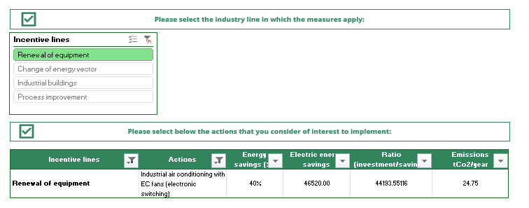
MOOC 2 - CASE STUDY 2
Case study in El Rosario (Tenerife, Spain).
4. Inference module
Main actions:
Industry
Promotion of energy consumption control in companies, e.g. industrial air conditioning with EC (electronically commuted) fans.

Slide 19
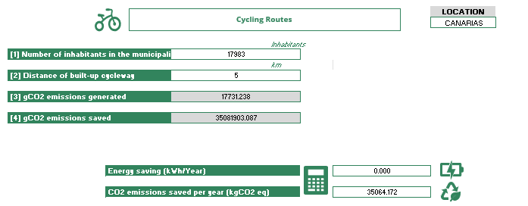
MOOC 2 - CASE STUDY 2
Case study in El Rosario (Tenerife, Spain).
4. Inference module
Main actions:
Increased bicycle lane line
Among the main actions is the creation of a mobility plan for the improvement of municipal transportation. This plan indicates the km of bike lanes to be extended, in this case it is proposed to include 5 km of lanes that will save CO₂ emissions according to the figure below.

Slide 20
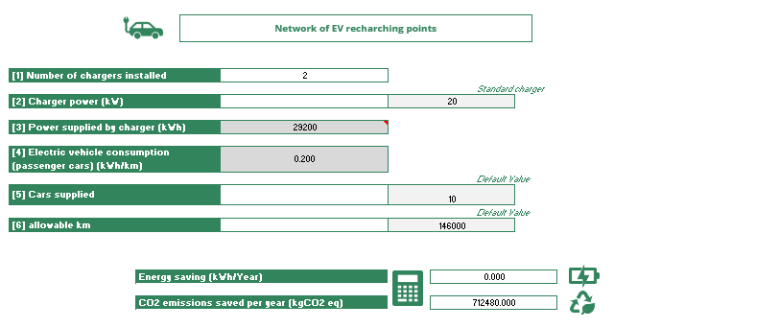
MOOC 2 - CASE STUDY 2
Case study in El Rosario (Tenerife, Spain).
4. Inference module
Main actions:
Implementation of alternative recharging points
Including recharging points to provide alternative options to conventional vehicles is another priority action. In this case, it is proposed to introduce 2 electric vehicle recharging points.

Slide 21
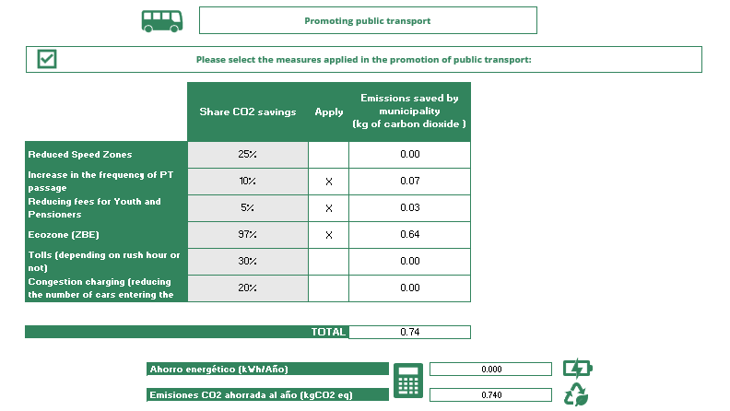
MOOC 2 - CASE STUDY 2
Case study in El Rosario (Tenerife, Spain).
4. Inference module
Main actions:
Actions to promote public transport
Some actions are the improvement of public transport by increasing frequency, reduced rates for young people and adults or the creation of a low emission zone.

Slide 22
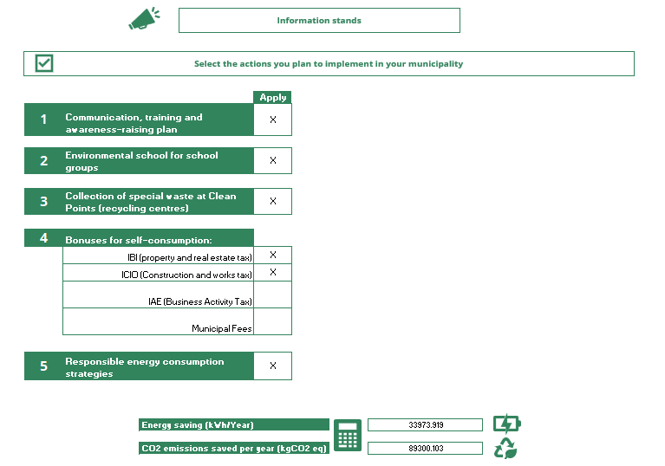
MOOC 2 - CASE STUDY 2
Case study in El Rosario (Tenerife, Spain).
4. Inference module
Main actions:
Awareness
Citizen awareness actions in El Rosario are directly aimed at the creation of a municipal awareness and training plan. They also include training in schools, collection points and training workshops for recycling and energy consumption reduction strategies. In addition, discount rates are also applied for homes with self-consumption or for construction works with bioclimatic solutions.

Slide 23
MOOC 2 - CASE STUDY 2
Case study in El Rosario (Tenerife, Spain).
4. Inference module
Main actions:
Awareness
Citizen awareness actions in El Rosario are directly aimed at the creation of a municipal awareness and training plan. They also include training in schools, collection points and training workshops for recycling and energy consumption reduction strategies. In addition, discount rates are also applied for homes with self-consumption or for construction works with bioclimatic solutions.

Slide 24
MOOC 2 - CASE STUDY 2
Case study in El Rosario (Tenerife, Spain).
5. Multi-criteria decision method and ranking of measures
Since this module has been described in case study 1, for more information on the use of the tool it is suggested to take a look and review the complete case.
Municipal Priorities
MUNICIPAL PRIORITIES
1 | Improvements in the equipment and infrastructure of the public lighting network, through the replacement of more efficient switchboards, luminaires and lamps.
2 | Municipal tax rebates for the use of renewable energies and energy efficient vehicles.
3 | Use of renewable energies: use of biogas energy generated by the contribution of waste at the provincial landfill, installation of photovoltaic plants and solar thermal installations
4 | Intention to set up a permanent personalized attention and advice department for individuals and legal entities interested in energy saving and the use of renewable energy sources

Slide 25
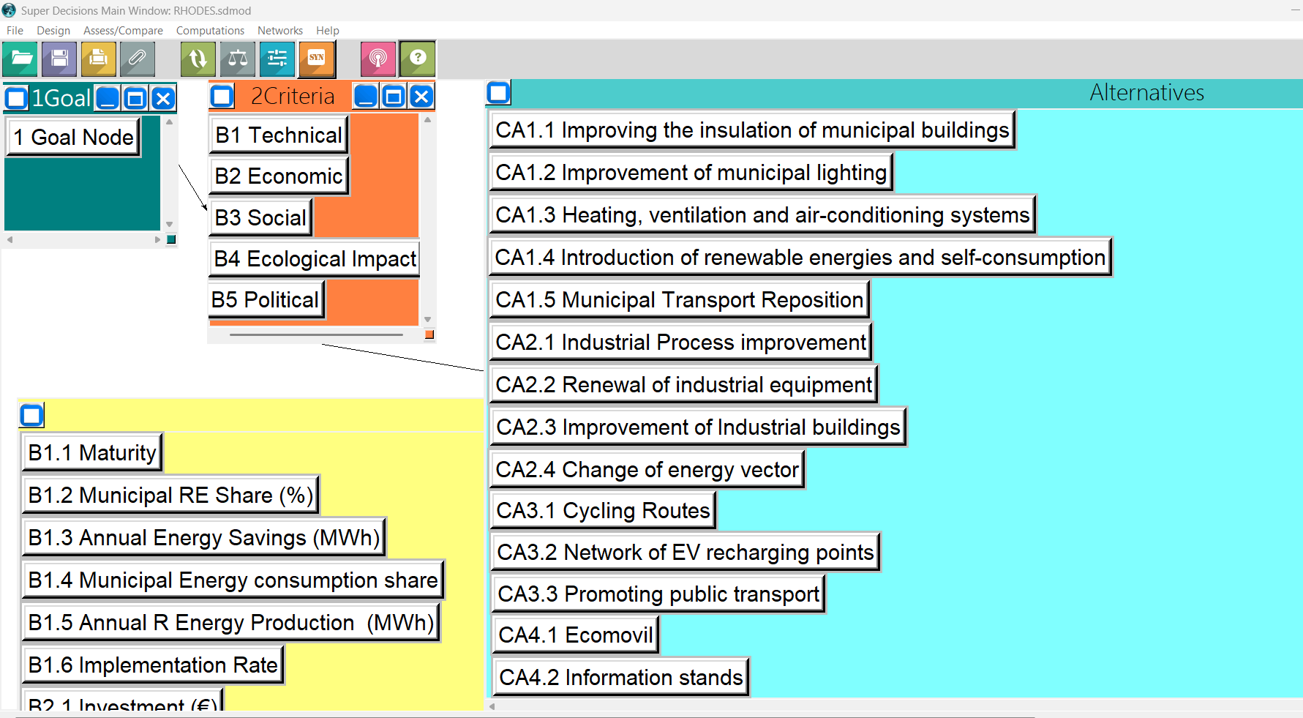
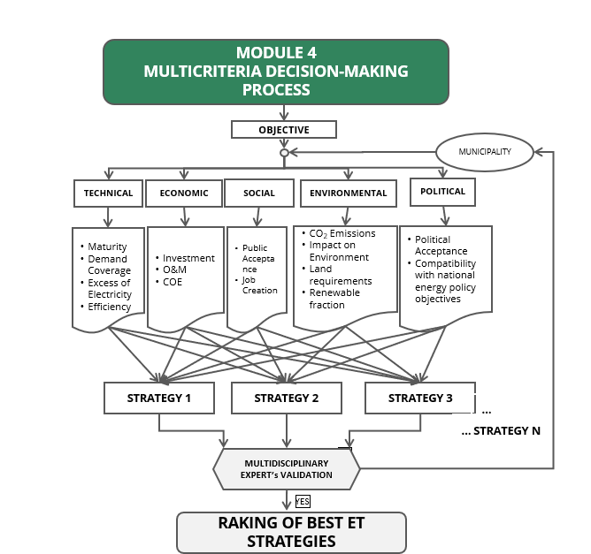
MOOC 2 - CASE STUDY 2
Case study in El Rosario (Tenerife, Spain).
5. Multi-criteria decision method and ranking of measures
Using the SuperDecisions tool

Slide 26
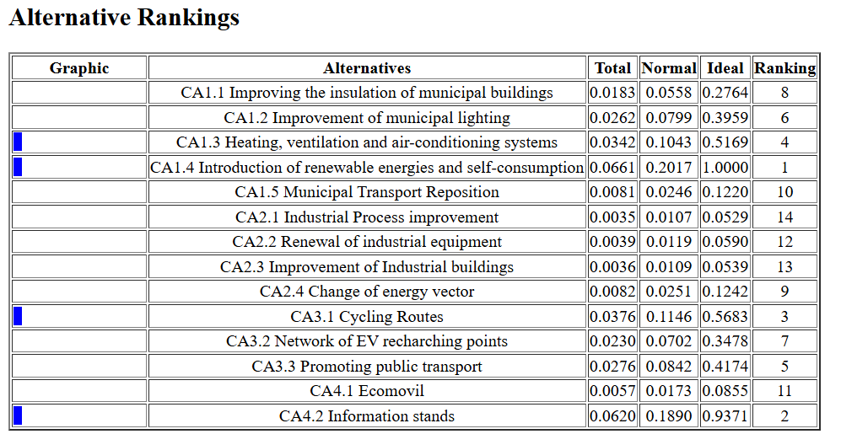
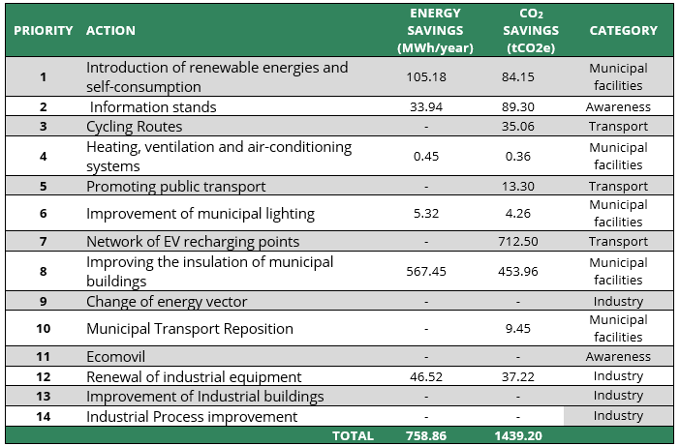
MOOC 2 - CASE STUDY 2
Case study in El Rosario (Tenerife, Spain).
5. Multi-criteria decision method and ranking of measures
Using the SuperDecisions tool

Slide 27
MOOC 2 - CASE STUDY 2
Propose your own case study
To practice and use the GENERA tools we propose you to create your own case study. You can start from any municipality about which you have information on its objectives and future plans, or start from a municipal action plan with the idea of improving it.
You can also make use of the cases described in MOOC2:
Sant Antoni de Portmany (Ibiza, Spain)
Stintino (Sardinia, Italy)
Halki (Greece)
There is also the option of taking a look at GENERA's deliverable D3.2: Pilot Descriptions and Results, where you will find more information and case studies.

Slide 28
MOOC 2 - CASE STUDY 2 Energy transition measurement and monitoring tools

